Slide 1
Weight loss medications…
Are they the answer?
Kristen Bilek, FNP-C

Slide 2
Overview of us obesity trends
Obesity has increased from 30.5% in 1999-2000 to 41.9% in 2017-2022.
Serious obesity has also increased from 4.7% to 9.2% during that same timeframe.
Indiana is ranked 12th in states that are impacted by obesity
36.3% of Adults in Indiana suffer from obesity

Slide 3
impact ON HEALTH AND HEALTHCARE COSTS
Obesity not only causes a financial burden to patients in regards to medications for co-morbidities but loss work days, lower household income.
In 2017 it is estimated that obesity cost in the united states was $1.4 trillion

Slide 4
Limitation of diet and exercise alone
Physical activity helps support and maintain weight loss
Nutrition is a key component to improving obesity
Genetics and co- morbidities affect weight loss and the use of anti-obesity medications can help combat obstacles that diet and exercise do not fully treat.

Slide 5
Obesity is a chronic disease
Obesity is a multifactorial disease. Some factors that play a role in obesity are:
Genetics
Race
Economic Status
Nutrition
Physical Activity
Use of certain prescription drugs
Co-morbidities

Slide 6
Overview of FDA approved Weight loss medications
Oral Medications
  Metformin
  Bupropion (*Wellbutrin)
  Topiramate (*Topamax)
  Phentermine
  Qsymia (*Topamax and Phentermine combination)
  Contrave (*Wellbutrin and Naltrexone combination)
Injectable
  GLP-1
    Semaglutide: Wegovy and Ozempic
  GLP-1/GIP
    Trezepitide: Zepbound and Mounjaro

Slide 7
Goals of antiobesity medications
Reduce weight and maintain weight loss
Improve health status
Minimize adverse effects
Weight loss medication is considered to be successful if patients are able to lose a minimum off 4-5% of baseline weight after three months on a therapeutic dose.
A 5-10% reduction in weight can significantly reduce cardiovascular affect of obesity

Slide 8
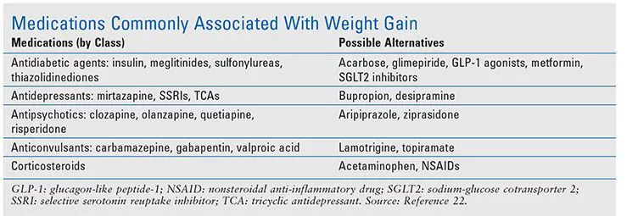
Weight gaining medications

Slide 9
Candidates for medication therapy
Obesity and a body mass index (BMI) ≥30 kg/m² or
A BMI of 27 to 29.9 kg/m² plus one or more weight-related comorbidities
Classifications of obesity
Overweight: BMI 25-29.9
Class 1 obesity: BMI 30-34.9
Class 2 obesity: BMI 35-39.9
Class 3 obesity: BMI >40

Slide 10
Oral medications
Metformin
Topiramate (Topamax)
Buproprion (Wellbutrin)
Contrave
Qsymia

Slide 11
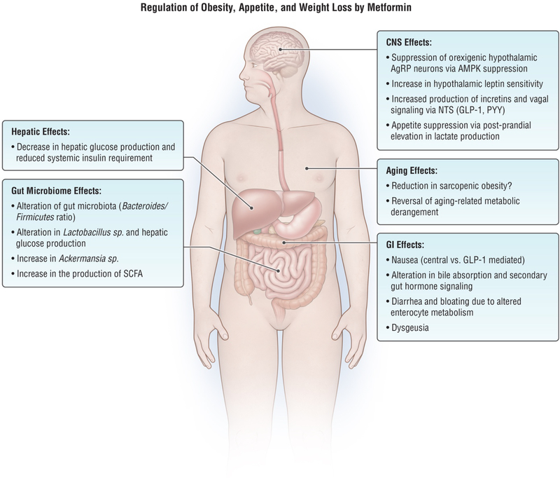
Metformin

Slide 12
Metformin
Off-label use for weight loss
First line treatment for obesity
May help improve:
Insulin resistance
Polycystic Ovarian Syndrome
Fatty liver
Cardiovascular disease

Slide 13
Metformin
Often times used in addition to:
  Anti-psychotic medications as may have a weigh gain property
  Human immunodeficiency virus (HIV) protease inhibitor-associated abnormalities
  Typical dosage
    500 to 2000 mg daily, usually split into 2 doses daily
  May help reduce the rate of some cancers
    Colon
    Ovarian
    Lung
    Breast
    Prostate

Slide 14
Metformin
The medication may increase the effects of gastrointestinal hormone receptors that affect weight loss such as:
  Glucagon-like peptide-1 (GLP-1)
  Peptide YY

Slide 15
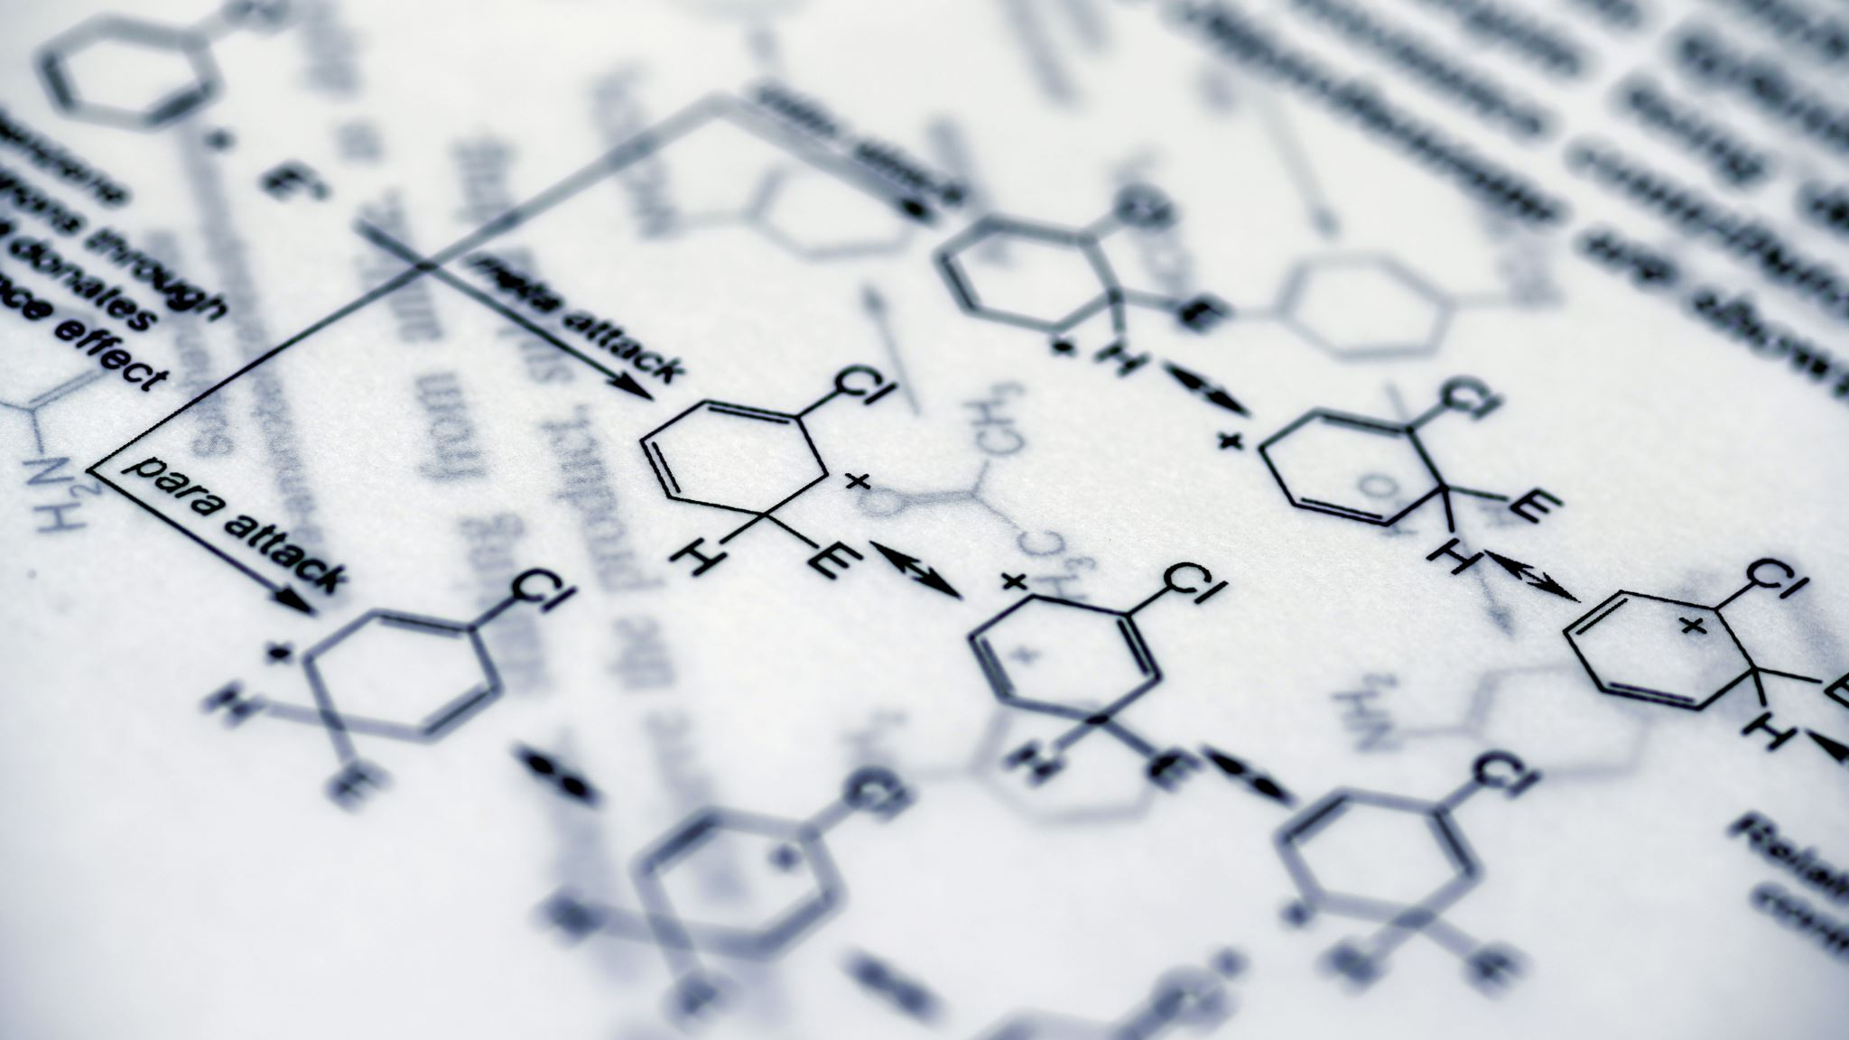
Metformin
Mechanism of Action
  Activates AMPK
  Decreases hepatic glucose production
  Increases muscle glucose uptake
  May increase glucagon-like peptide 1 (GLP-1)

Slide 16

Metformin
Side Effects
  Nausea
  Bloating
  Diarrhea
  Abdominal cramping
  Hypoglycemia
  Avoid in renal patient

Slide 17
Topamax
Classified as an anti-seizure medication but is often times used off-label for weight loss
Typical dosing
Epilepsy: 400 mg/day
Migraines: 200 mg daily
Obesity 25-100 mg daily

Slide 18
Topamax
Mechanism of Action
  Increases GABA
  Decreases carbonic anhydrase
  Helps with binge eating

Slide 19
phentermine
Sympathomimetic
Approved by the FDA in 1959
Used short term 3-6 months
Requires close monitoring
Long term use is not advised and is considered off lable

Slide 20
phentermine
BMI > 30
BMI >27 with 1 or more co-morbidities
Dosage 15 mg once daily to start and can go to 30 mg daily

Slide 21
Phentermine
Contraindications:
Hypertension
Pregnancy
Glaucoma
Anxiety
Use of MAOI medications
Use in caution with:
Cardiovascular disease
Alcohol use
Renal impairment

Slide 22
Phentermine
Adverse reactions:
Headaches
Dizziness
Fatigue
Hypoglycemia
Back pain
Cough
Nausea
Dry mouth
Insomnia
Constipation

Slide 23
Qsymia (Phentermine/Topamax)
Combination medication
Good for patients without cardiovascular disease
Not always covered by insurance

Slide 24
Qsymia (Phentermine/Topamax)
Indication
BMI > 30
BMI > 27 with at least one co-morbidity
Age 12 years and up

Slide 25
Qsymia (phentermine/Topamax)
Dosage
Start at 3.75/23 mg once daily for the first 2 weeks
Titrate to 7.5/46 mg for 12 weeks daily
Max dose after 12 weeks 11.25/69 mg daily

Slide 26
Qsymia (Phentermine/Topamax)
Contraindications
Pregnancy
Glaucoma
MAOI use withing the last 14 days

Slide 27
Qsymia (Phentermine/Topamax)
Precautions
Fetal Toxicity
Increased heart rate and blood pressure
Increased insomnia
Hepatic impairment

Slide 28
Contrave (Naltrexone/Bupropion)
Combination medication
Bupropion is a dopamine reuptake inhibitor
Naltrexone is an opioid receptor antagonist

Slide 29
Contrave (Naltrexone/Bupropion)
Contraindications
Pregnancy
Uncontrolled hypertension
Opioid use
Anorexia nervosa

Slide 30
Contrave (Naltrexone/Bupropion)
Precautions
Suicidal behavior
Hepatotoxicity
Risk of seizure
Increased blood pressure and heart rate

Slide 31
Contrave (Naltrexone/Bupropion)
Adverse reactions
Headache
Dizziness
Insomnia
Dry mouth
Constipation/diarrhea
Suicidal ideation
Elevated heart rate and blood pressure

Slide 32
OrlistaT (Alli or Xenical)
Mechanism of action
Gastric lipase inhibitor
Pancreatic lipase inhibitor
Alters fat digestion. More fat is excreted through feces and less is absorbed.

Slide 33
What is a GLP-1
GLP-1(GLucagon Like Peptide-1) is a natural hormone in our body that is released from the small intestine when we eat
GLP-1 medications mimic this natural hormone and act on GLP-1 receptors throughout the body

Slide 34
What is a GLP-1
Useful in Diabetes due to lowering pre-prandial, post-prandial blood glucose
Promoting insulin secretion
Decreasing glucagon secretion
Promotes weight loss by :
Slowing down gastric emptying
Increasing satiety
Reducing food intake

Slide 35
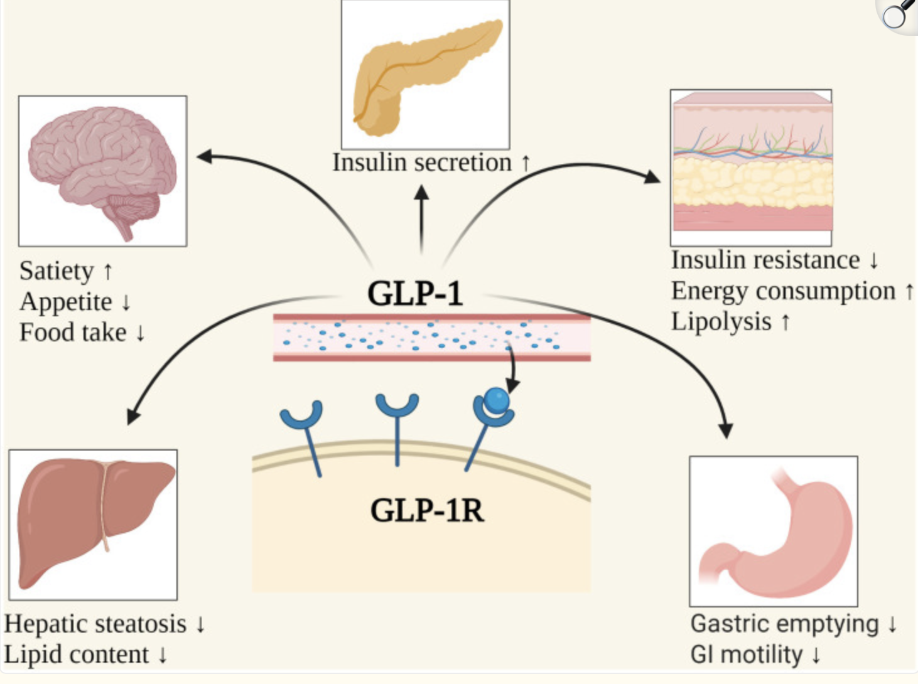
GLP-1
Wang JY, Wang QW, Yang XY, et al. GLP-1 receptor agonists for the treatment of obesity: Role as a promising approach. Front Endocrinol (Lausanne). 2023;14:1085799. Published 2023 Feb 1. doi:10.3389/fendo.2023.1085799
Copyright © 2023 Wang, Wang, Yang, Yang, Li, Jin, Zhang and Zhang
Front Endocrinol (Lausanne). 2023 Feb 1;14:1085799. doi: 10.3389/fendo.2023.1085799
The possible mechanisms of weight loss caused by GLP-1. GI, Gastrointestinal; GLP-1, Glucagon-like peptide-1; GLP-1R, Glucagon-like peptide-1 receptor. Created with BioRender.com.

Slide 36
Benefits of GLP-1RA Shown Beyond Weight Loss
Improvements in blood pressure
Advise pts to monitor BP, due to potential weight loss meds may need to eventually be adjusted
Improvement in cholesterol
Improvement in Fatty Liver disease

Slide 37
Benefits of GLP-1RA Shown Beyond Weight Loss
Delay disease progression in CKD
Reduction in MACE
Wegovy is the only medicine approved by FDA to reduce MACE in adults with established CV disease who are obese/overweight
OSA- recent FDA approval for Zepbound

Slide 38
Prescribing GLP-1RA
Pancreatitis- prescribe with caution
Contraindicated in patients with MEN2 or family/personal history of MTC
Should be avoided in patients with hx of GI disturbances such as gastroparesis
Should not be used in patients with T1DM
Try to avoid giving samples of Ozempic/Mounjaro to patients without T2DM as these medications are likely to be denied by Insurance

Slide 39
Most common Side Effects of GLP-1RA
Nausea
Can give patients helpful tips to helps mitigate nausea risk
Diarrhea
Constipation
Vomiting
Fatigue
Headache
Stomach Upset
Gastritis
Decreased Appetite
GERD

Slide 40
Rare but Important Counseling Points for Patients
Hypoglycemia-more common in T2DM while on other therapies
Shakiness, anxiety, excessive sweating, confusion
Risk of Thyroid Tumor
Trouble breathing, swallowing, change in voice
Pancreatitis
N/V, abdominal pain
Renal Failure (dehydration)
Edema, SOB, Itchy Skin, Decrease Urine Output

Slide 41
Rare but Important Counseling Points for Patients
Changes in Vision
Gall Bladder Disease
N/V, Jaundice, Fever Chills
New or Worsening Depression
Increased Heart Rate
Use of barrier method of contraception if taking oral contraceptive
Risk of pulmonary aspiration- medication will need to held 1-2 weeks prior to surgery requiring sedation/general anesthesia

Slide 42
Counseling Continued
Diet and exercise in conjunction with the medication
Promote Strength and Resistance training
Medication not just targets fat tissue, chance for lean muscle mass loss as well, counsel on increasing protein intake
Staying hydrated
Increase Fiber, If needed add stool softener, OTC product if needed
Advise patient to not overeat, as this can worsen stomach upset
Smaller more frequent/meals snacks throughout the day

Slide 43
Wegovy and Zepbound
Both Approved for weight management
Dosed once weekly
Given in thigh, abdomen, back of the arm
Store in fridge
One-time use pens

Slide 44
Wegovy (Semaglutide)
GLP-1 Receptor Agonist
FDA Uses:
Use in patients who are obese or overweight with CV disease to reduce risk of overall major CV events (CV death, non-fatal MI, non-fatal stroke)
To reduce and maintain weight loss in patients over the age of 12 with at least one weight related comorbidities
Weight related comorbidities to look for in patients
Pre-Diabetes
T2DM
HTN
HLD
Fatty Liver Disease
OSA

Slide 45
Wegovy Dosing Schedule
Dose escalation to reduce risk of GI side effects
0.25mg for 4 weeks - Starting
0.5 mg for 4 weeks
1mg for 4 weeks
1.7mg for maintenance dose or for 4 weeks
2.4 maintenance dose

Slide 46
Wegovy Data
68 week study showed patients on average lost 35lbs (approx. 15 %) weight loss in conjunction with diet and exercise
SELECT CVOT- allowed Wegovy to become the first and only FDA approved weight loss medication to lower risk of MACE in patients with known heart disease who are either obese or overweight
Primary Endpoint
20% relative RRR of MACE
Secondary Endpoints
Showed reduction in Total chol, LDL, HDL, and Triglycerides vs placebo
Reductions in both systolic and diastolic BP
Reduction in waist circumference

Slide 47
Zepbound
Dual GLP-1/GIP Recepor Agonist
Mimics GIP as well (Gastric Inhibitory Peptide) an additional incretin hormone that is produced and released in the body when eat
Provides similar effects as GLP-1
Approved in patients in conjuction with reduced calorie intake:
Reduce and maintain weight loss in patient with obesity or overweight with one weight related comorbidity
Treat OSA in adult patients with obesity

Slide 48
Zepbound Data
Surmount-5 Trial showed that patients with Obesity without Diabetes, patients taking Zepbound (tirzepatide) showed average weight loss of 20.2% versus 13.7% patients taking Wegovy(semaglutide)
Surmount -1 Trial
Included patients with BMI≥30kg/m or BMI≥27kg/m2 with one weight related comorbidity, pts with type 2 diabetes not included
Studied 5mg, 10mg, 15mg vs placebo at 72 weeks, including 20 week dose escalation
Zepbound 5mg: (-15.0% change) (-33.9lbs)
Zepbound 10mg: (-19.5% change (-44.4lbs)
Zepbound 15mg : (-20.9% change) (-48.1lbs)
Placebo : (-3.1%) (-6.6lbs)

Slide 49
Dosing of Zepbound
2.5mg starting dose for 4 weeks
5mg for 4 weeks or maintenance (weight reduction only)
7.5mg for 4 weeks
10mg for 4 weeks or maintenance (all indications)
12.5mg for 4 weeks
15mg for maintenance (all indications) (MAX DOSE)

Slide 50
Lilly Direct
Can be used for patients who are not covered by insurance to receive Zepbound
Lilly Direct ships Vials directly to patient from manufacturer
Current doses available 2.5mg, 5mg, 7.5, 10mg
Send script into LillyDirect Self Pay Pharmacy Solutions
Company will reach out to patient and handle the logistics
Patients pay out of pocket, prices per vial ranges from $349-$499 per month
https://lillydirect.lilly.com/pharmacy/zepbound

Slide 51
References
Ard JD, Fitch A, Fruh S, Herman L. Weight loss and maintenance related to the mechanism of action of glucagon‐like peptide 1 receptor agonists. Adv Ther. 2021;38:2821–2839.
Berberich AJ, Hegele RA. Lipid effects of glucagon-like peptide 1 receptor analogs. Curr Opin Lipidol. 2021 Jun 1;32(3):191-199. doi: 10.1097/MOL.0000000000000750. PMID: 33900276.
CDC. (2024, September 20). Adult Obesity Prevalence Maps. Obesity. https://www.cdc.gov/obesity/data-and-statistics/adult-obesity-prevalence-maps.html
Center. (2024). FDA’s Concerns with Unapproved GLP-1 Drugs Used for Weight Loss. U.S. Food and Drug Administration. https://www.fda.gov/drugs/postmarket-drug-safety-information-patients-and-providers/fdas-concerns-unapproved-glp-1-drugs-used-weight-los
Dosage Forms: The Zepbound Pen & Vial | Zepbound® (Tirzepatide), zepbound.lilly.com/hcp/dosage. Accessed 19 Mar. 2025.
Indiana ranks 12th in states impacted by obesity. (n.d.). https://www.obesityaction.org/wp-content/uploads/Indiana2023.pdf

Slide 52
References continued
Jastreboff AM, Aronne LJ, Ahmad NN, et al. Tirzepatide Once Weekly for the Treatment of Obesity. N Engl J Med. 2022;387(3):205-216. doi:10.1056/NEJMoa2206038
John Anderson, James R. Gavin, Davida F. Kruger, Eden Miller; Optimizing the Use of Glucagon-Like Peptide 1 Receptor Agonists in Type 2 Diabetes: Executive Summary. Clin Diabetes 1 July 2022; 40 (3): 265–269. https://doi.org/10.2337/cd22-0020
Lincoff AM, Brown-Frandsen K, Colhoun HM, et al. Semaglutide and Cardiovascular Outcomes in Obesity without Diabetes. N Engl J Med. 2023;389(24):2221-2232. doi:10.1056/NEJMoa2307563
Locatelli JC, Costa JG, Haynes A, et al. Incretin-Based Weight Loss Pharmacotherapy: Can Resistance Exercise Optimize Changes in Body Composition? Diabetes care. 2024;47(10):1718-1730. doi:10.2337/dci23-0100
Mantovani A, Petracca G, Beatrice G, Csermely A, Lonardo A, Targher G. Glucagon-Like Peptide-1 Receptor Agonists for Treatment of Nonalcoholic Fatty Liver Disease and Nonalcoholic Steatohepatitis: An Updated Meta-Analysis of Randomized Controlled Trials. Metabolites. 2021 Jan 27;11(2):73. doi: 10.3390/metabo11020073. PMID: 33513761; PMCID: PMC7911747.
Nachawi N, Rao PP, Makin V. The role of GLP-1 receptor agonists in managing type 2 diabetes. Cleve Clin J Med 2022; 89(8):457–464. doi:10.3949/ccjm.89a.21110.

Slide 53
References
O’Riordan, M. (2024, December 4). Tirzepatide bests semaglutide for weight loss: Surmount-5 topline results. TCTMD.com. https://www.tctmd.com/news/tirzepatide-bests-semaglutide-weight-loss-surmount-5-topline-results
Professional, Cleveland Clinic medical. “GLP-1 Agonists.” Cleveland Clinic, 19 Mar. 2025, my.clevelandclinic.org/health/treatments/13901-glp-1-agonists.
Seino Y, Fukushima M, Yabe D. GIP and GLP-1, the two incretin hormones: Similarities and differences. J Diabetes Investig. 2010;1(1-2):8-23. doi:10.1111/j.2040-1124.2010.00022.x
Wang JY, Wang QW, Yang XY, et al. GLP-1 receptor agonists for the treatment of obesity: Role as a promising approach. Front Endocrinol (Lausanne). 2023;14:1085799. Published 2023 Feb 1. doi:10.3389/fendo.2023.1085799
Wegovy [Package Insert]. Bagsvaerd, Denmark. Novo Nordisk A/S.;2022
“Wegovy® Dosing Schedule: Wegovy® (SEMAGLUTIDE) Injection 2.4 Mg.” Wegovy® Dosing Schedule | Wegovy® (Semaglutide) Injection 2.4 Mg, www.wegovy.com/taking-wegovy/dosing-schedule.html. Accessed 19 Mar. 2025
Zaffina I, Pelle MC, Armentaro G, et al. Effect of dual glucose-dependent insulinotropic peptide/glucagon-like peptide-1 receptor agonist on weight loss in subjects with obesity. Front Endocrinol (Lausanne). 2023;14:1095753. Published 2023 Feb 22. doi:10.3389/fendo.2023.1095753
Zebound [Package Insert]. Indianapolis, IN. Eli Lilly and Company,Inc.;2023,2024

