Slide 1


Diabetic Pneumopathy
Identifying and Managing Pulmonary Complications in Diabetic Patients

Slide 2



Meghan Papineau
Pulmonary Nurse Practitioner
Franciscan Physician Network
Meghan.Papineau@franciscanalliance.org
No disclosures

Slide 3
Objectives
1. Define diabetic pneumopathy and identify those at risk.
2. Identify hypoglycemic agents that reduce diabetic pneumopathy
3. Name alternative methods to manage pulmonary disorders in diabetic patients

Slide 4
Diabetic Pneumopathy
Refers to the broad range of pulmonary complications in diabetic patients
Mechanisms are not well understood
Multiple theories and ongoing areas of research

Slide 5
By the Numbers
Total: 38.4 million people of all ages had diabetes (11.6% of the population) in 2021. 38.1 million were adults ages 18 years or older. (NIDDKD, 2024)
25 million people in the US have asthma; 8% of the adult population
(Asthma and Allergy Network, 2023)
11.7 million adults in the US have COPD
8% of adults living in a rural area, 5% of adults in an urban area
(American Lung Association, 2024)

Slide 6
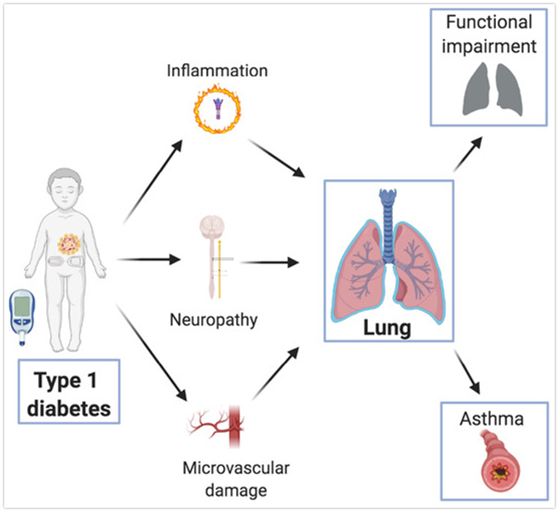
Notes:
Most theories focus on 3 major pathways:
Inflammation
Neuropathy
Vascular damage
This graphic is specifically for type 1 diabetes, but the premise is the same for both Type 1 and Type 2

Slide 7
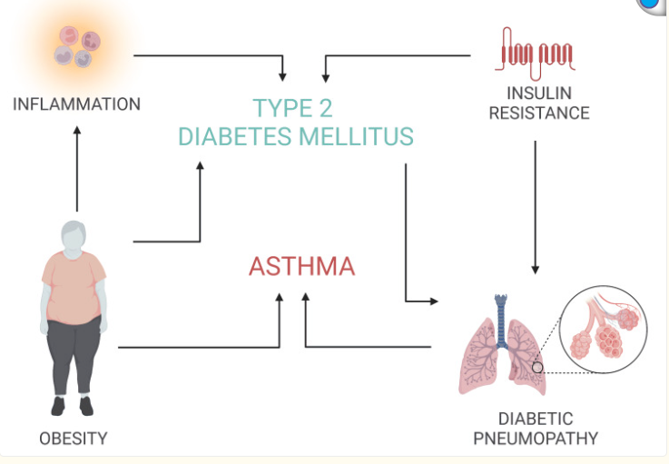

Slide 8
Asthma

Slide 9
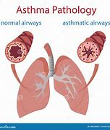
What is Asthma?
Chronic disease characterized by chronic airway inflammation. It is defined by a history of respiratory symptoms (wheeze, shortness of breath, chest tightness and cough) that varies over time and intensity, together with variable expiratory airflow limitation.
Airflow limitation can become persistent
Often associated with airway hyperresponsiveness and inflammation but they are NOT necessary for diagnosis.
Notes:
Characterized by exacerbations which are any increase in the daily symptoms.

Slide 10
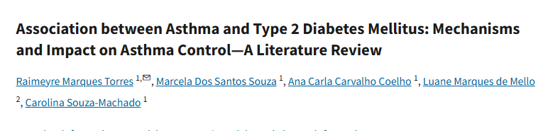
Asthma and Diabetes
Studies suggest that the presence of comorbidities such as T2DM is more common in individuals with asthma than in controls without asthma and may be associated with a worse outcome in asthma, contributing to greater use of health resources and worse quality of life
Causes: chronic inflammation, oxidative stress and use of asthma control medications
Longitudinal observational studies have found a risk of between 21% and 37% of adults with self-reported asthma have a documented diagnosis of T2DM
Notes:
2021 Literature Review in the Canadian Respiratory Journal
TNF alpha (tumor necrosis factor alpha)
IL6
Obesity causes changes in the circulating levels of adiponectin, leptin, and resistin – causing oxidative stress to the lung tissue

Slide 11

When hospitalized for asthma, diabetic patients had increased hospital length of stay, cost and risk for 30-day all cause and asthma – related readmittions.
Increased risk for developing non-respiratory complications during their stay
Similar risk of mortality
Notes:
A 2021 retrospective analysis in the Journal of Allergy and Clinical Immunology in Practice.

Slide 12
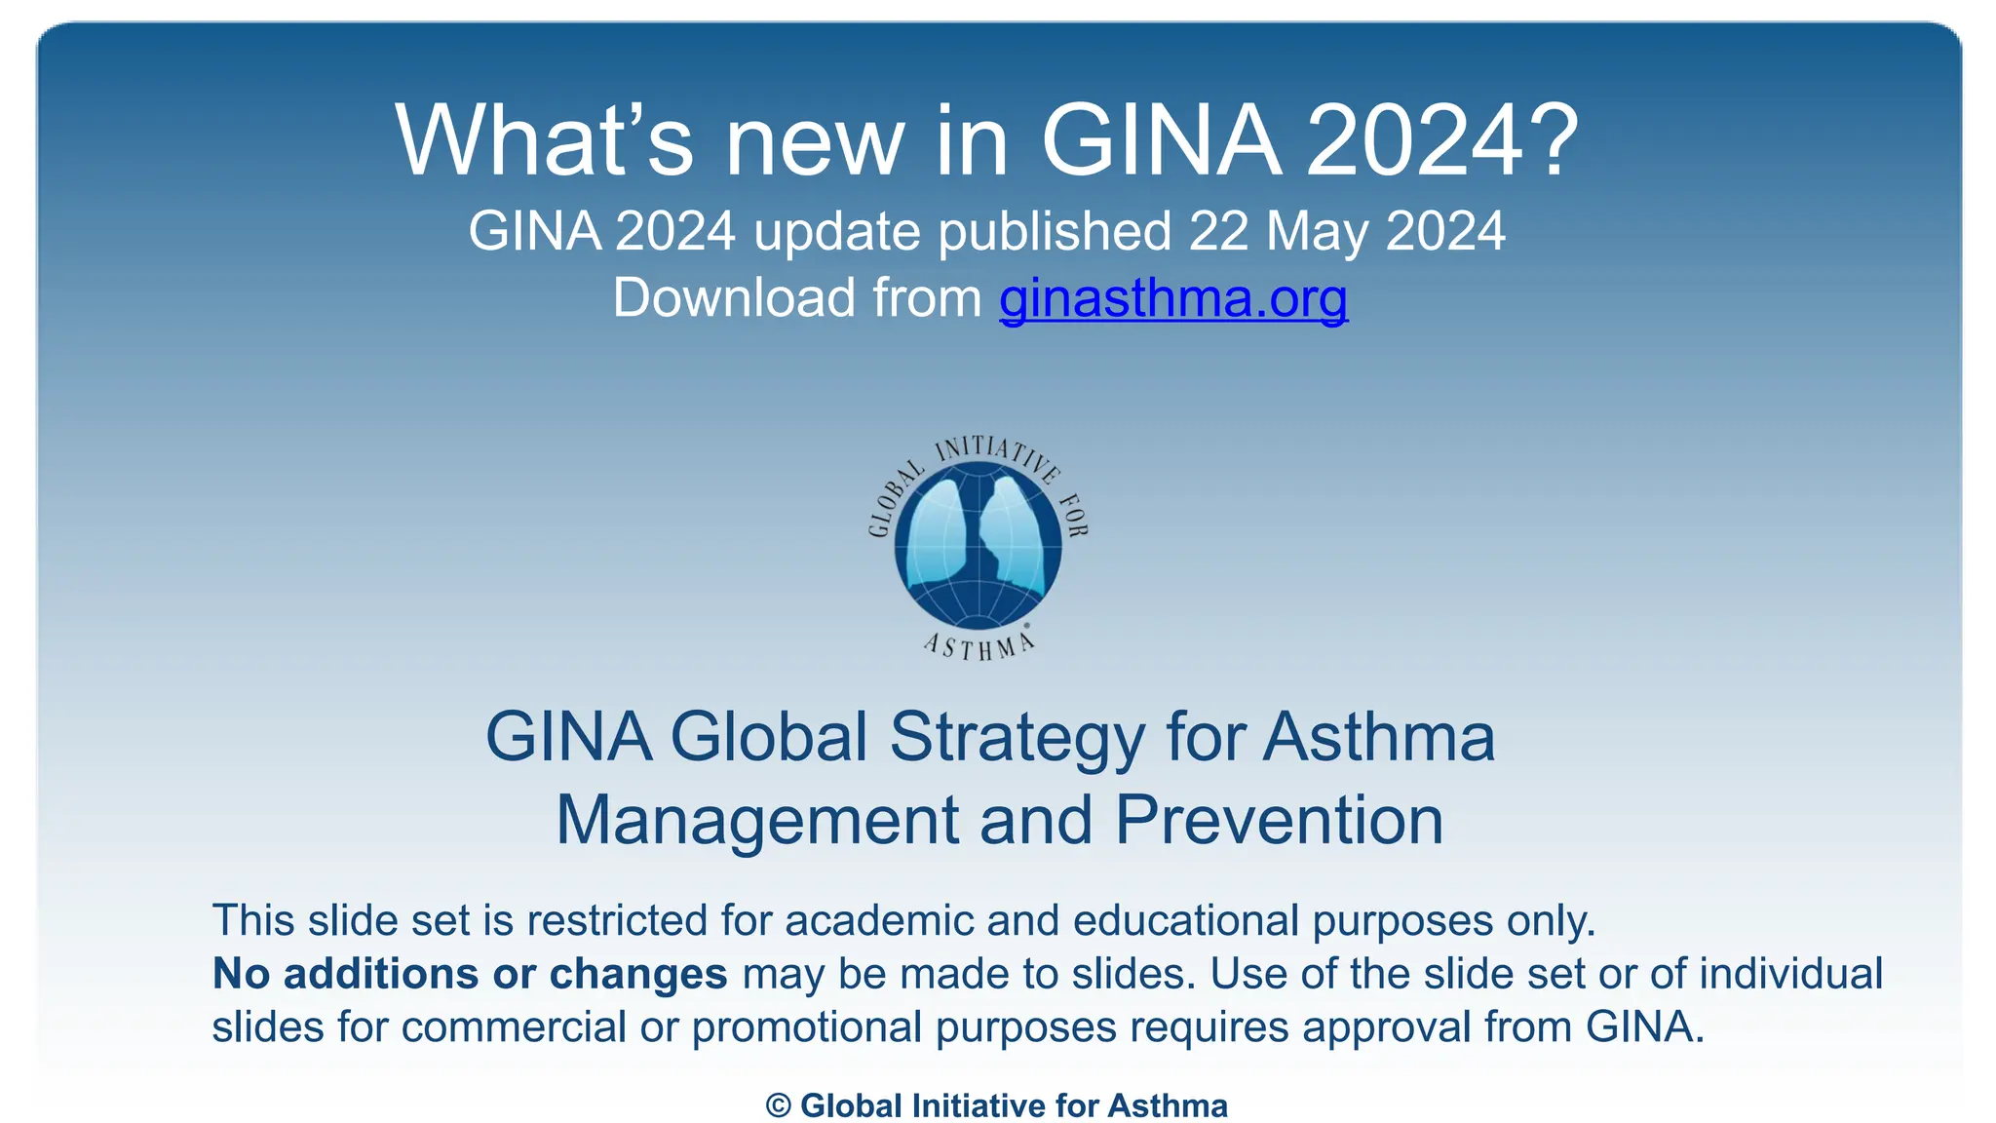
How do we Treat?
The Global Initiative for Asthma publishes regularly updated guidelines for treatment of daily symptoms and management of exacerbations

Slide 13
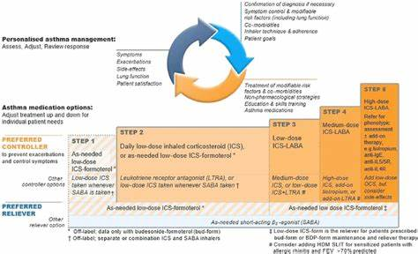
Notes:
May or may not be familiar but a few key points:
Treatment with SABA (albuterol, etc) only is NO LONGER recommended (since 2019) due to risk for increased exacerbations
As needed inhalers of choice are actually ICS/SABA or an as needed ICS to be used with the SABA
It is important to note that this is OFF label use of this medication although this should be changing
ASSESS/Re-EVAL
Escalate and de-escalate based on symptoms
Once you hit Level 4 , but definitely level 5, should consider referral

Slide 14
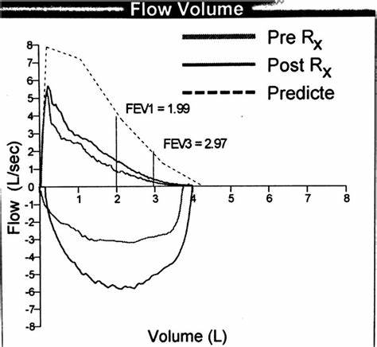
Patients with diabetes and asthma had a 3 – 10% difference on PFT compared to those with asthma alone

Slide 15
Steroids
Notes:
For our Diabetic patients, what is in EVERY level of treatment??

Slide 16
Why are steroids bad?
Exposure to systemic glucocorticoids has several side effects, including a diabetogenic action that occurs through different mechanisms:
(1) increases hepatic gluconeogenesis;
(2) decreases the peripheral glucose uptake in the skeletal muscle, liver, bone, and adipose tissue;
(3) decreases the insulin sensitivity and antagonizes its effect;
(4) inhibits the insulin secretion by β cells;
(5) favors the systemic release of fatty acids and triglycerides with the consequent lipotoxicity that negatively affects the function of β cells
Increased Risk with older age, higher A1C, lower GFR, obesity, or with first degree relatives who have diabetes

Slide 17
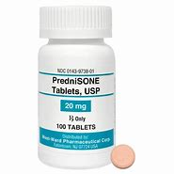
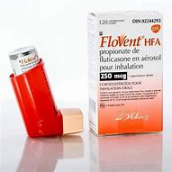
Seven studies explain the association between asthma and DM2 as a result of the use of medications to control asthma, mainly the use of corticosteroids, both systemic and inhaled
Some authors point out that the use of systemic corticosteroids is associated with several adverse metabolic effects, including insulin resistance and glucose intolerance, as well as hyperglycemia and DM
Other authors report that the use of inhaled corticosteroids (IC), especially at higher doses, is related to small disturbances in glucose control
However, glycemic changes due to the use of IC are still controversial
Notes:
For every study that shows IC increase blood sugar, there are others that say they don’t
Individual basis

Slide 18
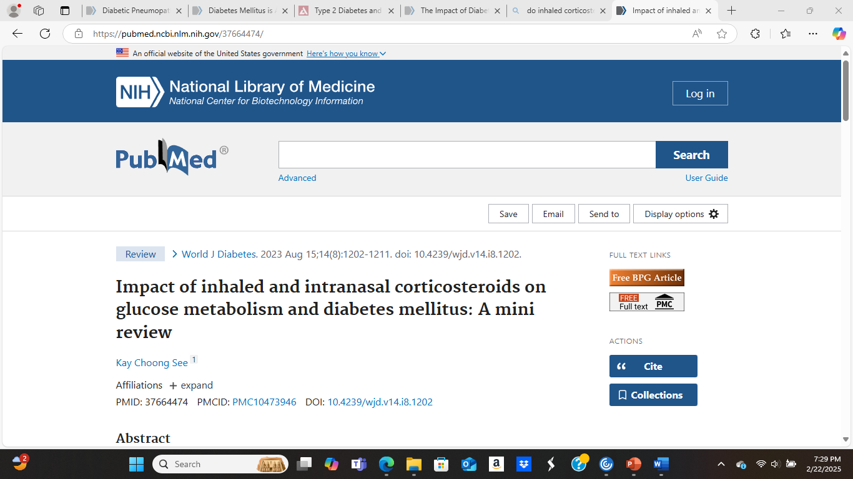
Multiple large observational studies suggest that high dose ICS is associated with increased incident DM and worsened DM control, though the contribution of other risk factors is less certain.
Notes:
One of the most recent studies: World Journal of Diabetes in 2023
High dose steroids should be avoided if possible, BUT if necessary should be closely monitored

Slide 19
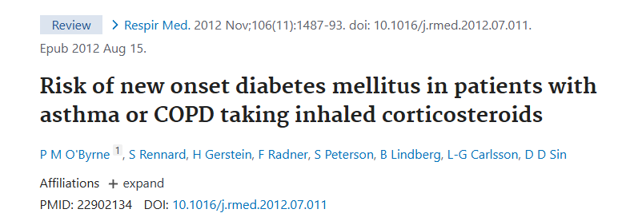
A 2012 retrospective analysis of all trials comparing ICS versus placebo in asthma patients found NO STATISTICAL association between treatment with inhaled corticosteroids and increased risk of new onset diabetes or hyperglycemic events.

Slide 20
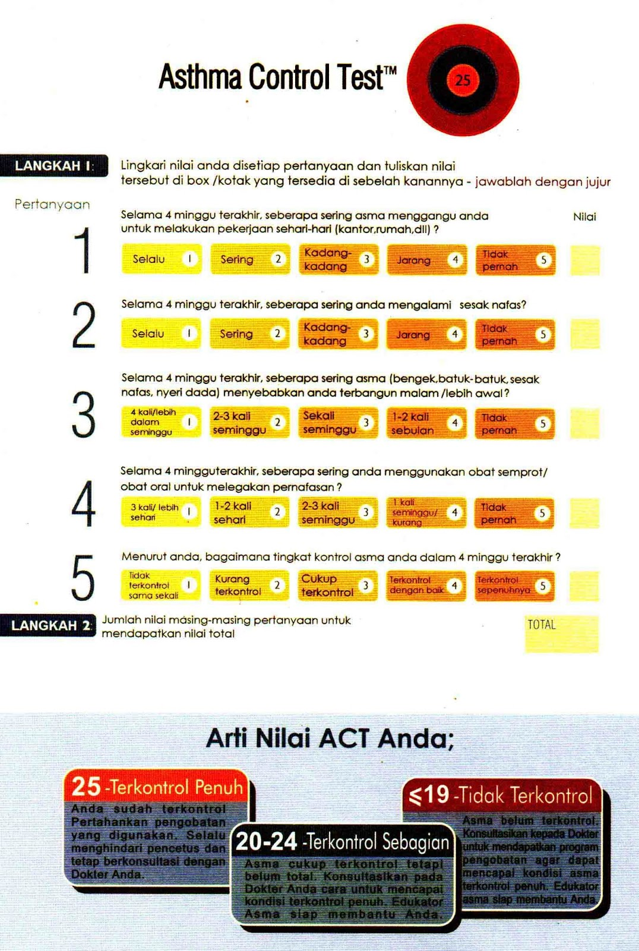
So What are the Options?
Previous recommendations:
SABA Only as needed for mild cases
Monitoring:
  ACT
Notes:
SABA only is still listed as a Track 2 option in GINA: To be used in patients with stable asthma and good compliance
ACT:
Rules of 2 – more than 2 days per week short of breath, more than 2 nights per week wheezing, more than 2 exacerbations within a 6 month period

Slide 21
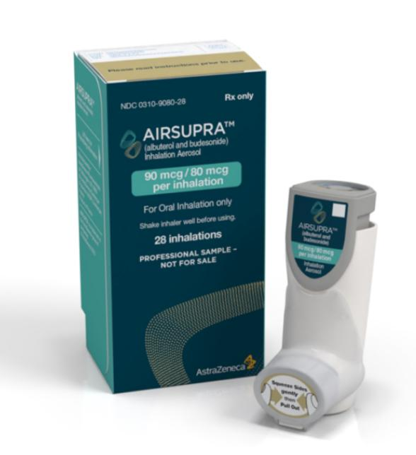
Airsupra (albuterol and budesonide)
As needed ICS/SABA
FDA Approved January 2023
Only 18 and older
Works best in those who respond well to steroids during an exacerbation
Notes:
When it first came out, it was only able to be ordered by Pulmonary, changing now to include internal medicine and PCP
- Consult if needed!!

Slide 22
AIRSUPRA | AIRSUPRA ASTHMA RESCUE COMMERCIAL 2024 | GOODBYE TO YOU - SCANDAL - PATTY SMYTH | COMMENT

Slide 23
Daily Maintenance Inhalers
Notes:
For Levels 2 – 5:
Daily ICS/SABA – Start low and Keep it Low

Slide 24
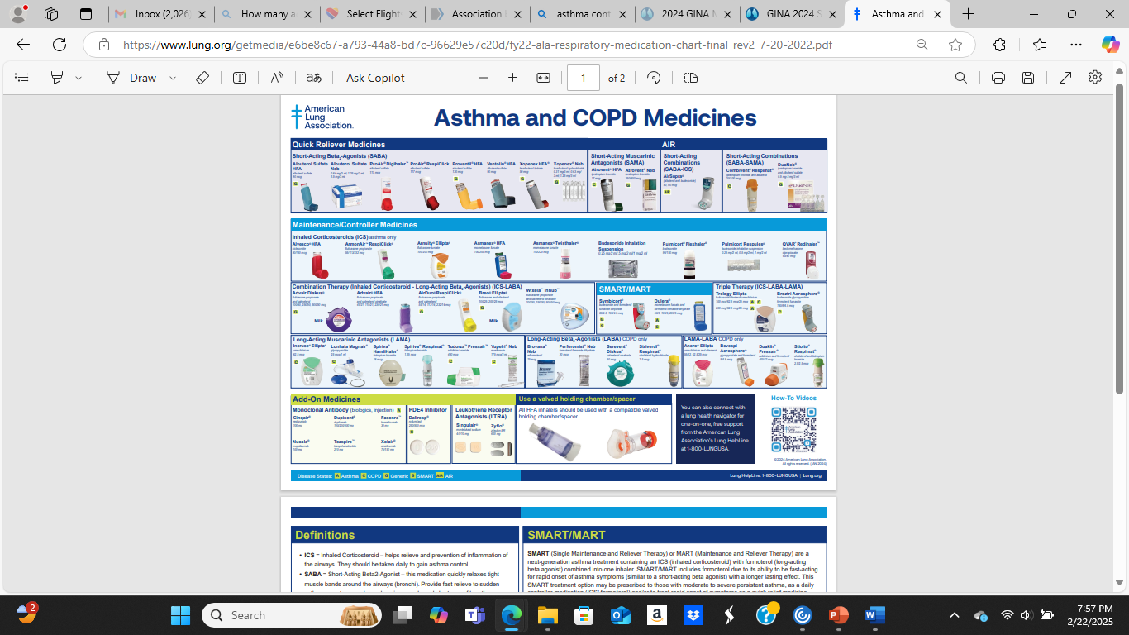

Slide 25
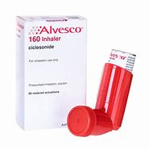

Low & Medium Dose Inhaled Corticosteroids
Alvesco (Ciclesonide)
80 and 160mg 1 puff BID
Arnuity Ellipta (Fluticasone Furoate)
100 and 200mcg 1 puff daily

Slide 26
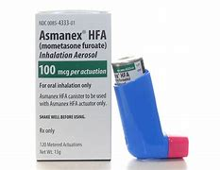
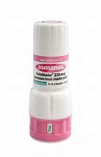
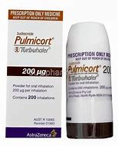
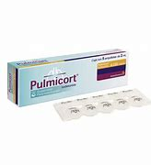
Low & Medium Dose Inhaled Corticosteroids
Asmanex HFA or Twisthaler (Mometasone furoate)
100 and 200 mcg 2 puffs BDI
Pulimocort Flexihaler or Nebulizer
(Budesonide)
90 or 180 mcg 1 puff BID
Or 0.25/0.5mg per 2ml nebulizer BID

Slide 27
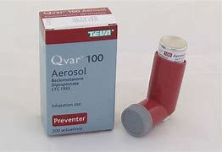
Low & Medium Dose Inhaled Corticosteroids
QVAR (Beclomethasone)
40 and 80 mcg 1 puff BID

Slide 28
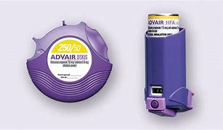
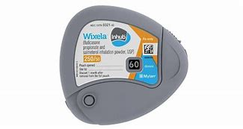
ICS/LABA Combo
Advair Diskus/HFA
Fluticasone propionate and Salmeterol
100/50, 250/50 and 500/50
1 puff BID
Wixela
Fluticasone propionate and salmeterol xinafoate
100/50, 250/50 and 500/50
1 puff BID
Notes:
Start earlier in diabetics – once hitting moderate dose ICS
Good options in those that have a positive response to albuterol
Check the PFT, if strong bronchodilator response, can start ICS/LABA as first step instead of just ICS
First # is steroid dose – start low

Slide 29
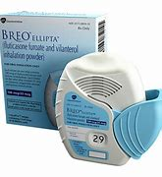
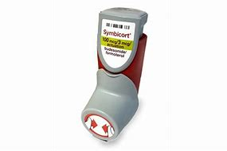
ICS/LABA Combo
Breo
Fluticasone and vilanterol
100/50, 200/50
1 puff daily
Symbicort
Budesonide and Formoterol fumarate
80/4.5, 160/4.5
2 puffs BID

Slide 30
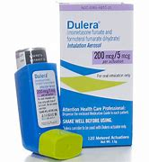
ICS/LABA Combo
Dulera
Mometasone Furate and Formoterol Furate
50/5. 100/5. 200/5
1 puff BID

Slide 31
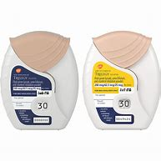
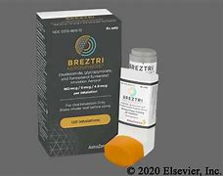
ICS/LABA/LAMA Combo
Trelegy
Fluticasone/Vilanterol/Umeclidinium
100/62.5/25 or 200/62.5/25
1 puff daily
Breztri
Budesonide/Glycopyrolate/Formoterol Fumarate
160/9/4.8 mcg
2 puffs BID
Notes:
As of 2020, Trelegy is FDA approved for treatment of asthma
Especially with asthma/COPD overlap
Breztri is NOT FDA approved for asthma, but it is going in front of the FDA now, and studies look promising.

Slide 32
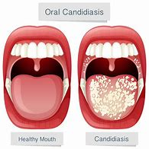
Risk of ICS
In ANY inhaler containing ICS
THRUSH
Teaching proper inhaler technique is Necessary
Rinse mouth after EVERY puff
Consider a spacer
Notes:
Consider problems of needing to rinse with every puff when using Airsupra or ICS/LABA as needed
Treatment: Nystatin or Diflucan

Slide 33
Non-Inhaler Treatments

Slide 34
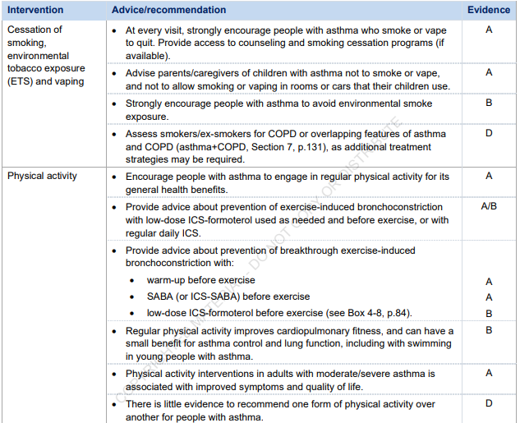
Non-Pharmacological Treatments

Slide 35
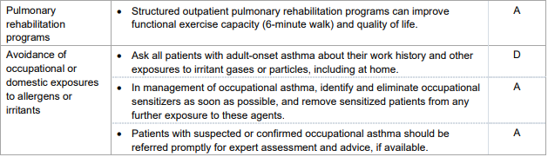
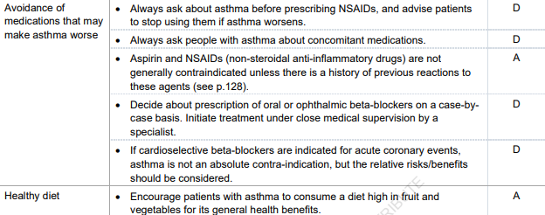

Slide 36
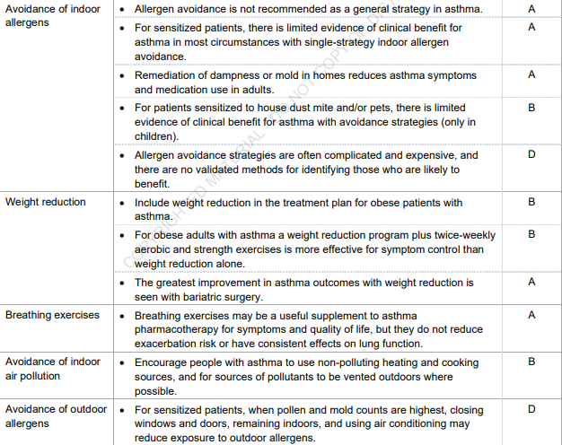
Notes:
Indoor allergens: clean furnace filters, air purifier, keep carpets clean
PETS

Slide 37
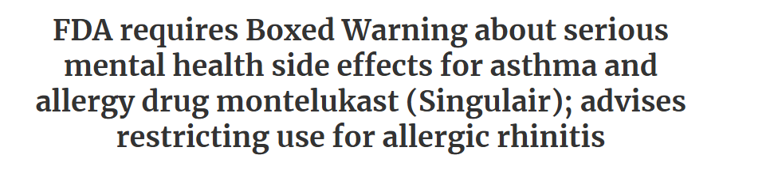
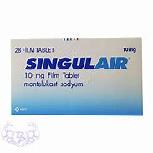
Non-Inhaler Therapy
Leukotriene Receptor Antagonists:
Blocks the effects of leukotrienes, which are inflammatory chemicals involved in asthma and allergic rhinitis
Singulair (montelukast)
Accolate (zafirlukast)
Zyflo CR (zileuton) – non controlled release was withdrawn from market
Notes:
Singulair – Cough, URI.
Black box warning – suicidal ideation in teenagers.
Weird dreams, sleep walking.
Zyflo, not frequently used. IR was withdrawn from market in 2008. Side effects – nausea and hallucinations. Frequent drug interactions

Slide 38

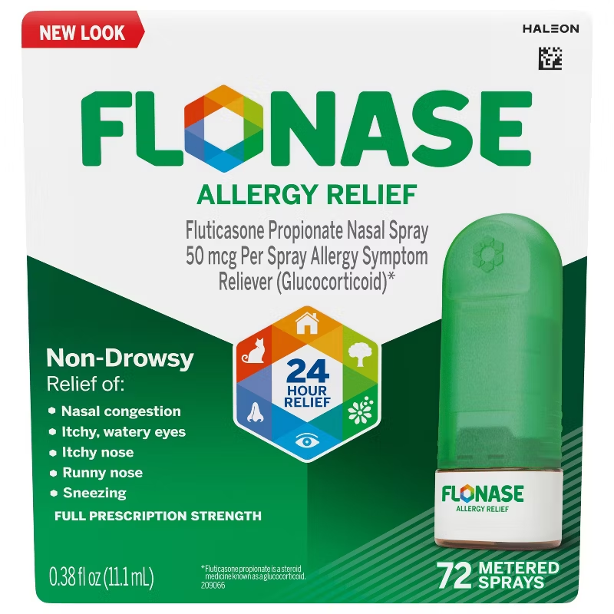
Non-Inhaler Therapy
Antihistamine Treatments
Zyrtec, Claritin, Allegra, Xyzal, etc
Nasal Regimen
Flonase, Astelin, nasal lavage, etc.
Allergy Shots
Consult with allergist
Notes:
Do no discount, OTC treatments – antihistamine
Nasal regimen –
-ICS steroids – do we run into the same problem as ICS?
- Need a minimum of 4 weeks consistent use

Slide 39
Injectable Treatments
For moderate to severe asthma, those with persistent symptoms despite adequate use of inhalers
  More than 2 rounds of steroids in 1 year, more than 2 ER visits for asthma in 1 year
Based on biologic markers (eosinophils, IgE)
Risks:
  Severe allergic reaction – patients should have an EpiPen and be taught how to use it
  Increased risk for parasitic infection
5 subcutaneous approved injectables for asthma (2 more in clinical trials, phase 3)
1 IV treatment
Notes:
Not emergency medications

Slide 40
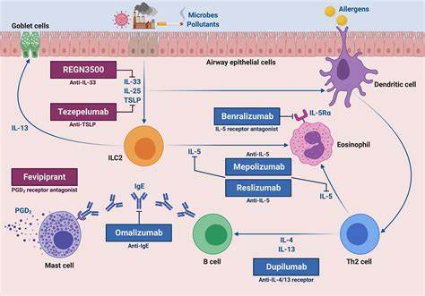

Slide 41
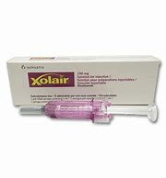
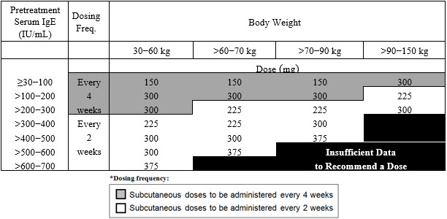
IGE-Mediated Injections
Xolair (Omalizumab)
  Asthma treatment by reducing the release of inflammatory substances that cause asthma symptoms
  Also, hives, nasal polyps
  Age 6 and older
  Risk of allergic reaction – should have Epi Pen
  Fever, body aches, headache, injection site reaction – resolve quickly
  2 – 3months for full results

Slide 42
Eosinophilic Treatment
Dupixent (dupilumab)
Also for eczema, nasal polyps
IL -4/IL - 13
Risk for reaction: rash, hives, severe headaches, eye problems, swelling, shortness of breath
Minor reactions: dry eyes, throat pain, stomach cramps, muscle aches
Typically every 2 week dosing
Nucala (mepolizumab)
Also for eosinophilic granulomatosis with polyangiitis (EGPA), hypereosinophilic syndrome (HES), nasal polyps
IL 5
Allergic reaction possible (Epi-Pen)
Shingles has happened
Minor side effects: Back pain, joint pain

Slide 43
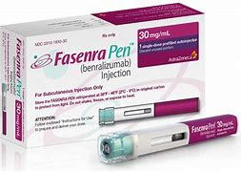
Eosinophilic Treatment
Fasenra (benralizumab)
Also for eosinophilic granulomatosis with polyangiitis (EGPA)
IL - 5
Severe allergic reactions reported (patient needs EpiPen)
Minor reactions: headache, sore throat

Slide 44
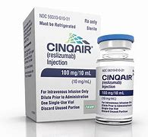
Eosinophilic Treatment
Cinqair (reslizumab)
Reduces production and survival of eosinophils
Also treats IL-5
At least 4 weeks to feel any benefit
Only given intravenously, has to be at an infusion center

Slide 45
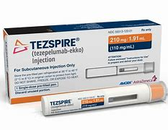
Tezspire
Tezepelumab
Works on TLSP pathway
No biologic to test for – needs to have at least 2 exacerbations per year despite adequate treatment
Minor reactions: throat pain, joint pain, back pain

Slide 46
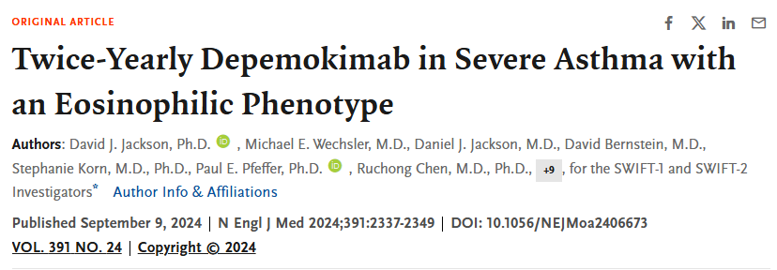
Trials
Ligelizumab – Phase 3 Clinical trial
  IGE mediated treatment
UB – 221 – Phase 1 Clinical trial
  IGE mediated treatment
Depemokimab – Phase 3 Clinical Trial
  IL5 mediated treatment
  Twice yearly injections

Slide 47
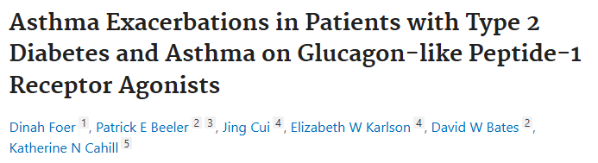
Do Diabetes Medications Affect Asthma?
YES
A 2020 study in the American Journal of Respiratory and Critical Care Medicine found adult patients on GLP-1 agonists had lower counts of asthma exacerbations
Notes:
Likely associated with metabolic dysfunction

Slide 48
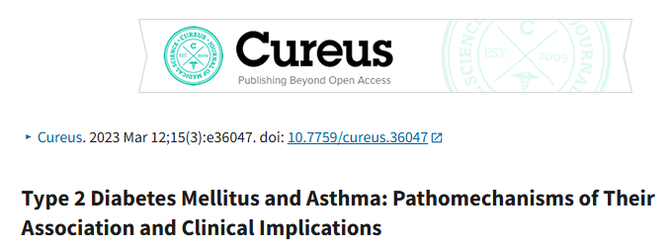
Metformin was associated with a decreased asthma occurrence, asthma-exacerbations, and asthma-related hospitalizations.
GLP – 1 medications were associated with lower asthma exacerbations
Thiazolidinediones also associated with lower rate of asthma exacerbations, but was associated with weight gain

Slide 49
COPD

Slide 50
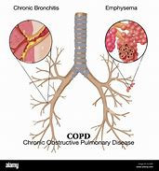
What is COPD?
A heterogenous condition characterized by chronic respiratory symtpoms (dyspnea, cough, sputum production and/or exacerbations) due to abnormalities of the airways (bronchitis, bronchiolitis) and or alveoli (emphysema) that cause persistent and often progressive airflow obstruction.

Slide 51
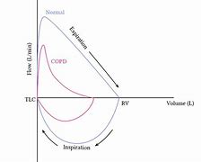
Diagnosed with Pulmonary Function Testing
FEV1/FVC < 0.70
Stages are based on degree of air flow limitation:
Mild/GOLD 1: FEV1 > 80
Moderate/GOLD 2: 50 – 70
Severe/GOLD 3: 30 – 49
Very Severe/GOLD 4: < 30

Slide 52
COPD Statistics
Estimated that the global prevalence of COPD is 10.3%
With increased prevalence of smoking in Low to Middle Income Countries and aging populations in high-income countries, the prevalence is expected to rise
Estimated the number of COPD cases globally in patients aged > 25 years will increase by 23% from 2020 to 2050, approximately 600 million patients.
Globally, approximately 3 million COPD deaths annually
Significant economic burden

Slide 53
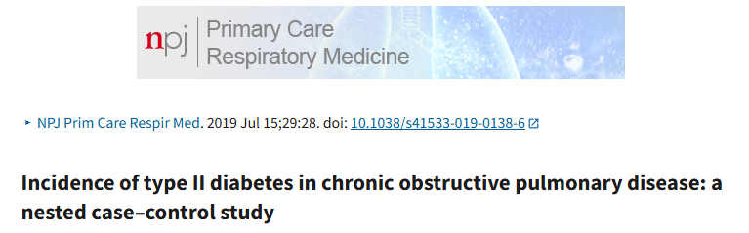
Incidence of COPD and Diabetes
Patient with COPD have an increased risk of developing diabetes
The incidence rate of T2DM in COPD patients was 1.26 per 100 patient years (95% CI: 1.24–1.28) and was higher among men (1.32 vs 1.18 among women).
Frequent exacerbations increases to 1.47 (95% CI: 1.36–1. 60) – compared to those who do no have exacerbations
Patients receiving high-dose ICS (>800 mcg budesonide equivalent dose) was 1.73 (95% CI 1.65–1.82) compared to patients receiving no ICS therapy.
Notes:
UK study monitoring patients already diagnosed with COPD from 2010 - 2016

Slide 54
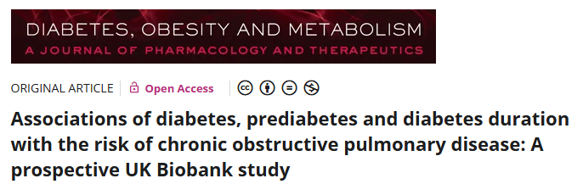
Even Pre-Diabetes is a Risk
Those with prediabetes and diabetes were associated with an 18 and 35% higher risk of COPD
COPD patients with prediabetes and diabetes had a 9% and 21% higher risk of overall death
Diabetes duration was associated with COPD risk:
  7 years or longer - 1.23 higher incidence
  3 – 7 years - 1.20 higher incidence
  Less than 1 year - 1.18 higher incidence
Notes:
2023 Study in Diabetes, Obesity and Metabolism Magazine
12.3 year study, 12,595 cases of COPD

Slide 55
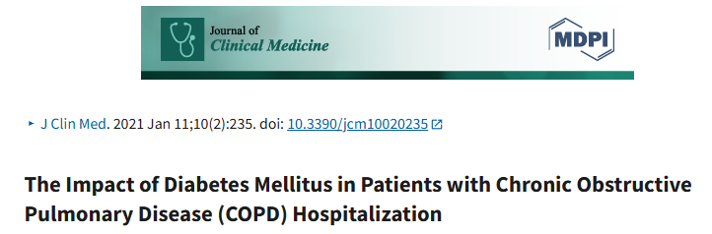
After adjusting for clinical, demographic, and comorbidities, the odds of increased LOS in the COPD/DM with complication were 1.37 (confidence interval (CI): 1.326–1.368), and those of DM without complication were 1.061 (1.052–1.070) when compared with COPD alone. The odds of pneumonia, respiratory failure, stroke, and acute kidney injury were also higher in COPD hospitalizations with DM.
Notes:
COPD patient with DM have worse outcomes with hospitalization
A 2021 retrospective analysis of > 7 million COPD hospitalizations in the Journal of Clinical Medicine:
Longer length of stay and increased complications
Increased health burden

Slide 56
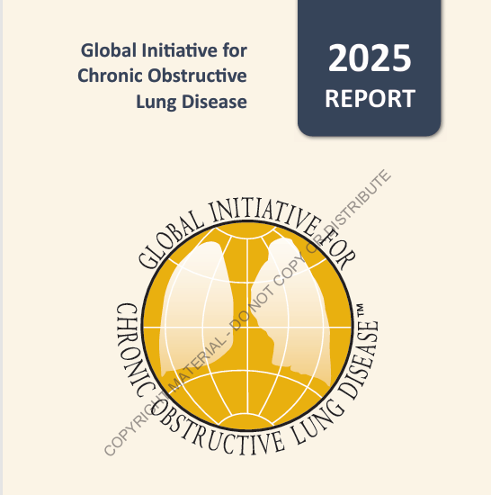
How is COPD Managed?
Global Initiative of Chronic Obstructive Lung Disease (GOLD)
Established 1998
Review published research on COPD management & prevention, to evaluate the impact of this research on recommendations in the GOLD documents regarding management and prevention and post yearly updates on the GOLD website
Notes:
Asthma has GINA, COPD has GOLD
Latest update 2025

Slide 57

Notes:
Categories based on:
MMRC (Modified MRC Dyspnea Scale) – how far can you go without symptoms?
0 = only in strenuous activity, 4 = short of breath with any movement
CAT (8 questionnaire interview about symptoms – cough, chest tightness, sleeplessness, energy, etc)

Slide 58

Goals of Management
Reduce symptoms
  Relieve symptoms
  Increase exercise intolerance
  Improve health status
Reduce Risk
  Prevent progression
  Prevent and Treat Exacerbations
  Reduce Mortality
Notes:
Tobacco Cessation
Vaccination
Avoidance of Triggers – learning and identifying individual trigger

Slide 59

Inhaler Choice in COPD
Based on ABE GOLD Criteria
Class A:
  Bronchodilator – either short or long acting
Class B:
  LABA/LAMA
Class E:
  LABA/LAMA
  Plus ICS
Notes:
Bronchodilator:
Albuterol, recommended here
For patients with asthma/COPD overlap, consider albuterol anyways
LABA/ICS is NOT recommended
Easier to go steroid free

Slide 61


Bronchodilators
Short acting:
  Albuterol, ProAir, Ventolin
  1-2 puffs every 4 – 6 hours
  Albuterol (nebulizer)
  1 treatment every 4 – 6 hours

Slide 62


Bronchodilators
Long –acting:
  Serevent (Salmeterol)
  Striverdi (olodaterol)
  Brovana (aformoterol) - nebulizer
  Performist (formoterol) – nebulizer
  BID

Slide 63


LABA/LAMA
Anoro
1 puff daily
DPI, needs enough inspiratory capacity to use inhaler
Stiolto
2 puffs daily
A mist, easier to take in
Powder free

Slide 64

LABA/LAMA
Bevespi
2 puffs BID
Can use a spacer

Slide 65
ICS/LABA/LAMA Combo
Trelegy
Fluticasone/Vilanterol/Umeclidinium
100/62.5/25 or 200/62.5/25
1 puff daily
Breztri
Budesonide/Glycopyrolate/Formoterol Fumarate
160/9/4.8 mcg
2 puffs BID
Notes:
Both FDA approved for COPD
Guidelines suggest starting with eosinophils >300, but I also use for frequent exacerbations, regardless of eosinophils

Slide 66
What are options for avoiding steroids?

Slide 67

Azithromycin
For those no not currently smoking
Frequent exacerbations
250mcg MWF PO
CONSIDERATIOINS:
  Resistance Organisms
  QTC monitoring
Notes:
Generally QTC around 500 is a cut off

Slide 68

PDE4 Inhibitors
Daliresp (Roflumilast)
500mcg 1 tab daily
SIDE EFFECTS: Diarrhea, nausea, diarrhea
Blocks phosphodiesterase 4 -> Increases cyclic AMP -> Decreased inflammation
Consider with frequent exacerbations
FEV1 < 50
Notes:
Concern for daliresp in diabetics – given the side effects of diabetic medications?

Slide 69

PDE4 Inhibitor: Ohtuvayre Nebulizer
Ensifentrine
Approved June 26, 2024
BID nebulizer dosing
Add on therapy
Relaxes muscles of the airway and reduces airway swelling
Patients say they can walk farther (300 -400 yards)

Slide 70

Theophylline
1,3 – dimethylxanthine
Relaxes the muscles around the airways to reduce bronchospasm and ease work of breathing
Therapeutic Level: 5 – 15 Ug/ml
  Some suggest 10 – 20ug/ml
Theophylline toxicity: Nausea, vomiting, abdominal pain, tachycardia, hypotension, hypokalemia, hypercalcemia
Notes:
Can be used in asthma also
Has to be titrated up!

Slide 71

Injectables for COPD: Dupixent
Dupixent (dupilumab)
Also for eczema, nasal polyps
Risk for reaction: rash, hives, severe headaches, eye problems, swelling, shortness of breath
Minor reactions: dry eyes, throat pain, stomach cramps, muscle aches
Typically every 2 week dosing
In COPD, with eosinophils > 300
Notes:
Approved by US FDA September 27, 2024.

Slide 72
Non-Pharmalogical
Smoking cessation
Pulmonary Rehab/Exercise Programs
Avoidance of triggers:
  Vaccinations
  Air filters, etc.

Slide 73
Oxygen/Ventilator Therapy
Oxygen
Ventilator
Long term administration of oxygen improves outcomes in those with severe resting hypoxemia
Oxygen use in moderate exercise induced hypoxemia has not been shown to improve length time to death or reduce hospitalizations
Used for symptom management
Simple Pulmonary Stress test/6 Minute Walk test demonstrating a Spo2 of 88% or less
Severe chronic hypercapnia and a history of acute hypoxemic respiratory failure, may qualify for non-invasive ventilation
Has been shown to reduce hospital re-admission rates after acute events
Failure of Bipap
PCO2 > 53 on ABG
Notes:
Spo2 goal in COPD 90 – 94%

Slide 74





Slide 75

Best Diabetic Medications for Those with COPD?
Metoformin!
Over a 2-year period, metformin users had a significantly lower risk of death (hazard ratio, 0.46; 95% CI, 0.23–0.92) compared with non-metformin users in patients with coexistent COPD and DM. Moreover, metformin users had similar survival to COPD patients without DM.
Notes:
2019 Article in Respiratory Research Magazine:
- Retrospective Cohort study of COPD patients > 40 years of age, monitored from 2008 – 2014.

Slide 76

GLP – 1 and SGLT - 2
Observational study in JAMA Internal Medicine Magazine (December 2024)
The initiation of SGLT-2is and GLP-1RAs was associated with a reduced risk of severe or moderate COPD exacerbations for individuals with T2D compared with DPP-4is.
Notes:
Observational study and database search – more research is needed
Just published February 2025

Slide 77
Acute Exacerbations

Slide 78
Corticosteroids
Acute exacerbations of asthma and COPD are treated with corticosteroids – namely PREDNISONE
Not indicated in acute bronchitis or allergic rhinitis in those without an underlying lung condition
Event short-term systemic steroids can cause hyperglycemia, elevated blood pressure, immunocompromised state, mood and sleep disturbance, and fat necrosis when injected
Risk versus benefit?

Slide 79

Taper Versus Burst
Treatment of acute exacerbations of COPD with a shorter course of systemic corticosteroids (seven or fewer days) is likely to be as effective and safe as treating with longer courses (more than seven days). There is no significant difference in adverse effects between shorter and longer courses (Strength of Evidence B)
No difference in risk of relapse
Notes:
American Family Physican – meta-analysis of 5 clinic trials across multiple countries
Did not specify between 3 day, 5 day or 7 day course

Slide 80
Infections: CAP

Slide 81

Diabetes Worsens Outcomes in Pneumonia
Mortality among diabetic patients was greater than that among other patients: 19.9 vs. 15.1% after 30 days and 27.0 vs. 21.6% after 90 days
Presence of type 2 diabetes did not predict pulmonary complications or bacteremia
High glucose level on admission was a predictor of death among patients with diabetes and more so among those without diagnosed diabetes
Notes:
2007 study
29,000 patients in Denmark

Slide 82
Higher Rates of Complications
A 2021 retrospective study, which investigated the outcomes of 1262 patients with type 2 diabetes and severe CAP and 2425 patients with severe CAP but without type 2 diabetes, reported:
  a longer ICU stay (13 vs. 12 days, p = 0.016),
  higher 30-day mortality (26% vs. 23%, p = 0.046),
  higher ICU mortality (31% vs. 27%, p = 0.005), and
  higher in-hospital mortality (35% vs. 31%, p = 0.009) in patients with type 2 diabetes.

Slide 83

Why?
Dysregulated immune system
Impaired defense against microorganisms
Chronic state of low-grade inflammation
Hyperglycemia:
  Neutrophil degranulation,
  Impaired complement activation

Slide 84

Pneumococcal Pneumonia
Retrospective study reported the rates of pneumococcal pneumonia of adults with diabetes mellitus versus healthy counterparts were 2.9 in adults aged 18 to 49 years, 3.0 in 50 to 64 years, and 2.7 ≥65 years
Elevated A1C is also a predictor of poorer outcomes

Slide 85
A 2017 study found an increase in long-term mortality among patients with pneumococcal pneumonia. In the study, approximately 40% of all patients who survived the first 30 days after presentation of pneumococcal pneumonia died within the following five years.
However, patients with diabetes responded better to Pneumonia Vaccination:
A randomized controlled trial study among elderly (≥65 years) individuals with comorbidities investigated the vaccine efficacy (VE) of PCV13 in patients with diabetes. The authors reported that diabetes mellitus significantly modified VE, reaching a level of 89% in immunocompetent elderly patients with diabetes mellitus compared with 25% in non-diabetics.
PCV20, alone or in combo with PCV15 or PCV23

Slide 86

What Diabetic Medications Can Help with Pneumonia Prevention & Treatment?
Metformin
Metformin use was associated with a significantly lower risk of bacterial pneumonia, invasive mechanical ventilation, and death compared to non-use.
Mortality rates were significantly lower for the metformin users at 30 and 90 days

Slide 87
Diaphragmatic Neuropathy

Slide 88

Phrenic Neuropathy
Damage or dysfunction of the phrenic nerve
Causes paralysis of the diaphragm, which impairs respiration
Symptoms: Orthopnea, dyspnea with exertion, increased breathlessness
Can be unilateral or bilateral
Notes:
Mechanical trauma (surgery), compression or neuropathy.

Slide 89

Ultrasound
https://www.youtube.com/watch?v=ci4E3ELjnlY
Fluroscopy (SNIF Test)
https://www.youtube.com/watch?v=hZAzl2WkTmY

Slide 90

Phrenic Neuropathy in Diabetics
Reported causes of bilateral nerve palsy with no precipitating condition
Type II diabetes mellitus patients had significant dysfunction in pulmonary functions with early involvement of restrictive parameters
In both right and left phrenic nerves, the amplitudes were lower in prediabetic and diabetic patients than control subjects, respectively. Both of the phrenic nerve conductions were altered similarly. The results of our study demonstrate that phrenic nerves are affected like peripheric nerves in prediabetic and diabetic patients.
Notes:
Observational study of patients – 2003, 2013, 2018
2023 comparative cross –sectional study of only 50 participants
2013 study of 77 patients

Slide 91

Treatment
Diagnose
  - Imaging, SNF Test, symptoms
Phrenic Nerve EMG
  Any nerve function? If No
    Lung Plication surgery
    Exercises
    External Ventilator
  If Yes, may be a candidate for a phrenic nerve stimulator

Slide 92
Sleep Apnea

Slide 93

What is Sleep Apnea?
A breathing disorder characterized by disruptions in breathing during sleep
OBSTRUCTIVE: throat muscles relax causing airway closure
  Can be associated with tongue and jaw closure
CENTRAL: Inappropriate brain signaling cause disruption in breathing
Symptoms: daytime sleepiness, fatigue, snoring and headaches
Notes:
Measured with an Apnea, Hyponea Index (AHI)

Slide 94

Diabetes and Sleep Apnea
Strong association between diabetes and sleep apnea
The prevalence of mild OSA (5 ≤ AHI < 15) and moderate‐to‐severe OSA (AHI ≥ 15) was 33.9% and 23.8%, respectively, in patients with self‐reported diabetes, but 27.0% and 15.6% in non‐diabetics
Notes:
pooled study of multiple population‐based cohorts in the USA

Slide 95

Sleep Apnea and Diabetes
OSA severity was shown to be positively associated with the incidence of type 2 diabetes, independent of adiposity
Risk of developing diabetes were 0.94 for mild (5.0 ≤ apnea–hypopnea index [AHI] ≤ 14.9), 1.28 for moderate (15.0 ≤ AHI ≤ 29.9) and 1.71 for severe OSA (AHI ≥ 30), compared with a non‐OSA population (AHI < 5).
OSA symptoms, including daytime sleepiness, observed apnea and bothersome snoring, were associated with higher levels of fasting glucose, 2‐h glucose and lower insulin sensitivity
Notes:
2019 study in the Journal of Diabetes Investigation

Slide 96

Treatment of Sleep Apnea
CPAP
Inspire – implanted hypoglossal nerve stimulator
Mandibular device
CPAP, a primary treatment for OSA, might not significantly improve glucose metabolism and insulin resistance.
  Related to adherence to mask
  Other lifestyle factors: diet, activity, obesity

Slide 97

Zepbound
Tirzepetide
FDA approved December 20, 2024 for weight loss in sleep apnea patients
Moderate to Severe sleep apnea
2 trials which demonstrated a reduction in AHI with weight loss in patients using Zepbound
Some patients achieved remission or mild sleep apnea (AHI < 15) within 1 year

Slide 98
Pulmonary Fibrosis

Slide 99

What is Pulmonary Fibrosis?
Idiopathic pulmonary fibrosis (IPF) is a progressive and fatal pulmonary disease with a prevalence of 18.2 cases per 100,000 persons in America
Characterized pathologically by proliferation and differentiation of lung fibroblasts.
Cigarette smoking, age and gender, chronic viral infections, etc., are considered as risk factors of IPF
Inflammatory-driven process related to aberrant activation of the alveolar epithelial cells
The exact etiology of IPF remains unclear.
Notes:
BUT chronic inflammation does sound like it might have a link to DM

Slide 100


Slide 101

A 2021 meta-analysis and systematic review found that while IPF and DM may be associated, the causal relationship remains indeterminate till now. Further rigorously designed studies are required to confirm the present findings and investigate the possible mechanisms behind the effect of DM on IPF.

Slide 102

Recent studies in mouse models of type 1 and type 2 diabetes demonstrated that diabetes causes pulmonary fibrosis. Both types of diabetes trigger a cascade, starting with increased DNA damage, an impaired DNA repair, and leading to persistent DNA damage signaling
Notes:
2021 study:
More research is needed

Slide 103


Treatment Options for ILD
Ofev (Nintedanib)
Bid oral dosing
Slows the progression and prevents acute flare ups
Side Effects: nauseas, vomiting, DIARRHEA, liver damage
Esbriet (Pirfenidone)
TID oral dosing
Slows the progression and prevents acute flare ups
Side Effects: liver damage, sensitivity to sunlight, nausea, vomiting, diarrhea
Notes:
Expensive
Contraindicated in smokers
Clinical Trials

Slide 104
References:
Asthma and Allergy Network. (2023) Asthma Statistics. https://allergyasthmanetwork.org/what-is-asthma/asthma statistics/#:~:text=Asthma%20occurs%20in%20people%20of%20all%20ages%2C%20ethnicities%2C,Alaskan%20Natives%2C%20and%20people%20of%20multiple%20ethnicities%209
Bai, L., Zhang, L., Pan, T., Wang, W. et al. (2021) Idiopathic pulmonary fibrosis and diabetes mellitus: A meta-analysis and systematic review. Respiratory Research. 22: 175. Retrieved from https://respiratory-research.biomedcentral.com/articles/10.1186/s12931-021-01760-6#:~:text=Several%20studies%20have%20focused%20on%20the%20relationship%20between,to%20examine%20the%20association%20between%20diabetes%20to%20IPF.
Cilloniz, C. & A. Torres. (2024) Diabetes Mellitus and Pneumococcal Pneumonia. Diagnostics. 14(8). Retrieved from https://www.mdpi.com/2075-4418/14/8/859#B81-diagnostics-14-00859
Cleveland Clinic. (2024) Biologic Therapy for Severe Asthma. https://my.clevelandclinic.org/health/treatments/17711-biologic-therapy-for-severe-asthma
Costa, R., Doctor, P. , Mahajan, K. & V. Lakkappan. (2018) Bilateral phrenic nerve palsy in a diabetic causing respiratory failure. Indiana Journal of Critical Care Medicine. 22:10. 737-739. Doi: 10.4103/ijccm.IJCMM_261_18
Dvorin, E. & M. Ebell. (2020) Short-term systemic corticosteroids: Appropriate use in primary care. American Family Physician. 101(2). 89-94. Retrieved from https://www.aafp.org/pubs/afp/issues/2020/0115/p89.html
Foer, D, Beeler, P, Cui, J, Karlson, E. Et al. (2020) Asthma exacerbations in patients with type 2 diabetes and asthma on glucagon-like peptide-1 receptor agonists. American Journal of Respiratory and Critical Care Medicine. 203:7. 831-840. Retrieved from https://pubmed.ncbi.nlm.nih.gov/33052715/
Gayle, A., Dickinson, S., Poole, C., Pang, M., et al. (2019) Incidence of type II diabetes in chronic obstructive pulmonary disease: a nested case-control study. NPJ Pimary Care Respiratory Medicine. 29:28. Retrieved from https://pmc.ncbi.nlm.nih.gov/articles/PMC6629671/
Global Initiative for Asthma. (2024) Global Strategy for Asthma Management and Prevention. https://ginasthma.org/wp-content/uploads/2024/05/GINA-2024-Strategy-Report-24_05_22_WMS.pdf

Slide 105
Global Objectives on Chronic Obstructive Lung Disease. (2025) Global Strategy for the Diagnosis, Management and Prevention of Chronic Obstructive Pulmonary Disease. Retrieved from file:///C:/Users/14103/Downloads/GOLD-2025-Report-v1.0-15Nov2024_WMV.pdf
Gunasekaran, K., Murthi, S., Elango, K, et al. January 2021. The Impact of Diabetes Mellitus in Patients with Chronic Pulmonary Disease (COPD) Hospitalization. Journal of Clinical Medicine. 10(2). 235. DOI: 10.3309/jcm10020235
Kopf, S, Kumar, V, Kender, Z, et al. (2021) Diabetic Pneumopathy – A New Diabetes-Associated Complication: Mechanisms, Consequences and Treatment Considerations. Frontiers in Endocrinology. 25:12. Retrieved from https://pmc.ncbi.nlm.nih.gov/articles/PMC8655305/
Ho, T.W., Huang, C. Tsai, Y. Lien, A. Lai, F. & C. Yu. (2019) Metformin use mitigates the adverse prognostic effect of diabetes mellitus in chronic obstructive pulmonary disease. Respiratory Research. 20:69. Retrieved from https://pmc.ncbi.nlm.nih.gov/articles/PMC6451256/.
Kornum, J, Thomsen, R, et al. (2007) Type 2 diabetes and pneumonia outcome: A population-based cohort study. Diabetes Care. 30:9. Retrieved from https://diabetesjournals.org/care/article/30/9/2251/29360/Type-2-Diabetes-and-Pneumonia-OutcomesA-population
Magovern, M. & S. Sawyer. (2019) Different durations of corticosteroid therapy for COPD exacerbations. American Family Physician. 99(5): 295 – 296. Retrieved from https://www.aafp.org/pubs/afp/issues/2019/0301/p295.html
Muraki, I, Wada H., & T. Tanigawa. (2018) Sleep apnea and type 2 diabetes. Journal of Diabetes Investigation. 9:5: 991 – 997. doi: 10.1111/jdi.12823
National Institute of Diabetes and Digestive and Kidney Diseases. (2024) Diabetes Statistics. https:/www.niddk.nih.gov/health-information/health-statistics/diabetesstatistics#:~:text=Estimated%20prevalence%20of%20diabetes%20in%20the%20United%20States,undiagnosed%20%2822.8%25%20of%20adults%20with%20diabetes%20were%20undiagnosed%29.

Slide 106
O’Byrne, P.M., Rennard, S., Gerstein, H., Radner, F., Peterson, S. ,Lindberg, et al. (2012. Risk of new onset diabetes mellitus in patients with asthma or COPD taking inhaler corticosteroids. Respiratory Medicine. 106: 1487 – 1493. Retrieved from https://pubmed.ncbi.nlm.nih.gov/22902134/
Ray A, Paik JM, Wexler DJ, et al. Glucose-Lowering Medications and Risk of Chronic Obstructive Pulmonary Disease Exacerbations in Patients With Type 2 Diabetes. JAMA Intern Med. Published online February 10, 2025. doi:10.1001/jamainternmed.2024.7811
See, K. C. (2023) Impact of inhaled and intranasal corticosteroids on glucose metabolism and diabetes mellitus: A mini review. World Journal of Diabetes. https://pubmed.ncbi.nlm.nih.gov/37664474/
Su, J, Li, M., Wan, X. et al. (2023) Associations of diabetes, prediabete and diabetes duration with the risk of chronic obstructive pulmonary disease: A prospective UK Biobank study. Diabetes, Obesity and Metabolism: A Journal of Pharmacology and Therapy. Retrieved from https://dom-pubs.onlinelibrary.wiley.com/doi/10.1111/dom.15142
Torres, R.M., Souza, M. D, Coelho, A.C., de Mello, L.M. and C. Souza-Machado. (2021) Associated between Asthma and Type 2 Diabetes Mellitus: Mechanisms and Impact on Asthma Control – A literature review. Canadian Respiratory Journal. https://pmc.ncbi.nlm.nih.gov/articles/PMC7817304/#B21
Uppal, P, Mohammad, S.A., Rajashekar, S, et. Al (March 12, 2023) Type 2 Diabetes Mellitus and Asthma: Pathomechanisms of Their Association and Clinical Implications. Cureus. 15(3). DOI 10.7759/cureus.36047
U.S. Food and Drug Administration. (2024) FDA Requires Boxed Warning about serious mental health side effects for asthma and allergy drug montelukast; Advises restricting use for allergic rhinitis. https://www.fda.gov/drugs/drug-safety-and-availability/fda-requires-boxed-warning-about-serious-mental-health-side-effects-asthma-and-allergy-drug
Yesil, Y., Ugur-Altun, B., Turgut, N., et al. (2013) Phrenic neuropathy in diabetic and prediabetic patients without neuromuscular complaint. Acta Diabetol. 50:5. 673-7. Doi 10.1007/s00592-012-0371-8.
Zhang, P, Lopez, R., Attaway, A. et al. (April 2021) Diabetes Mellitus is Associated with Worse Outcome in Patients Hospitalized for Asthma. Journal of Allergy and Clinical Immunology In Practice. 9(4). 1562 -1569. Retrieved from https://www.jaci-inpractice.org/article/S2213-2198(20)31209-5/abstract

