Slide 1


OBESITY: THE TRUTH BEHIND WEIGHT LOSS
Melvin D. Richardson, MD, Regional Medical Director

Slide 2



Obesity
Medically Defined
Epidemiology
Medical Consequences
Prevention
Treatment

Slide 3




Obesity
“Chronic Disease” (1.) (2.)(3.) which is defined as excess amount of body fat.

Slide 4
“The recognition that being overweight or obese is a chronic disease and not simply due to poor self-control or a lack of will power comes from the past 70 years of research that has been steadily gaining insight into the physiology that governs body weight…”
https://www.ncbi.nlm.nih.gov/books/NBK279167/

Slide 5

How does the medical community define obesity?
Body mass index
Waist Circumference
Height weight calculation

Slide 6

Obesity Defined
Body type
BMI
Waist Circumference
Genetics
Environment

Slide 7

Measuring Obesity
Body Mass Index
Waist Circumference
Height/weight proportions

Slide 8
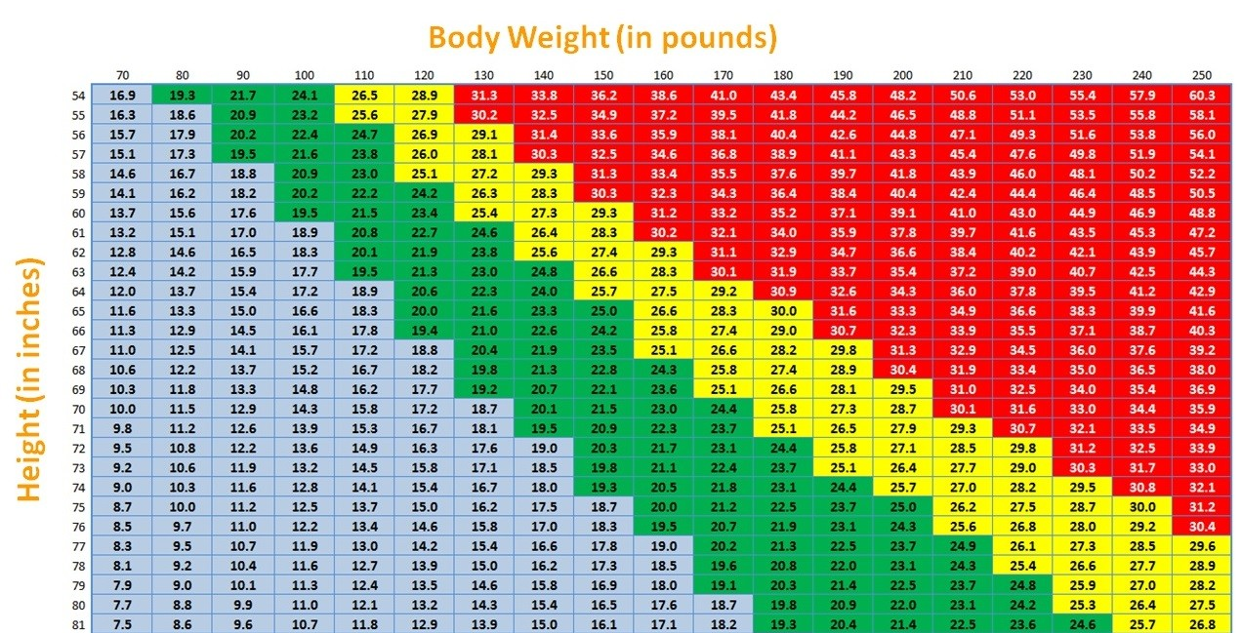

Slide 9
Height and Weight Calculation
Male: 106lb for the first 5 feet and then 6lb for every inch thereafter.
Female:105lb for the first 5 feet and then 5lb for every inch thereafter.
Example:
5foot 8inch female:
105 plus 8x5lb= 145lb (+/- 20%)

Slide 10
Metabolic Syndrome
Increases Risk for Cardiovascular disease:
Elevated blood sugar
Elevated triglycerides
Elevated blood pressure
Low HDL
Waist circumference: >35in. Female/>40inches Male
If you have 3 out of 5 of these: Metabolic Syndrome.

Slide 11

Leading causes of death in the US.
Heart disease: 696,962
Cancer: 602,350
COVID-19: 350,831
Accidents (unintentional injuries): 200,955
Stroke (cerebrovascular diseases): 160,264
Chronic lower respiratory diseases: 152,657
Alzheimer’s disease: 134,242
Diabetes: 102,188
Influenza and pneumonia: 53,544
Nephritis, nephrotic syndrome, and nephrosis: 52,547

Slide 12
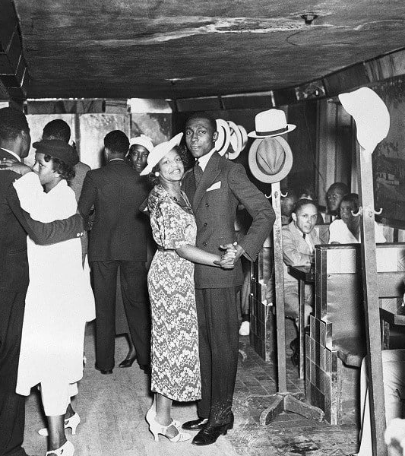
What was considered normal?
?OBESITY

Slide 13
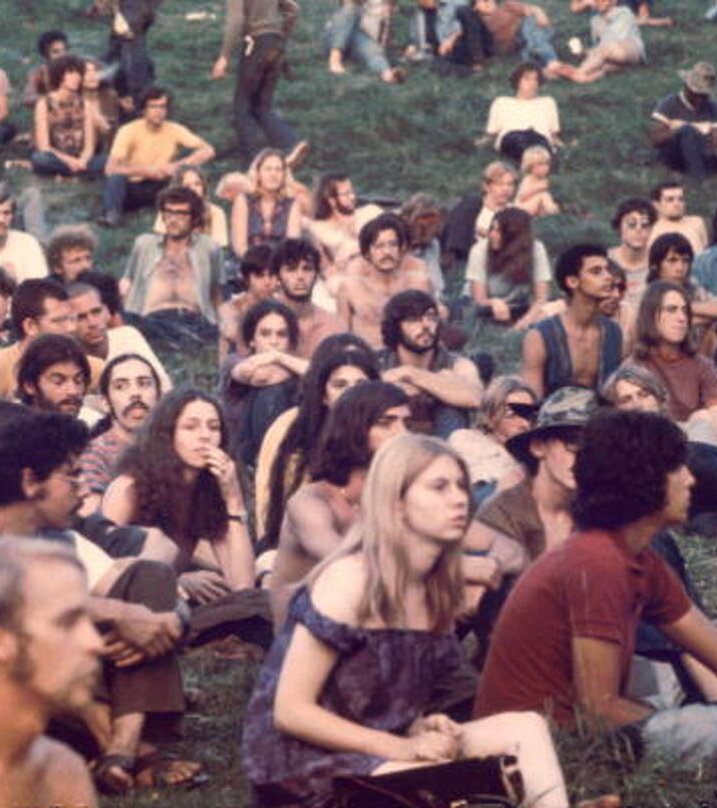
Genetics vs. Environment?
Woodstock

Slide 14
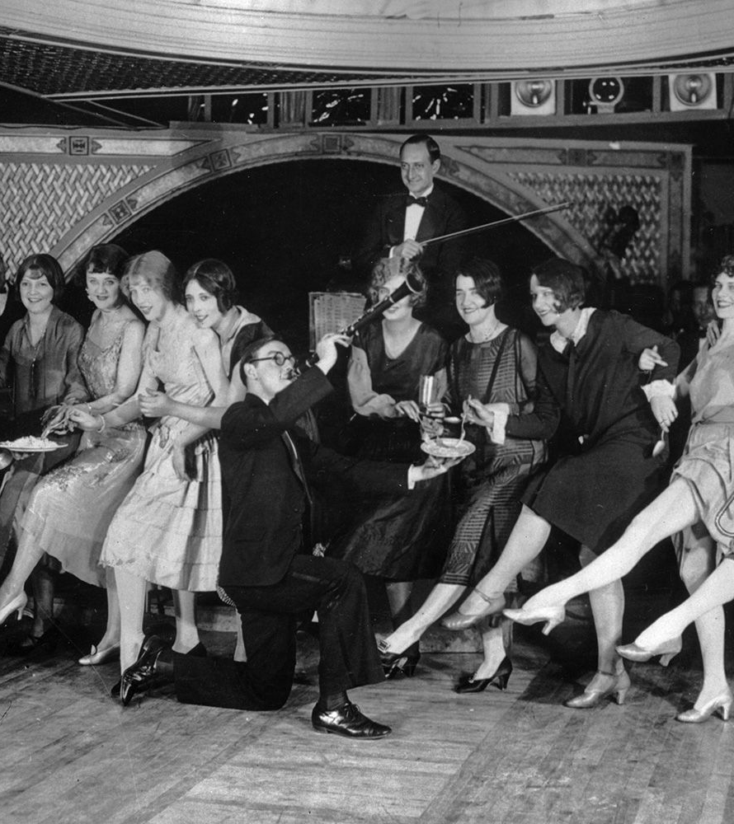
The Roaring 20’s
Chronic Obesity: A Modern Phenomena?

Slide 15

Obesity history:
1. Approximately 10 percent of U.S. adults were classified as having obesity during the 1950s. https://www.livestrong.com/article/384722-how-much-have-obesity-rates-risen-since-1950/
2. Obesity has tripled over the last 50 years. https://usafacts.org/articles/obesity-rate-nearly-triples-united-states-over-last-50-years/
3. 1999 to 2017:
Prevalence of obesity increased: 30.9% to 40.5%
Severe obesity increased: 4.7% to 9.2%
Medical cost: $173 Billion Dollars, annually
4. Obesity is erasing the health gains made by fewer US citizens smoking.

Slide 16
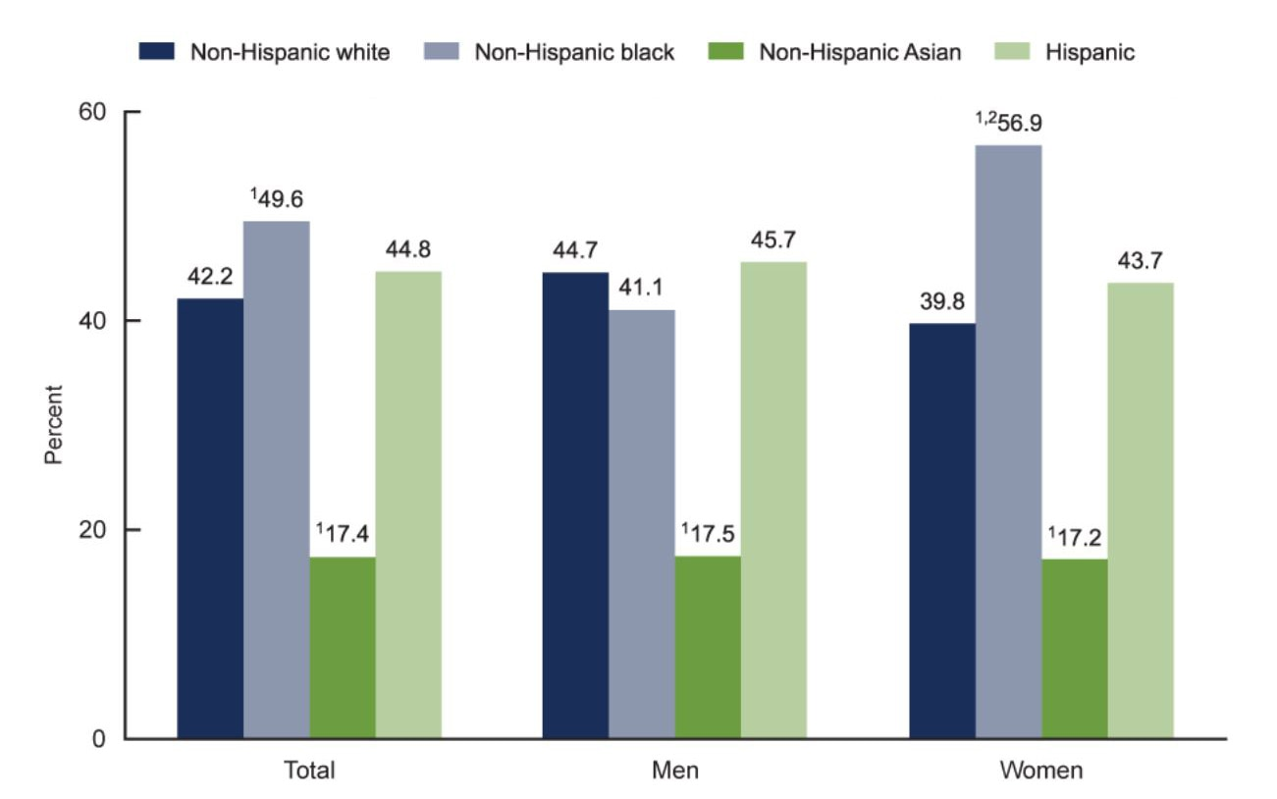

Slide 17
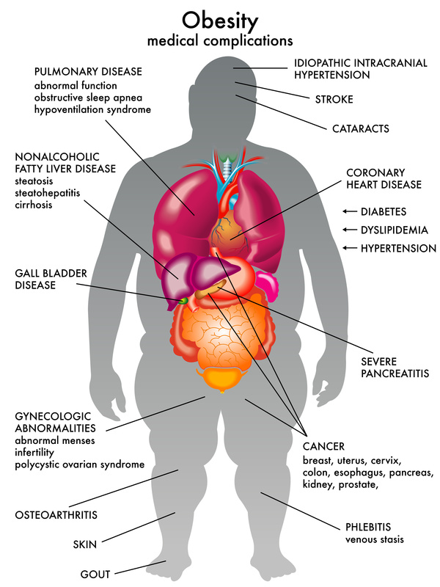

Slide 18
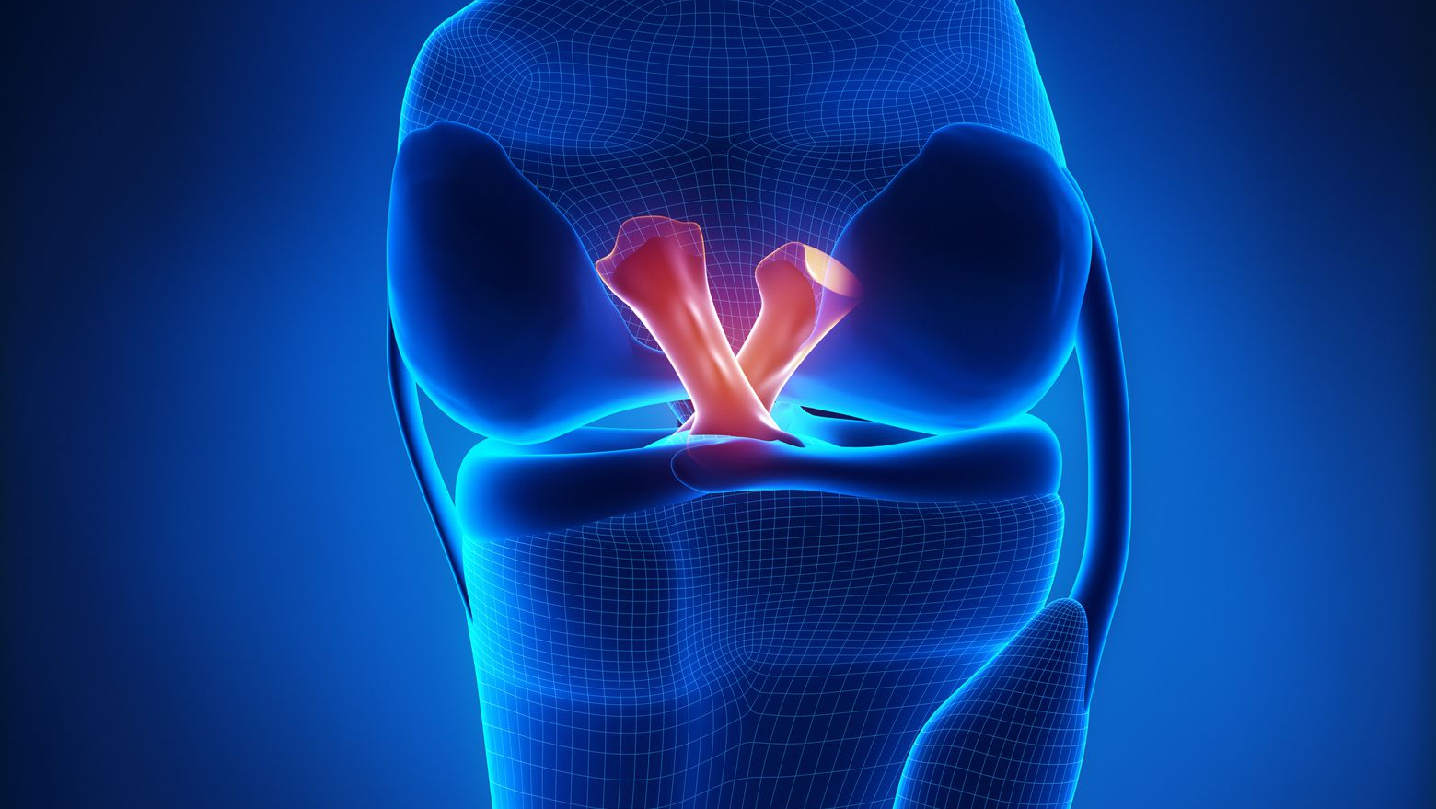
OSTEOARTHRITIS:
1LB OF WEIGHT LOSS TAKES 4LB OF PRESSURE OFF THE KNEE
https://pubmed.ncbi.nlm.nih.gov/15986358/
Chronic back pain: more prevalent in morbidly obese.
https://pubmed.ncbi.nlm.nih.gov/12841899/
Obesity worsens Gout, Rheumatoid Arthritis, Psoriatic Arthritis
https://creakyjoints.org/diet-exercise/obesity-and-arthritis/

Slide 19

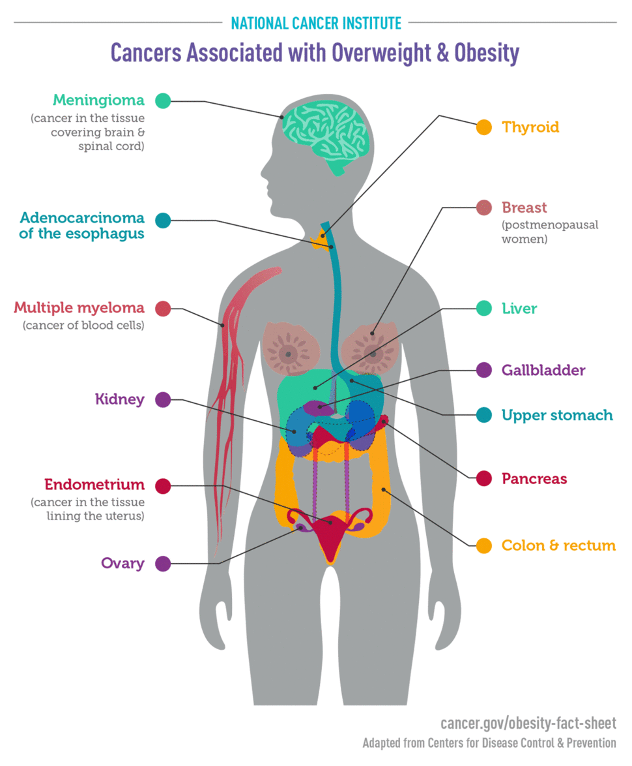
Cancer And Obesity

Slide 20
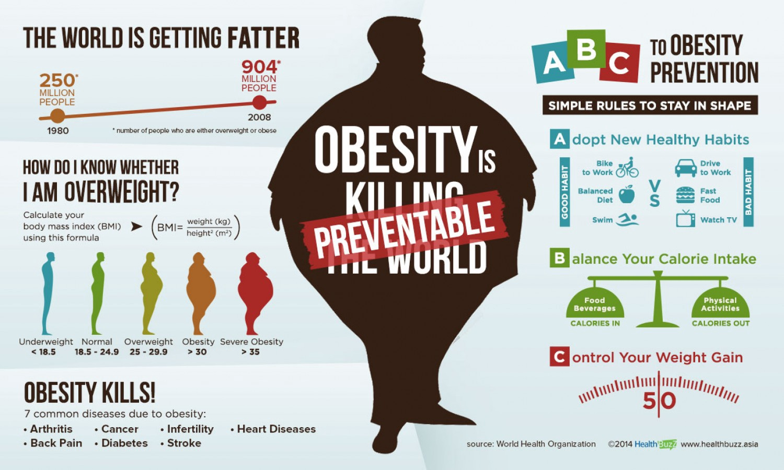

Slide 21
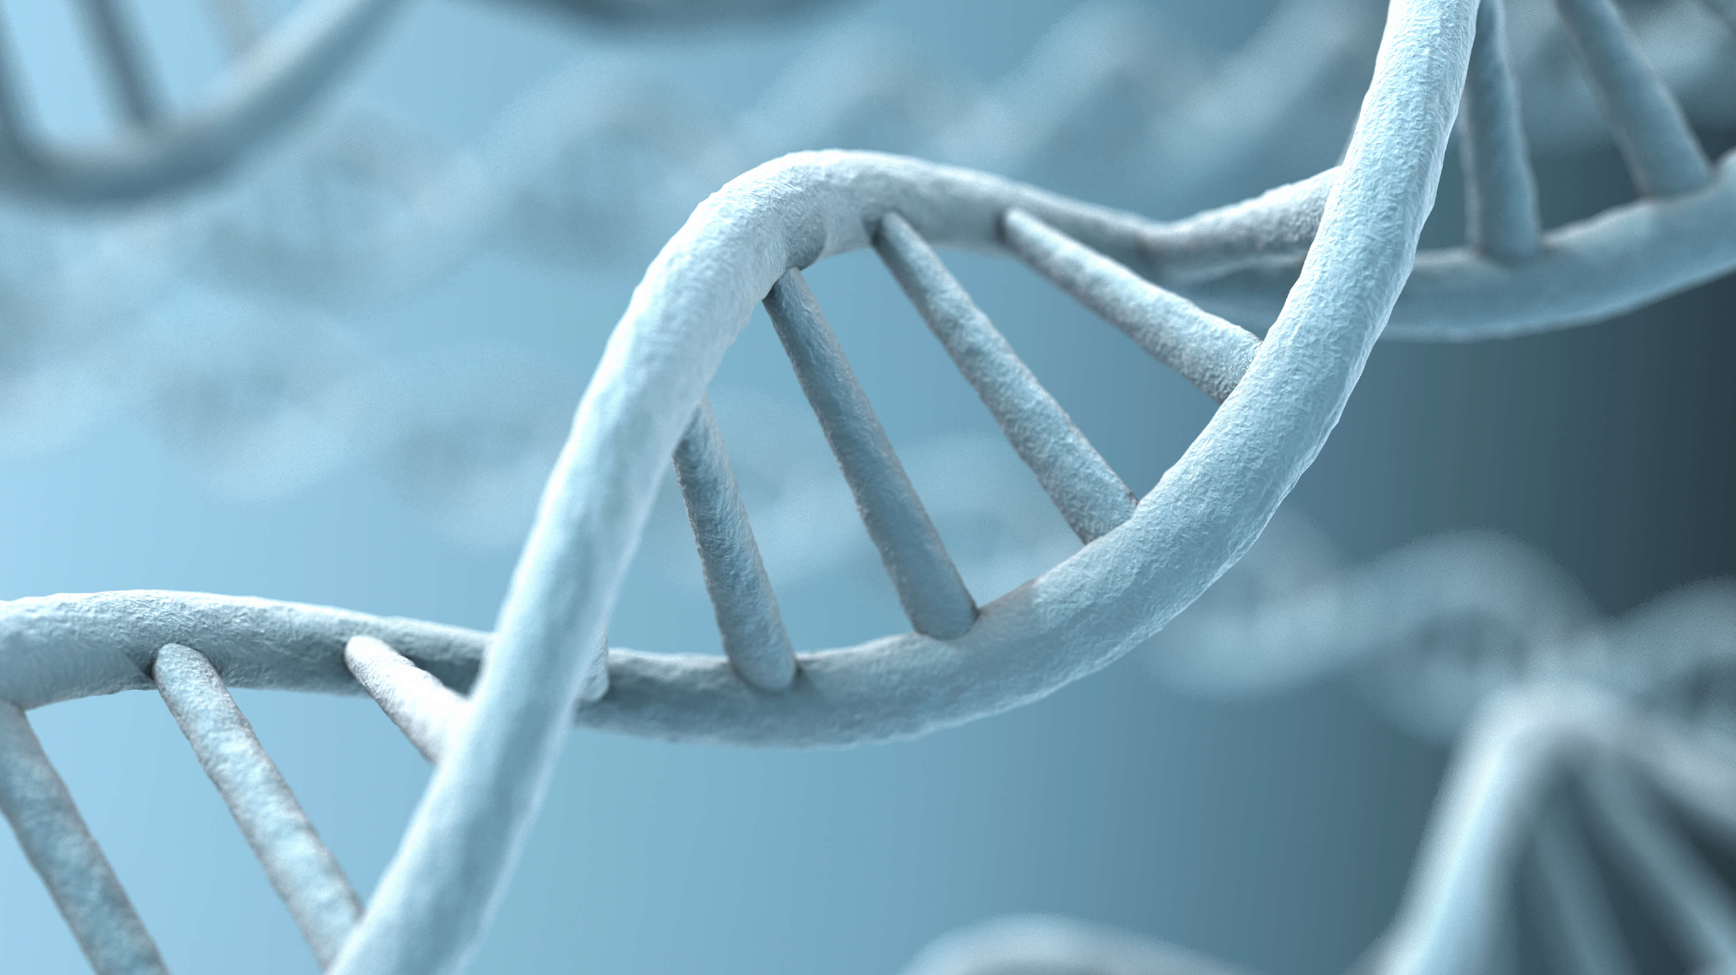
Genetics plus
Environment
Equals you.

Slide 22

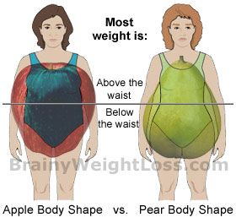



Body type
Recessive gene
½ from Mother
½ from Father
Cardiovascular risk.

Slide 23
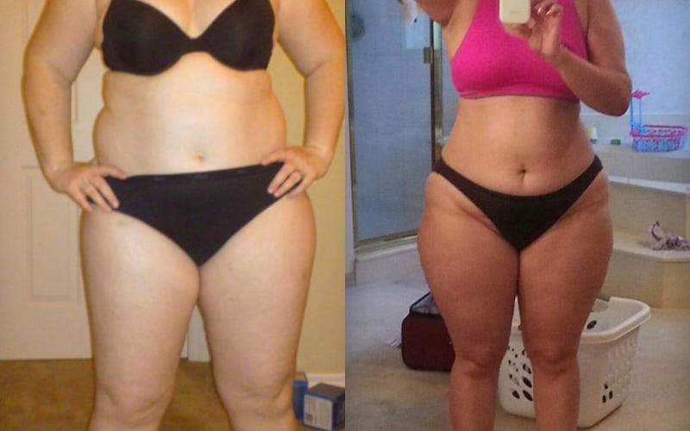
Both women weigh 200lb.
Waist circumference and body type is the difference.

Slide 24
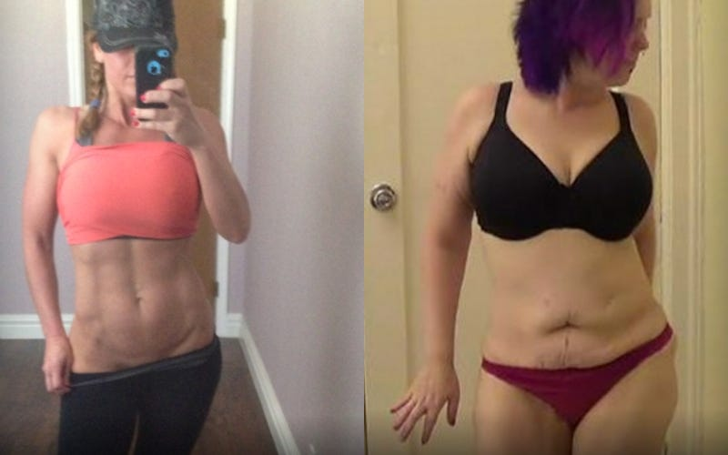
Muscle mass.
Both weigh 150lb.
Muscle composition.

Slide 25
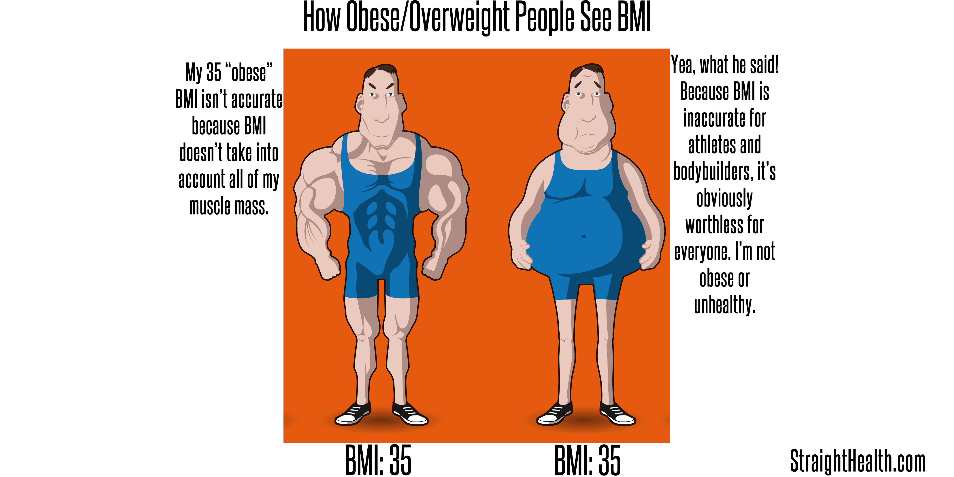
Muscle mass

Slide 26
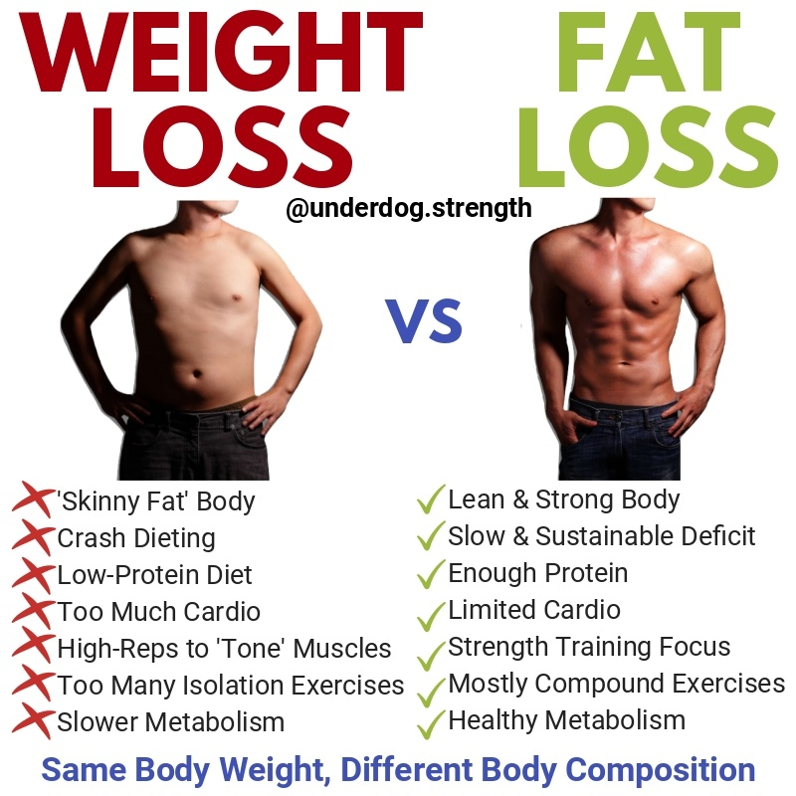
Skinny fat:
All weight loss is not treated equally.

Slide 27
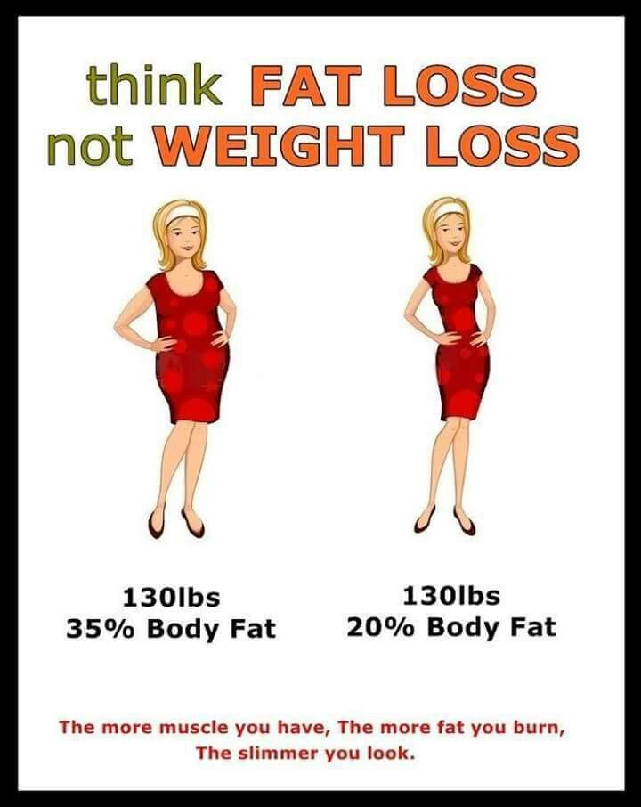
Metabolic Syndrome
1. Waist >35 inches for women
Waist >40 inches for men.
2. Elevated blood Pressure.
3. Elevated Blood Sugar.
4. Elevated Triglyceride.
5. Low HDL.

Slide 28
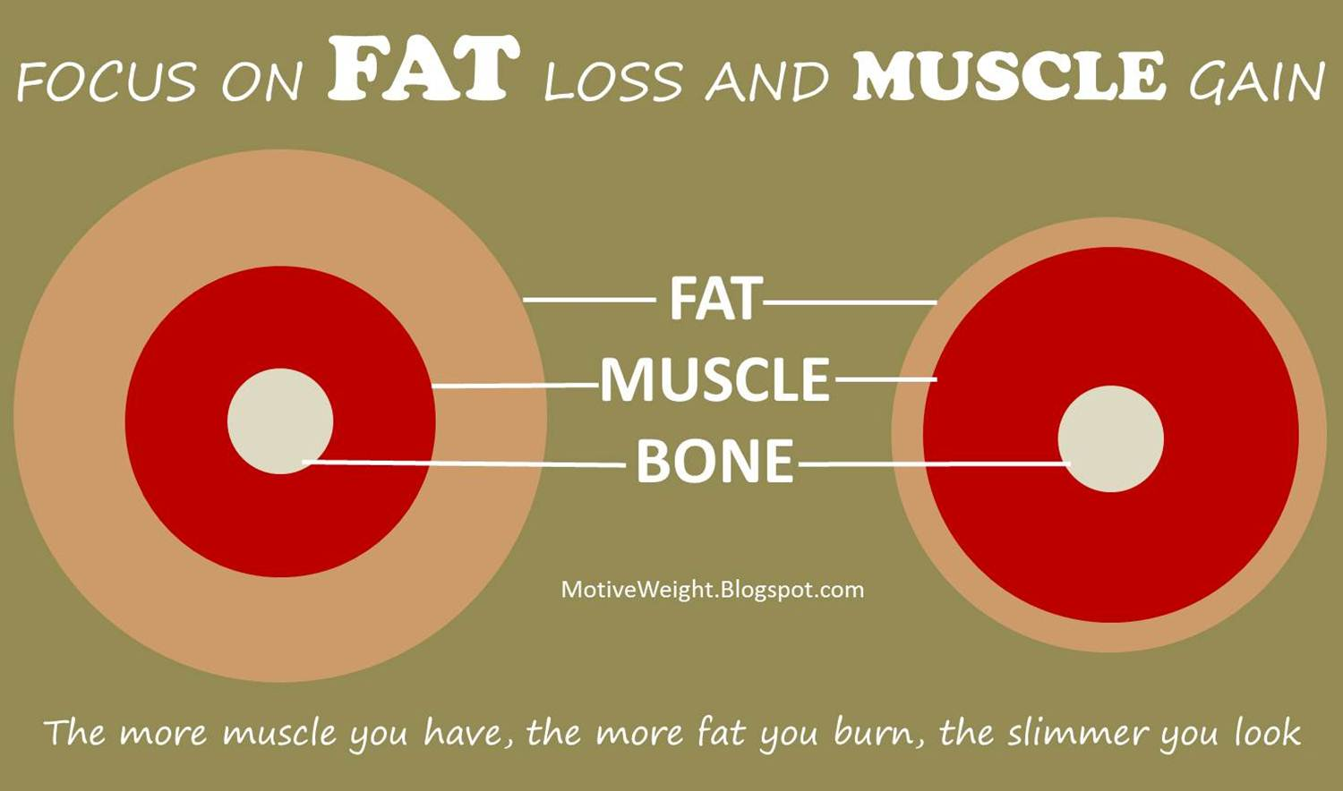
More Muscle→Higher Metabolism→
More Weight
Loss
Metabolic Syndrome

Slide 29
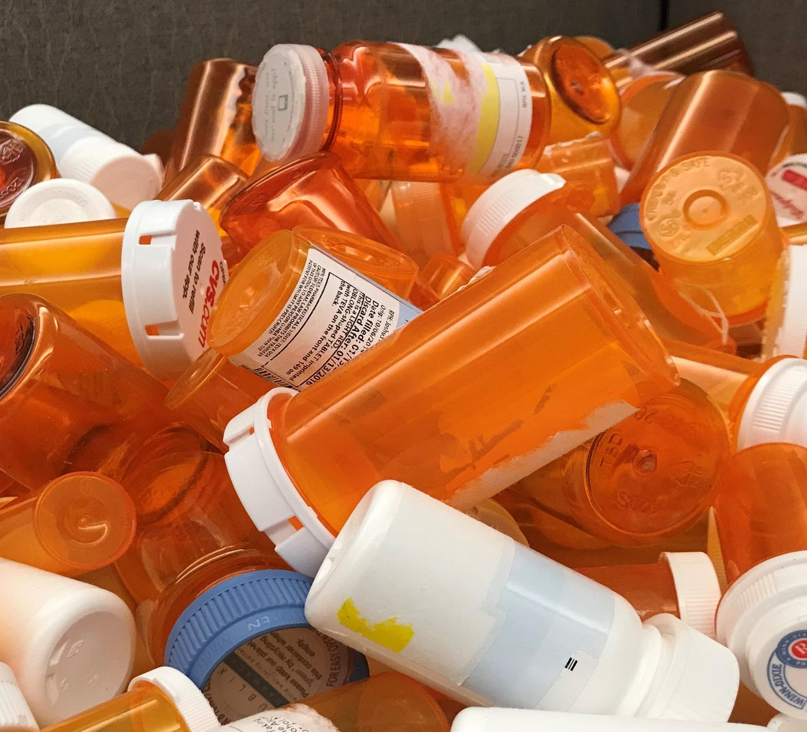
Medical Causes of Obesity
Thyroid disorders
Cushing’s Disease
Insomnia
Menopause
Depression
OSA
PCOS
CHF
DRUGS
EDEMA
Metabolic Syndrome
https://www.webmd.com/diet/obesity/ss/slideshow-weight-gain-conditions
https://www.healthgrades.com/right-care/weight-control-and-obesity/7-conditions-that-cause-weight-gain

Slide 30
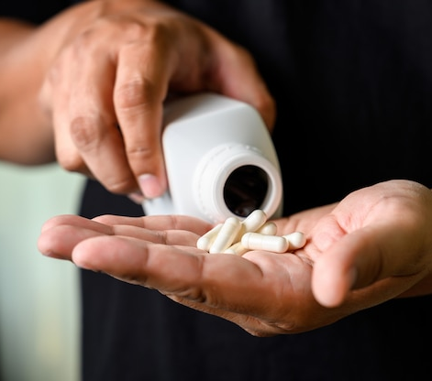
Drugs and Weight Gain
Diabetic Medicine (Prandin, Actos, Avandia.)
Tricyclic Antidepressants (e.g., Elavil.)
Steroid
Beta Blockers (Propranolol)
SSRI (e.g., Prozac, Paxil, Zoloft, Lexapro.)
Insulin
SNRI (Lexapro, Cymbalta, Effexor.)
Calcium Channel Blocker (Norvasc, Diltiazem.)
Gabapentin
Antihistamines (e.g., Allegra.)
Antipsychotic (Seroquel, Zyprexa, Haldol.) https://dakotadietitians.com/medications-cause-weight-gain/ https://obesitymedicine.org/antihistamines-and-weight-gain-obesity-medicine-association/

Slide 31

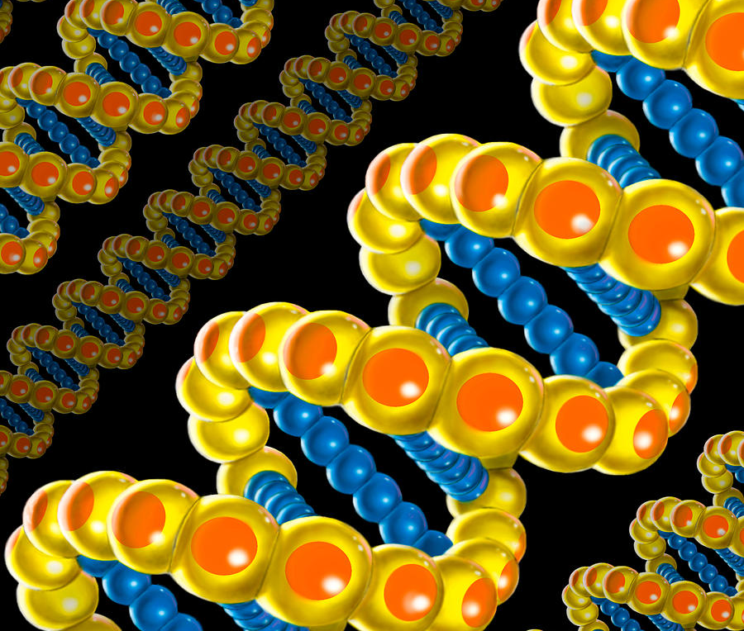
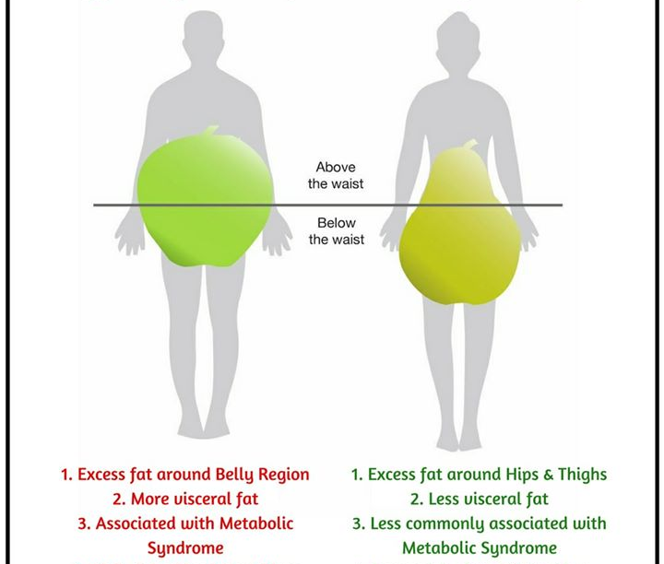
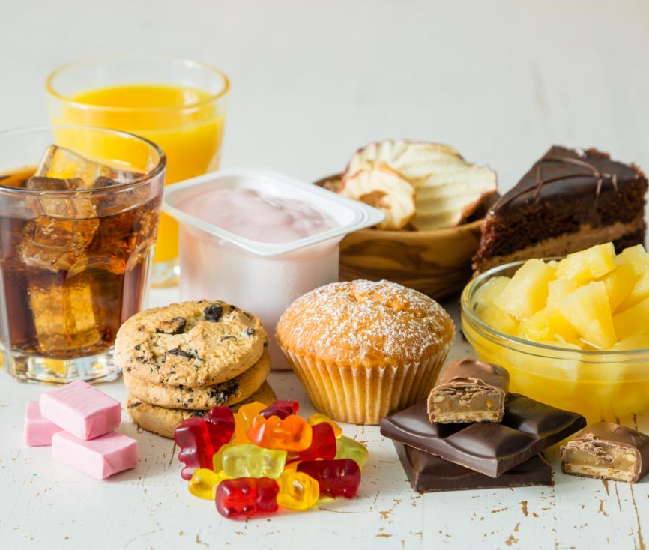
Genetics
NPY
LPL
Leptin
Ghrelin
PROP
Body Type
Cravings
6-N-PTU
BMR (Basal Metabolic Rate)
Recess Gene
Exercise
METABOLISM
Food

Slide 32
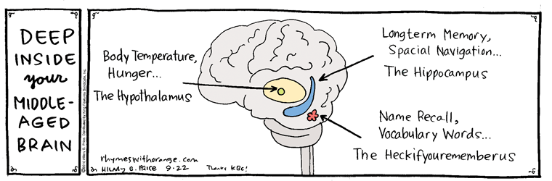
Neuropeptide-Y
Neuropeptide Y (NPY): relays information to the brain to TELL THE BRAIN: Eat OR STOP EATING

Slide 33
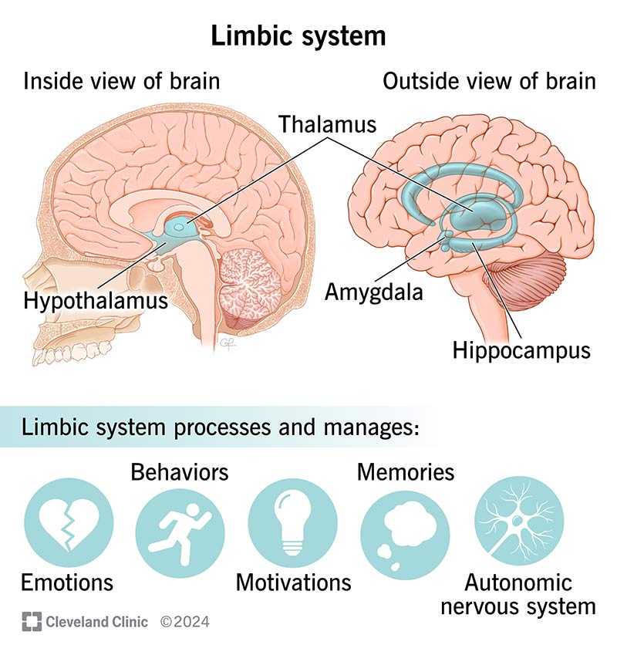
Limbic system
Primitive brain
The 4 F’s
The “Emotional Nervous System.”
4 components:
Hypothalamus thalamus
Amygdala
Hippocampus

Slide 34
LPL (Lipoprotein Lipase)
Chromosome 8
Enzyme
Passes fat into:
Muscle Cells for Energy or Fats Cells for Storage
Exercise Counteracts the Fat-Storage effect of LPL.

Slide 35

LPL
ADIPOSE TISSUE ←FAT→ MUSCLE

Slide 36
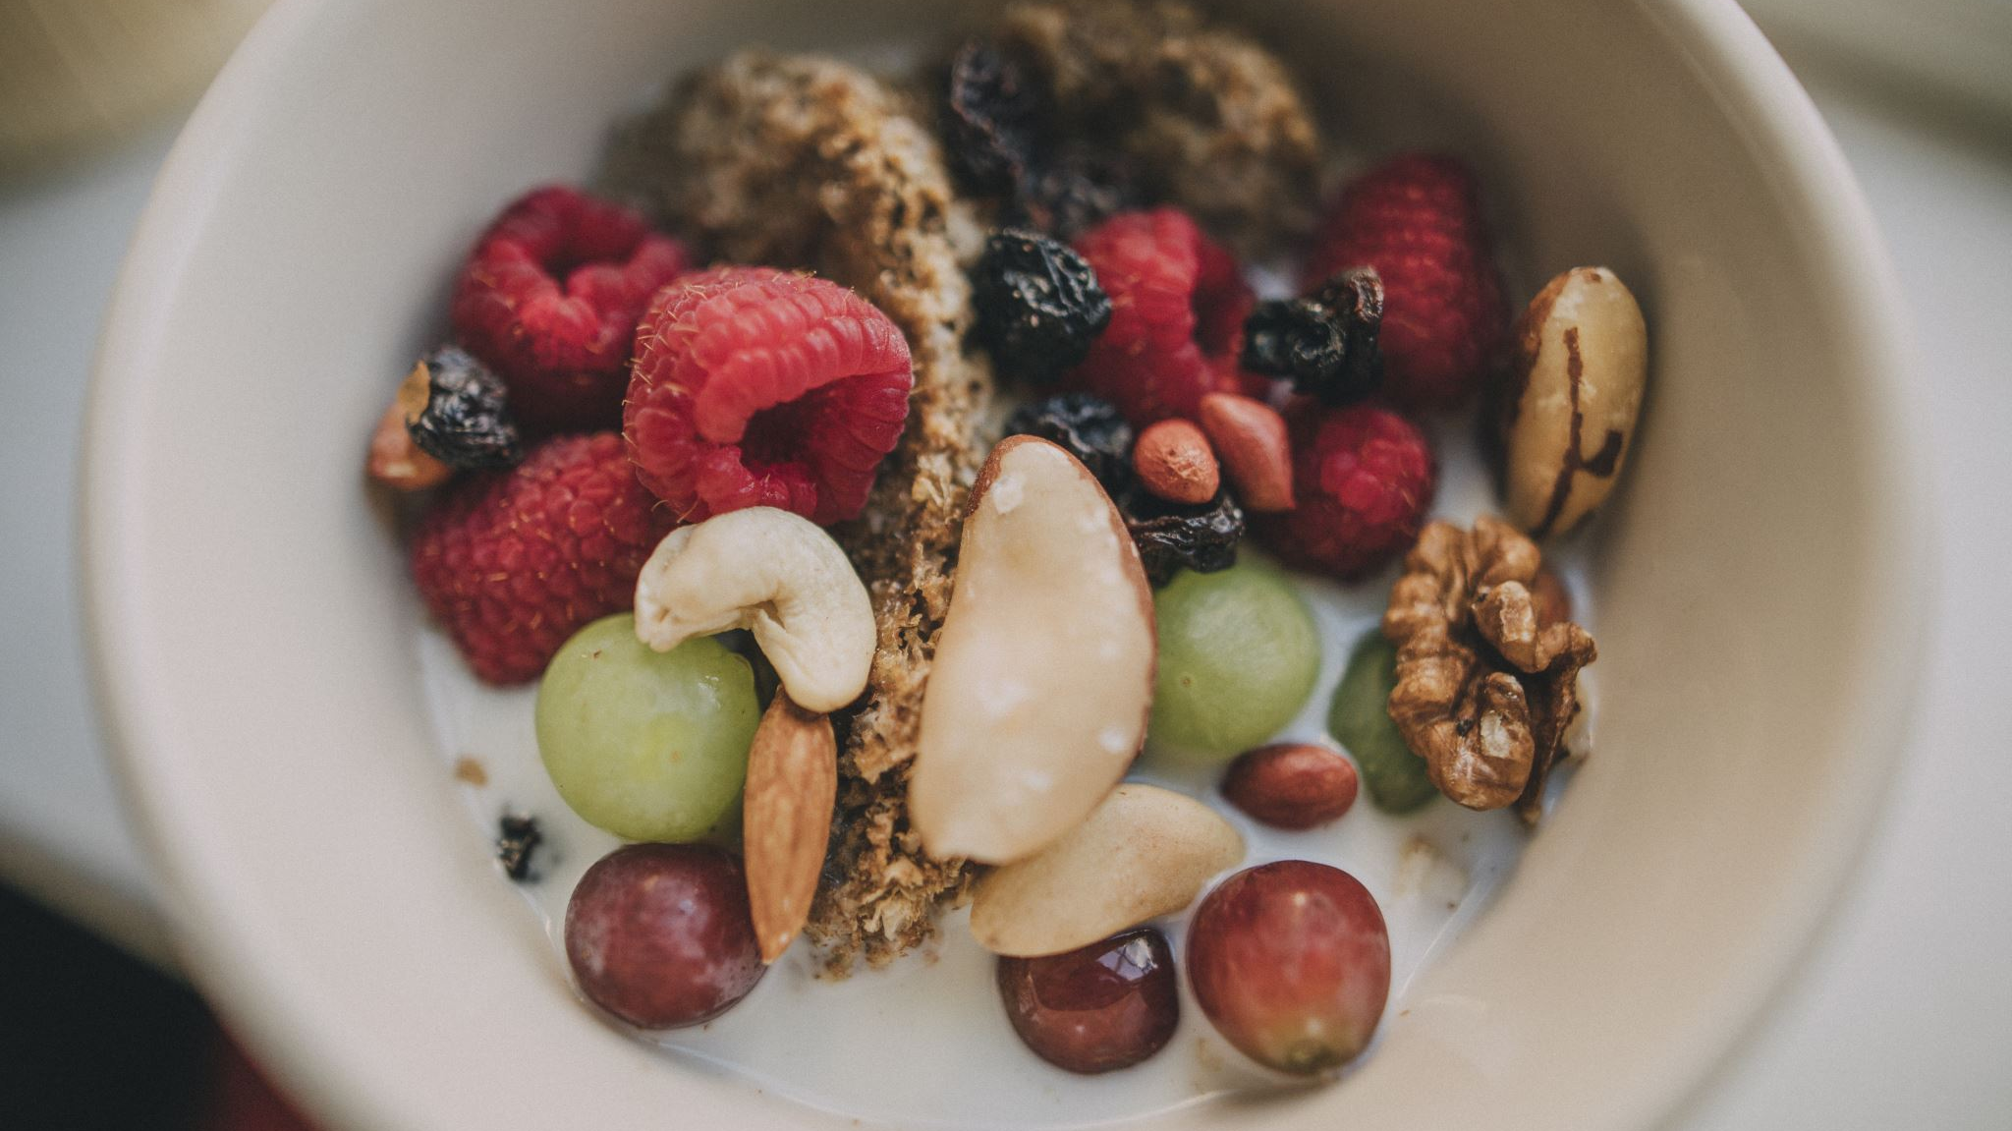
PROP (N-Propylthiouracil)
“Turn off the Fat Genes,” Neal Barnard, MD
1/5 of your taste or cravings comes from your parents.
PROP is a bitter substance (Gene marker.)
¾ OF Europeans can detect PROP
9/10 persons of Asian descent
most persons of African descent detect prop
If you can detect prop=aversion to sweets/fatty foods.

Slide 37
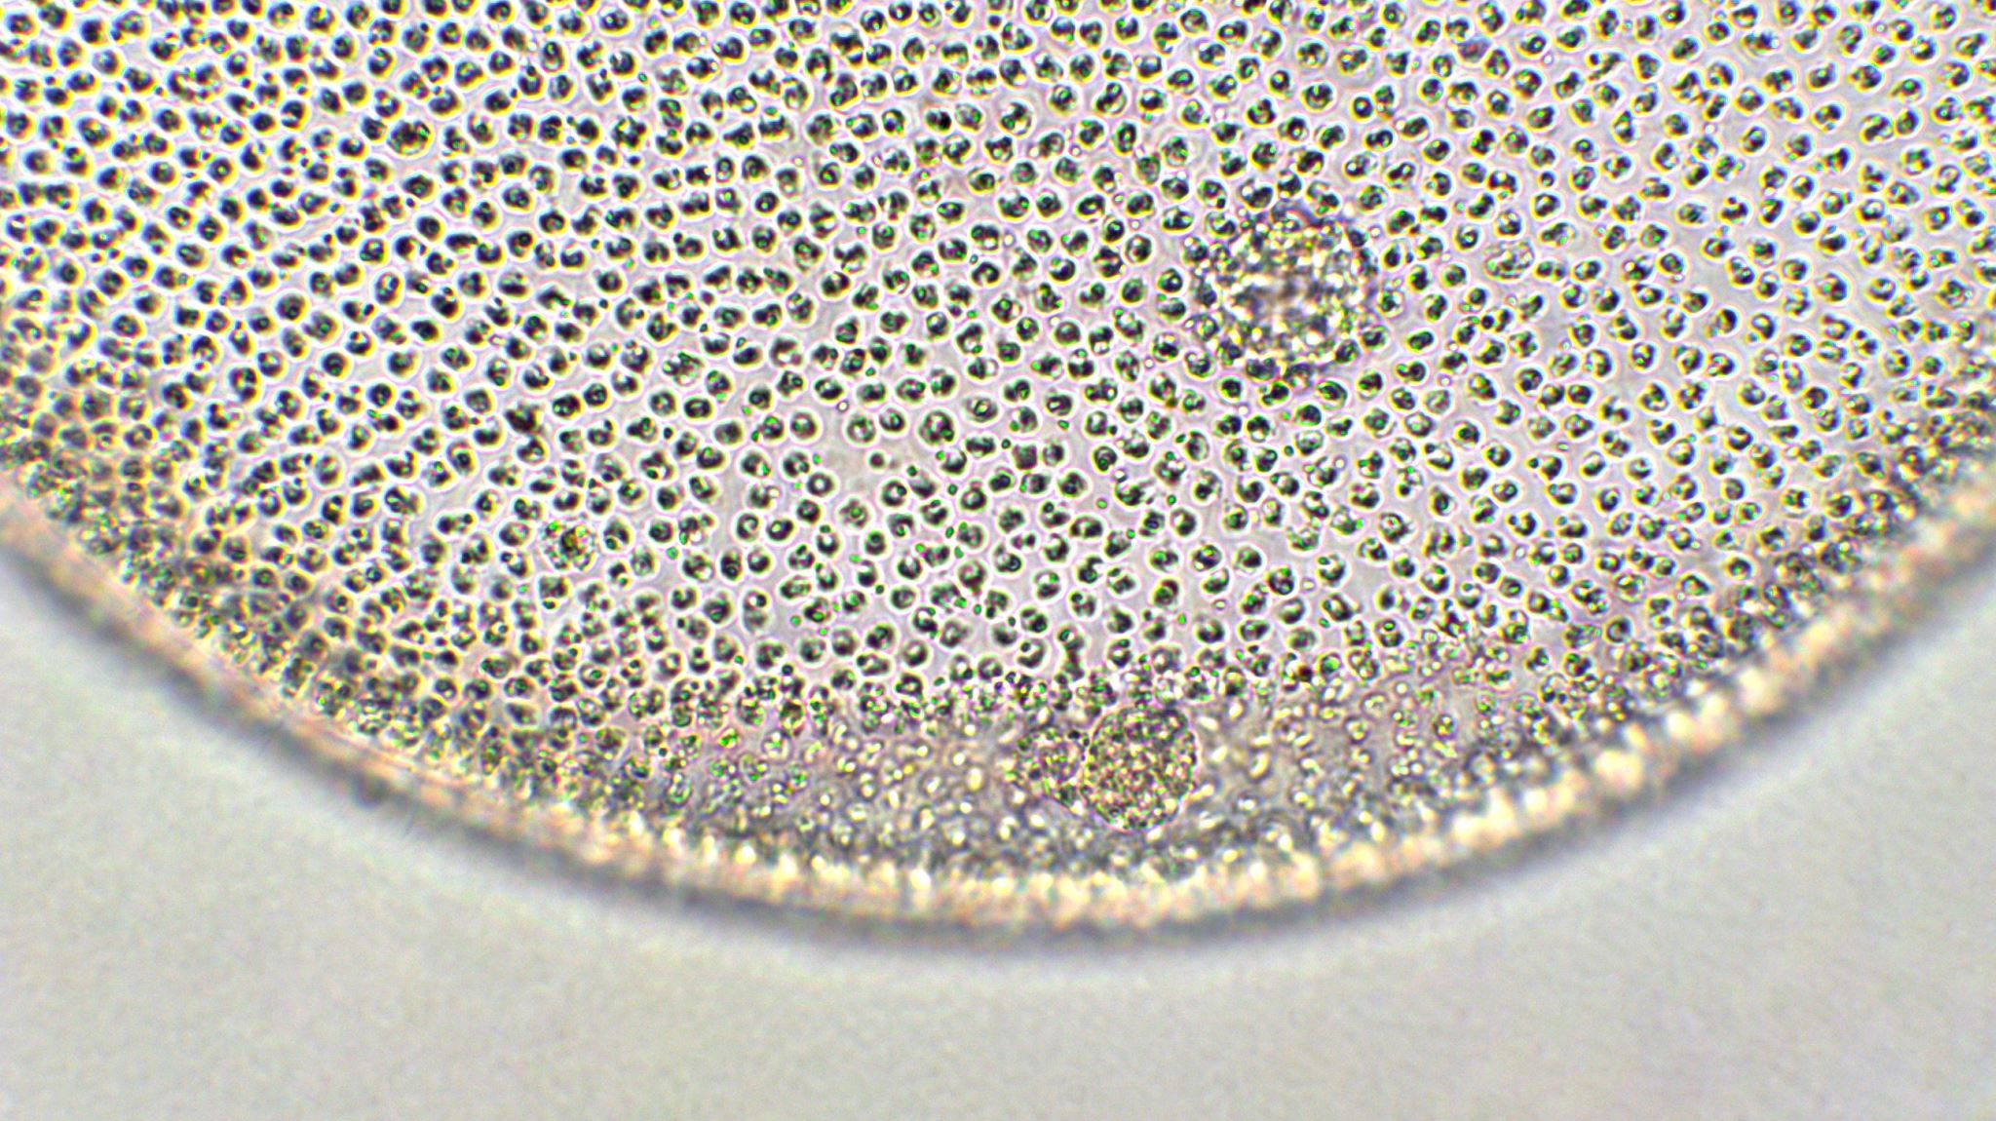
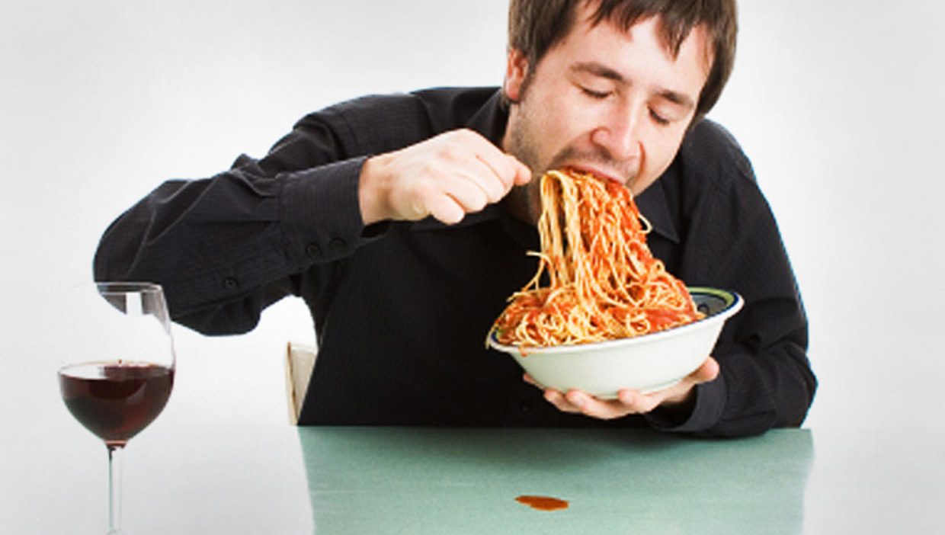
Ghrelin
“The hunger hormone”
Hormone
Stimulates hunger VIA npy
Stimulates storage of fat
Secreted in the lining of the stomach
https://pubmed.ncbi.nlm.nih.gov/24100676/

Slide 38
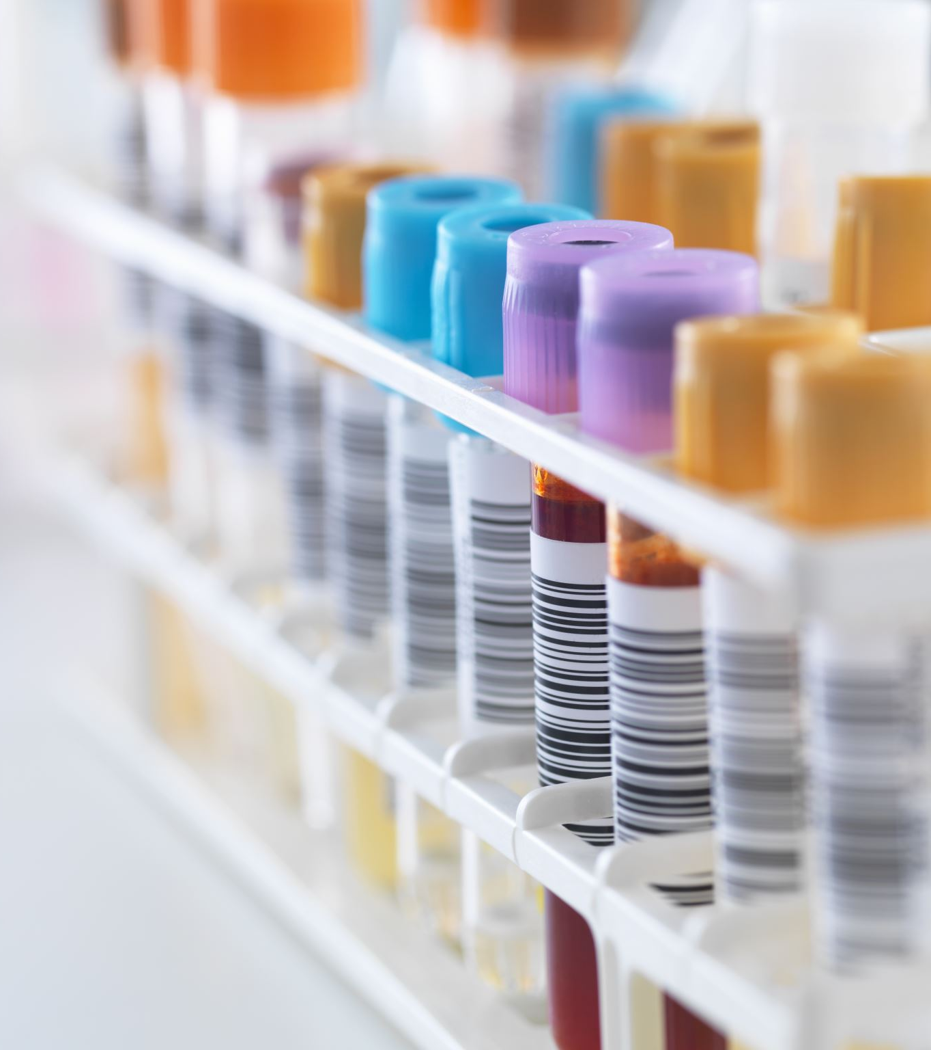
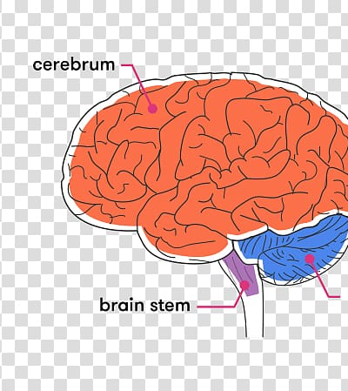
Leptin
Hormone discovered 1994
The “Thin Hormone”.
Released by Adipose (fat) Cells
Amount of Leptin correlates to amount of body fat
Inhibits hunger to the brain via NPY https://my.clevelandclinic.org/health/articles/22446-leptin

Slide 39

Fat cells via Leptin→ tell us to stop eating
“In a new study published in the Journal of Endocrinology, researchers describe how injecting a gene into the brain that codes for the hormone leptin may curb overeating, leading to long-term weight loss.”
https://www.medicalnewstoday.com/articles/301213

Slide 40
Leptin
Hormone produced by fat cells (https://my.clevelandclinic.org/health/articles/22446-leptin.)
Leptin prevents hunger.
Leptin Resistance.

Slide 41
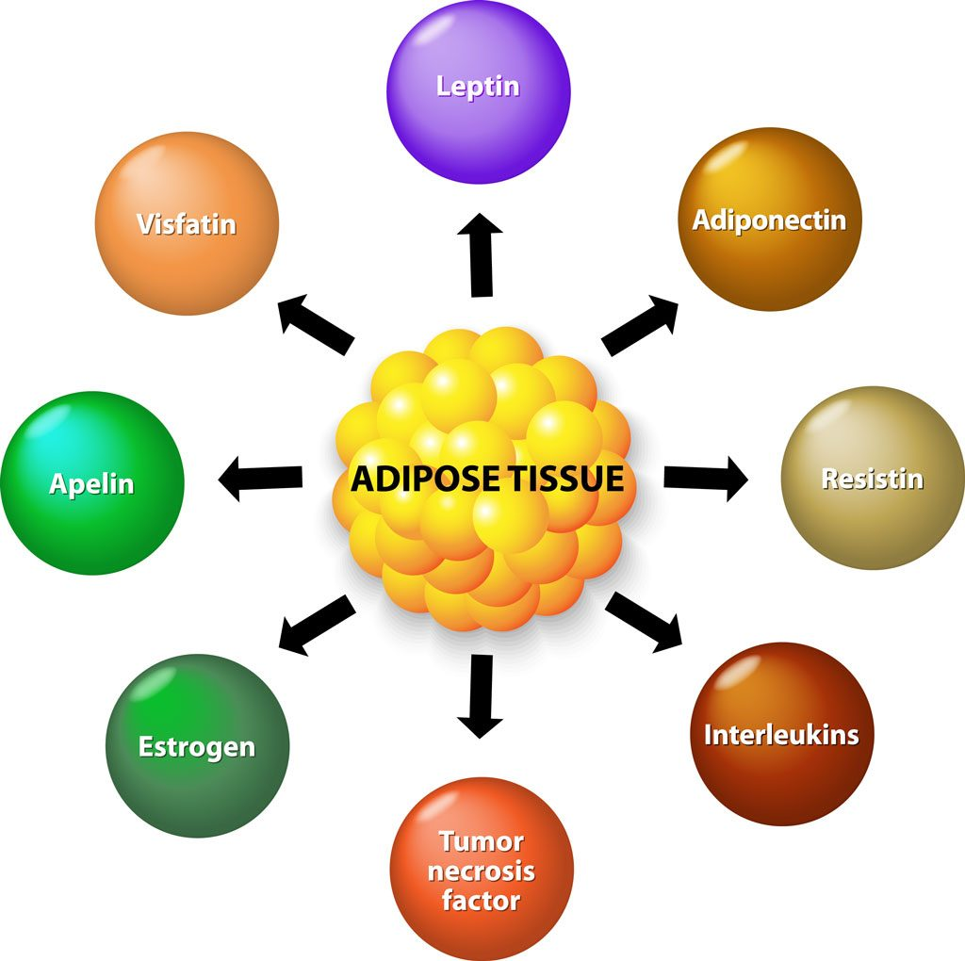
Fat cells are not inert!

Slide 42
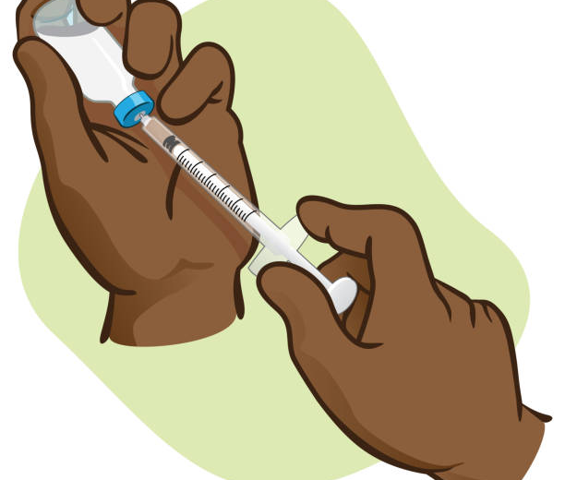
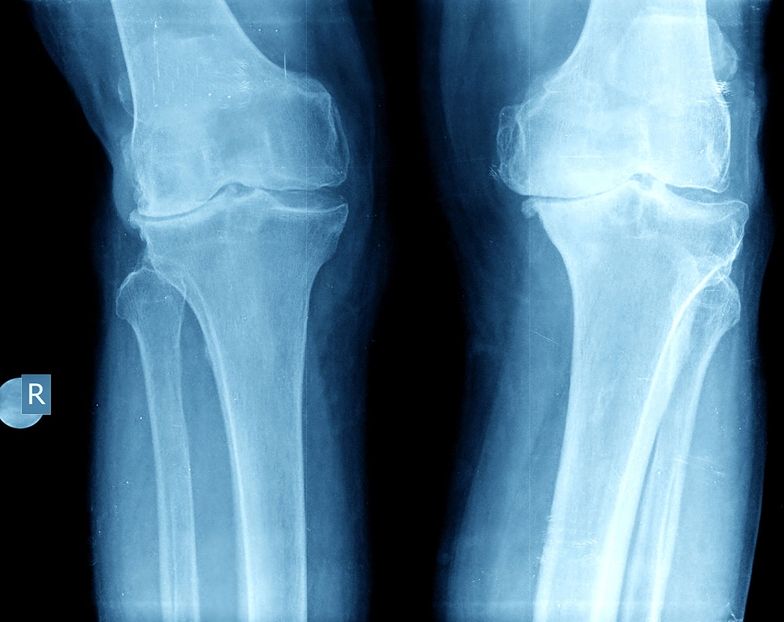
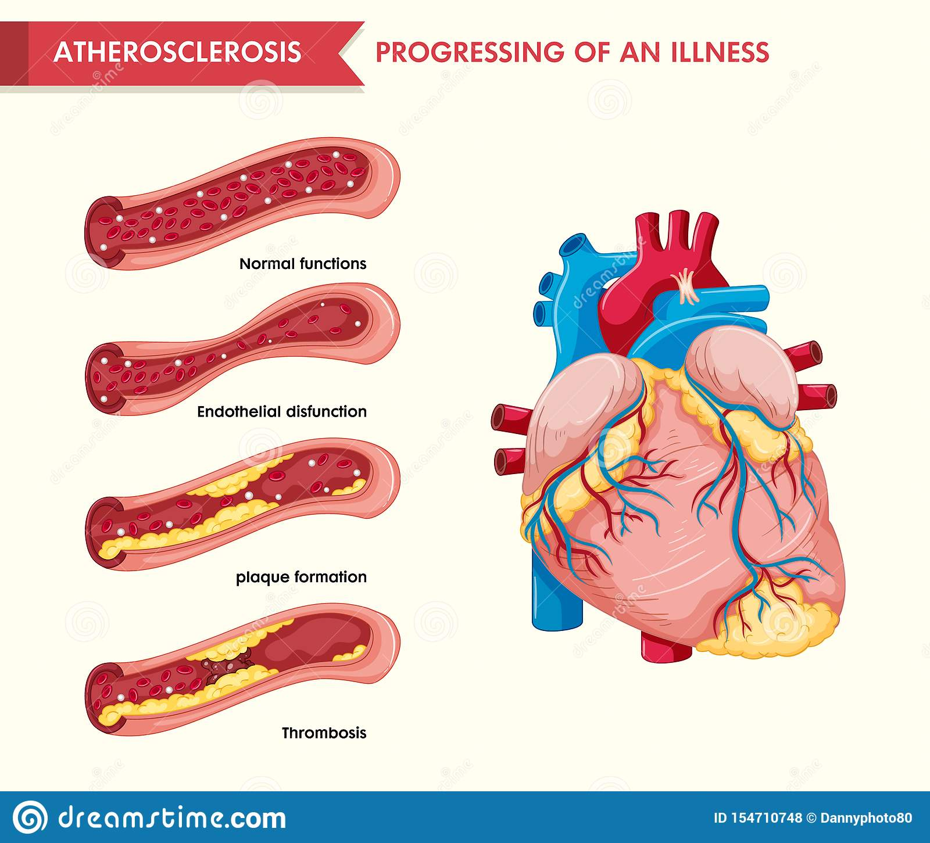
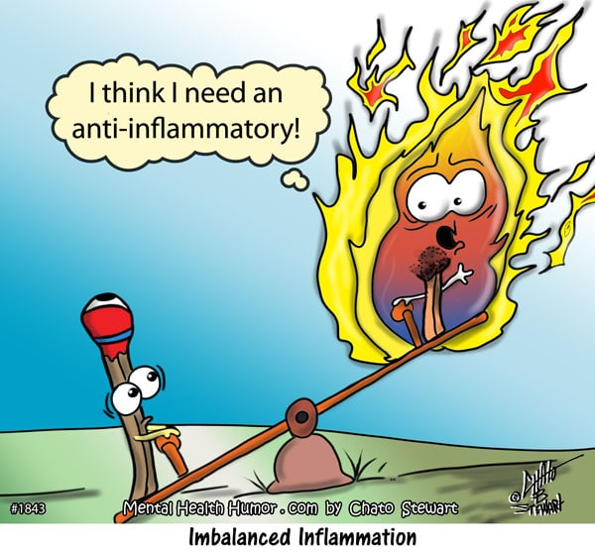
Chemicals produced by fat: https://my.clevelandclinic.org/health/articles/22439-adiponectin https://www.medicalnewstoday.com/articles/324841 https://pubmed.ncbi.nlm.nih.gov/18691043/
Resistin
TNF
Adiponectin
Interleukins
Obesity
Insulin
Resistance
Diabetes
Inflammation:
Arthritis
Artery
Obesity
Diabetes
inflammation

Slide 43
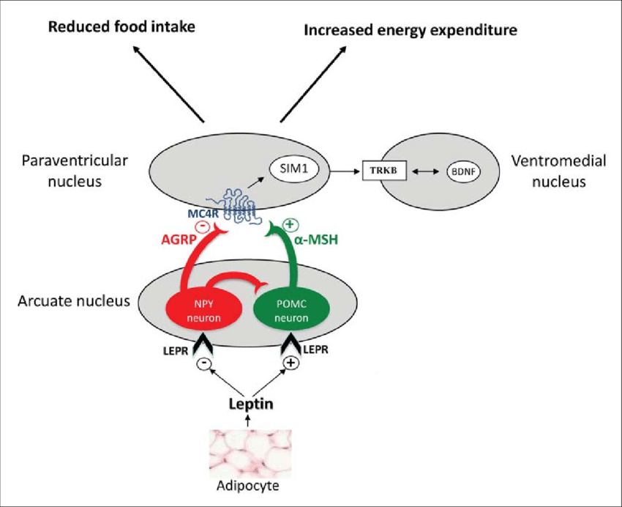
Pathway

Slide 44
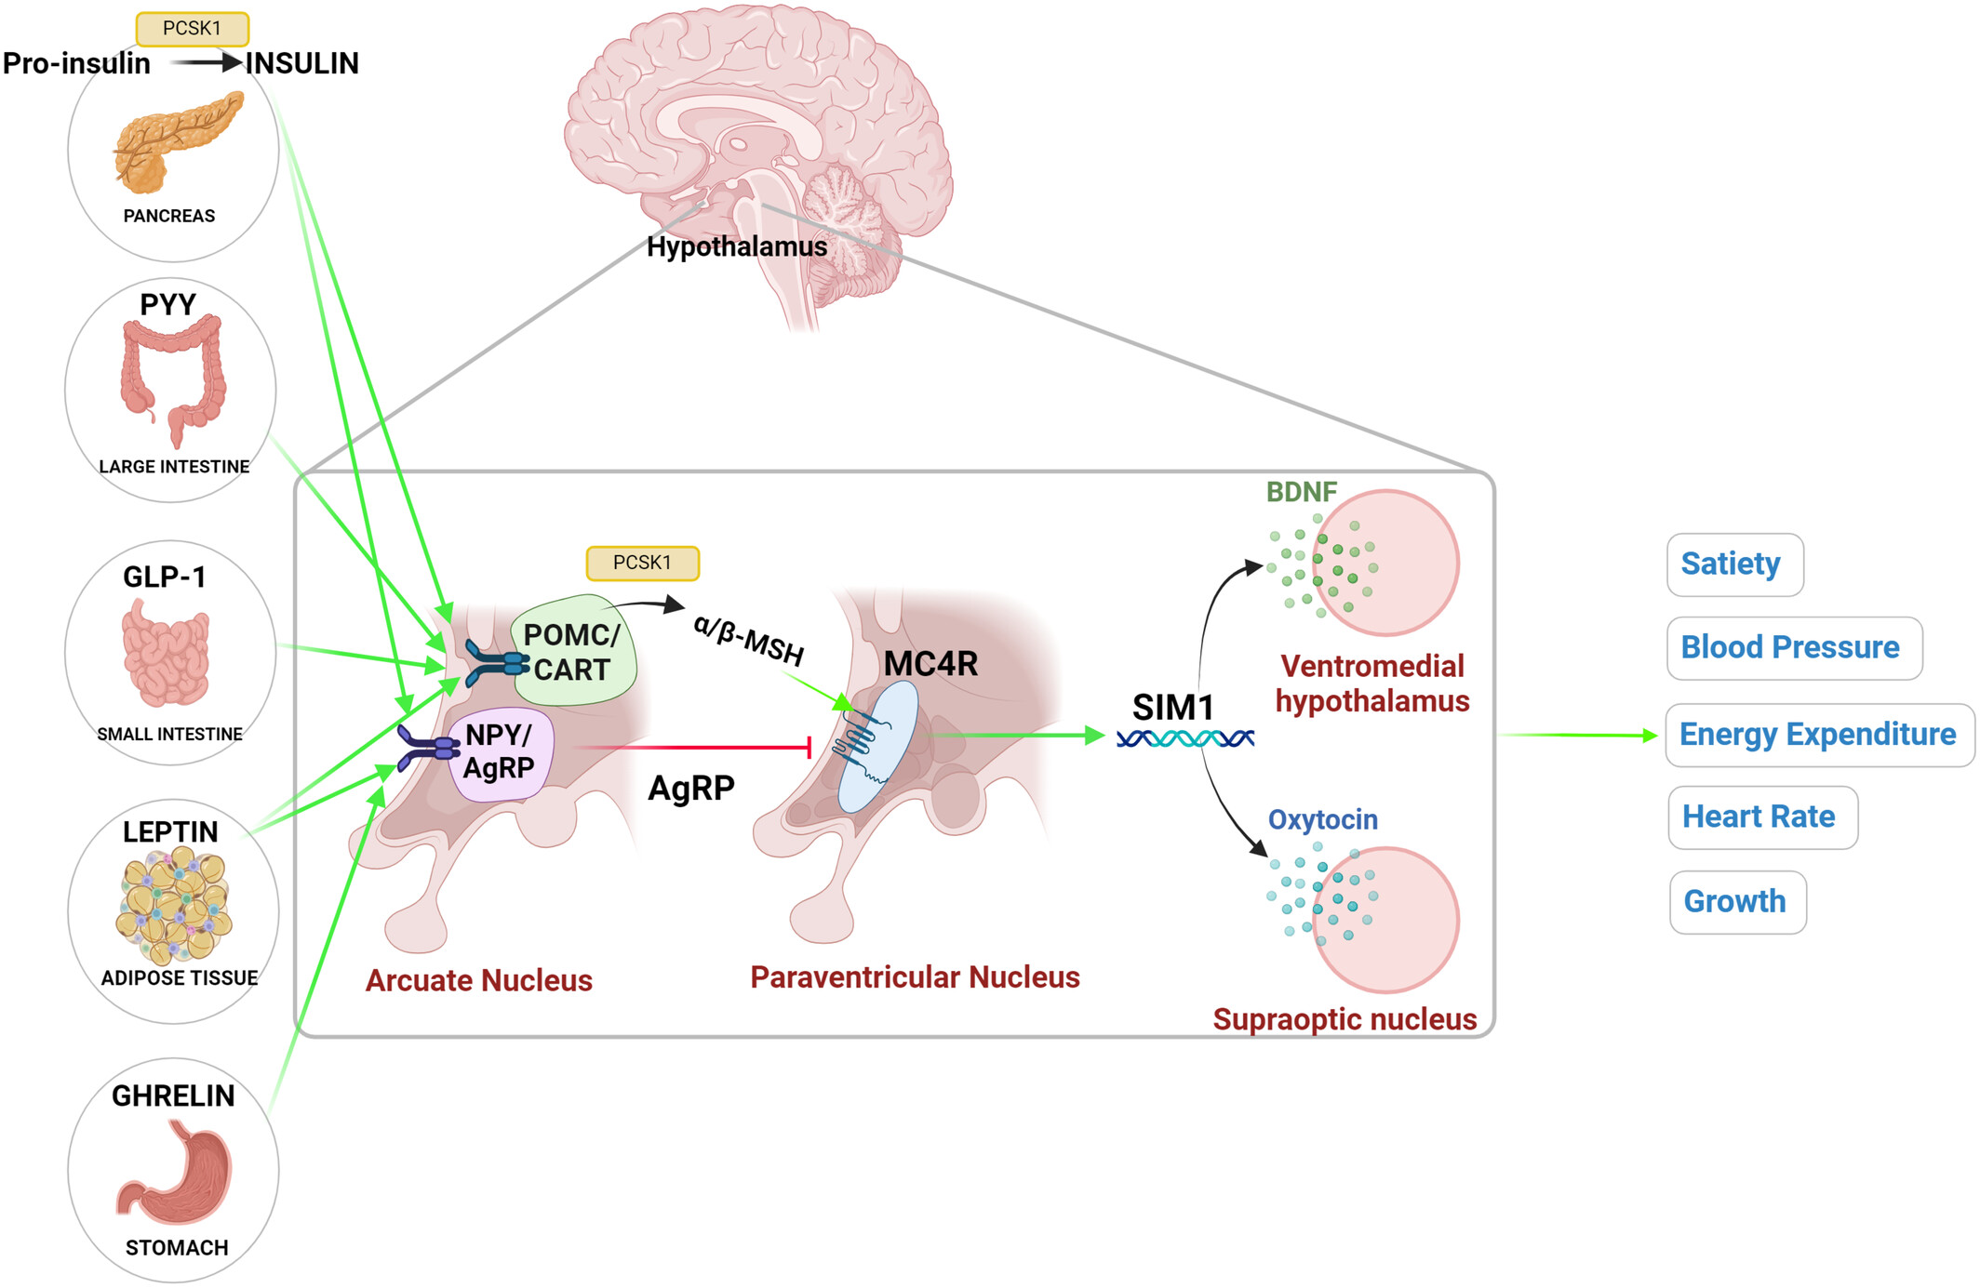
Melanocortin 4 Receptor Pathway
Regulates:
Energy Metabolism
Feeding
Sexual Behavior
Erectile Dysfunction
Cardiovascular Function
Lipid and Glucose Metabolism
https://pmc.ncbi.nlm.nih.gov/articles/PMC3365848/

Slide 45
Melanocortin 4 Receptor Pathway
Regulates:
Energy Metabolism
Feeding
Sexual Behavior
Erectile Function
Cardiovascular Function
Lipid and Glucose homeostasis
https://pmc.ncbi.nlm.nih.gov/articles/PMC3365848/

Slide 46
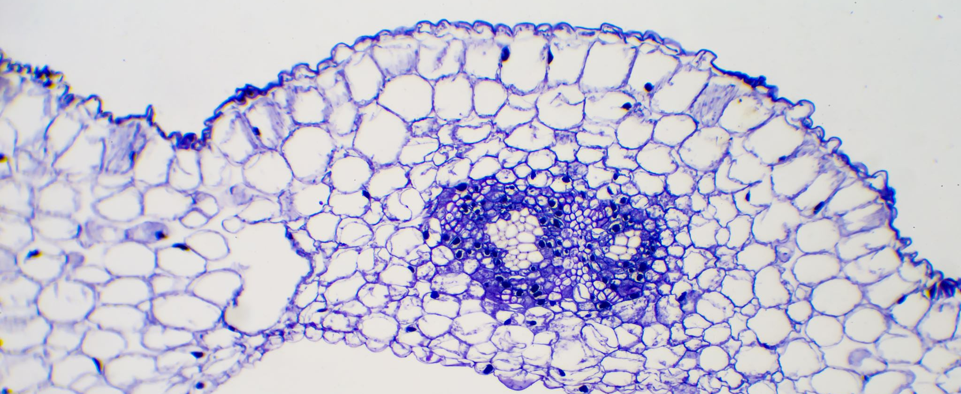
Melanocortin 4 Receptor Deficiency

Slide 47
Melanocortin 4 Receptor Mutation (MC4R)
Mutation causing monogenic obesity.
Weight loss associated with pathologic anorexia/cachexia.
MC4R activation raise arterial blood pressure.
MC4R inhibition causes marked weight gain.
There are over 150 different types of mutations.
Primarily Expressed in the brain: thalamus, hypothalamus (Para ventricle Nucleus) and hippocampus.
https://pmc.ncbi.nlm.nih.gov/articles/PMC3365848/

Slide 48
Melanocortin 4 Receptor Mutation (MC4R)
Mutation causing monogenic obesity.
Weight loss associated with pathologic anorexia/cachexia.
MC4R activation raise arterial blood pressure.
MC4R inhibition causes marked weight gain.
There are over 150 different types of mutations.
Primarily Expressed in the brain: thalamus, hypothalamus (Para ventricle Nucleus) and hippocampus.
https://pmc.ncbi.nlm.nih.gov/articles/PMC3365848/

Slide 49

Cortisol
“the Stress hormone”
Glucocorticoid

Slide 50
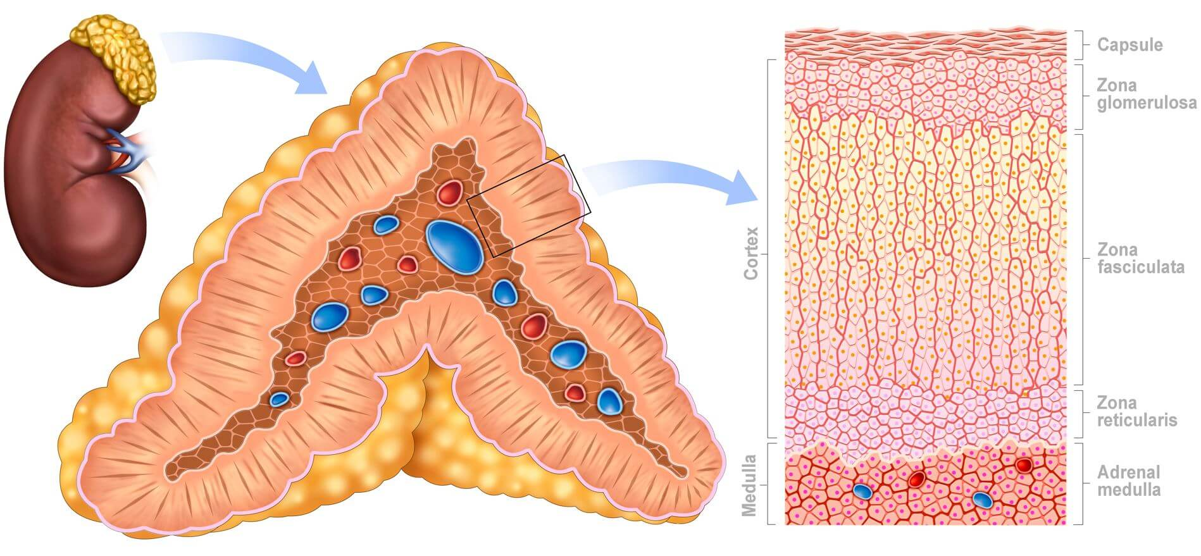
Adrenal Gland
Part of the Endocrine system.
Produces glucocorticoids, adrenaline, sex hormones (DHEA and androgenic steroids) mineralocorticoids.
Cortisol is released in response to stress.
https://my.clevelandclinic.org/health/body/23005-adrenal-gland

Slide 51
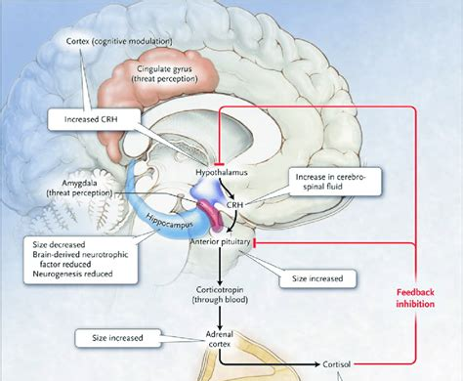
Cortisol
STRESS
Increased craving for simple sugars and starches.

Slide 52
Cortisol → Craving for Sugar
Stress
Detected in brain in Limbic system
ACTH released
Goes to ADRENAL CORTEX-Zona Fasciculata release Cortisol
Cortisol increases insulin which drops Blood Sugar
Crave Simple sugars and starch to get sugar up

Slide 53
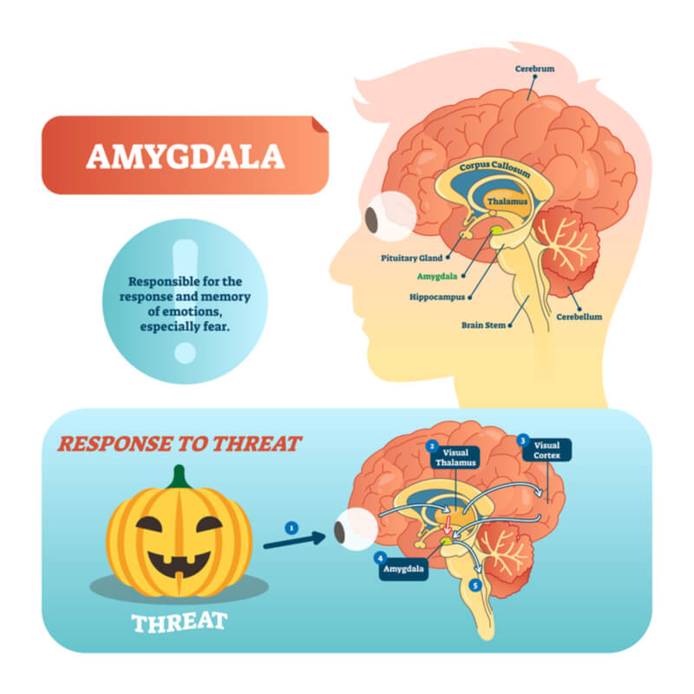
ANATOMY: DEPRESSION
Two major areas of the brain—the hippocampus (seat of memory) and the cortex (the thinking part of the brain)— undergo shrinkage. Both the size of nerve cells and the number of their connections with other neurons are reduced. At the same time, depressive behavior is linked to overactivation of the hypothalamus, which coordinates the stress response, and overactivity of the amygdala, which signals threat and generates negative emotions.
RECRUIT BEHAVIORAL HEALTH!!
https://www.psychologytoday.com/us/basics/depression/the-biology-depression

Slide 54

Exercise: Capacity Proclivity
Genetics affects prolonged physical activity.
Some persons have higher concentrations of Type 1 muscle cells which have high concentrations of LPL.
Exercise counteracts the effect of LPL fat storage.
You can overcome this deficit with regular exercise.

Slide 55
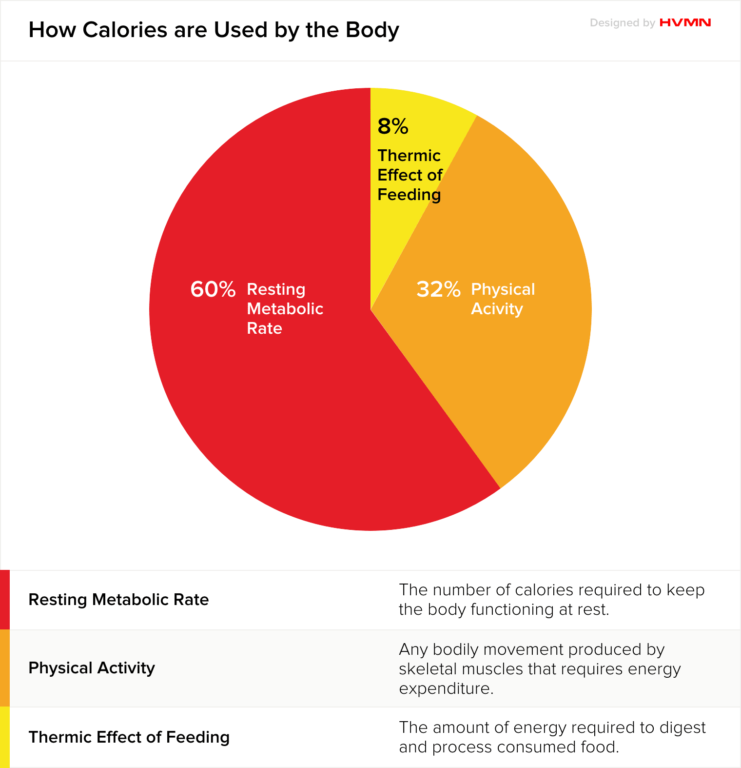
Metabolism
RMR (Resting Metabolic Rate): How quickly your body at rest burns calories.
Chromosome 11 (Turn off the Fat Genes, Neal Barnard.)
RMR slows as we age.
Diet and Exercise affect your RMR more then genetics.

Slide 56
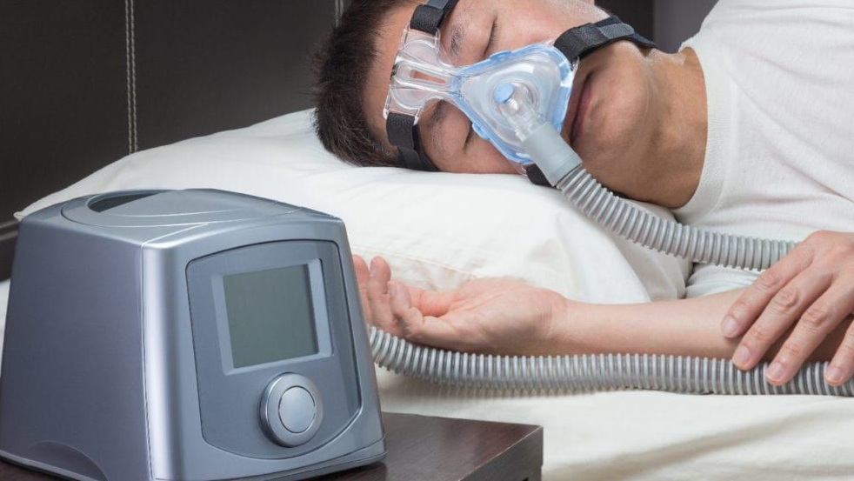
Sleep hygiene:
Obstructive Sleep apnea
Interruptions in breathing due to upper airway obstruction
OSA AFFECT LEPTIN (Fullness) and ghrelin (hunger) levels.
Sleep study and clinical evaluation
https://erj.ersjournals.com/content/22/2/251
https://pubmed.ncbi.nlm.nih.gov/16088283/

Slide 57
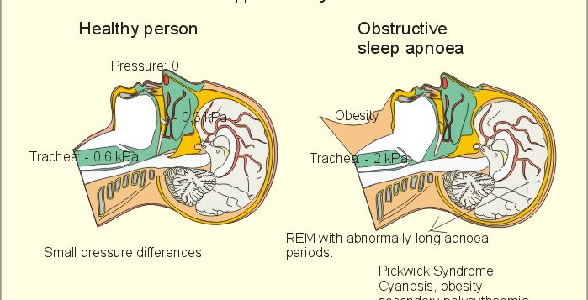

Slide 58

Symptoms OF Obstructive Sleep Apnea:
Excessive daytime sleepiness
Loud snoring
Observed episodes of stopped breathing during sleep
Abrupt awakenings accompanied by gasping or choking
Awakening with a dry mouth or sore throat
Morning headache
Difficulty concentrating during the day
Mood changes, such as depression or irritability
High blood pressure
Decreased libido

Slide 59

The way to get started is to quit talking and begin doing.
Walt Disney

Slide 60
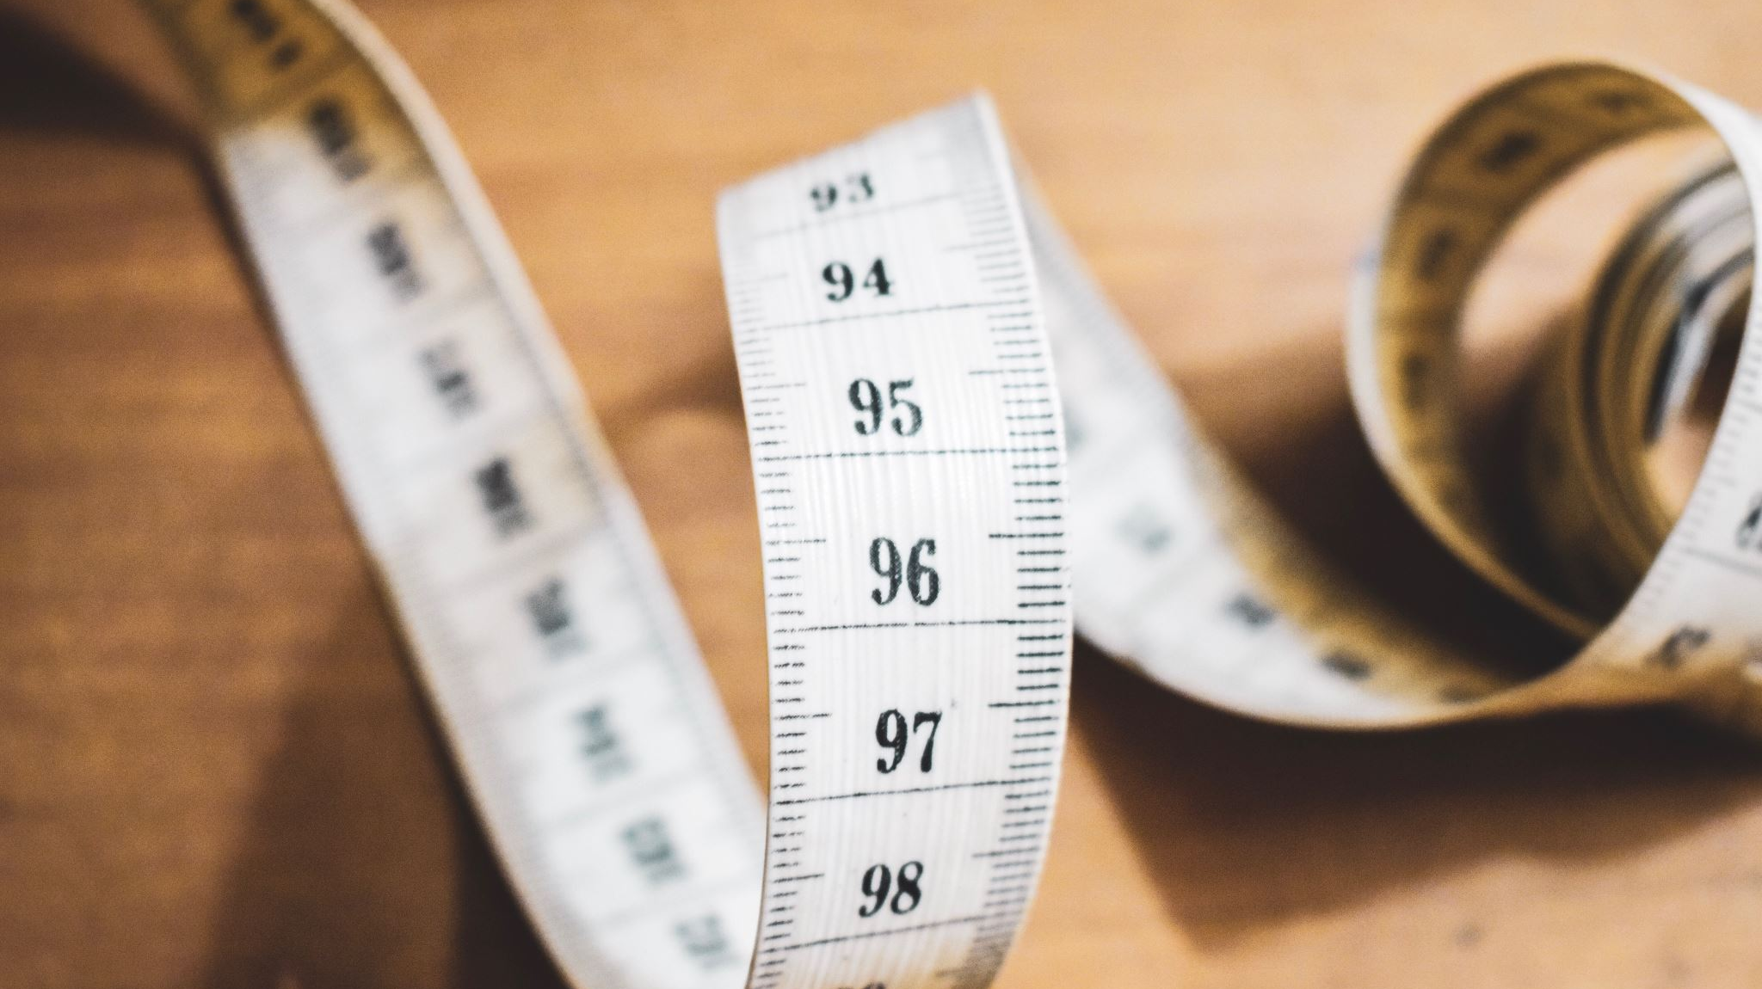
Starting a Weight Loss Plan
HAVE A REALISTIC AND HEALTHY GOAL

Slide 61

Congratulations!!!

Slide 62
How to get started losing weight…
Get help
See your Doctor. Know your numbers and your medical risk. Be evaluated thoroughly for comorbidities.
Goals
Set realistic goals and be consistent and patient.
Know thyself
Learn your body, genetics, eating habits/cravings, stress levels, sleep cycle, exercise tolerance.
Plan
Lifetime
Lifestyle changes not short-term diets. Get exercise, sleep, reduce your stress, utilize pharmacotherapy-surgery as applicable.
Avoid fad diets, and quick fix solutions. Count your calories. Be aware of pitfalls.

Slide 63
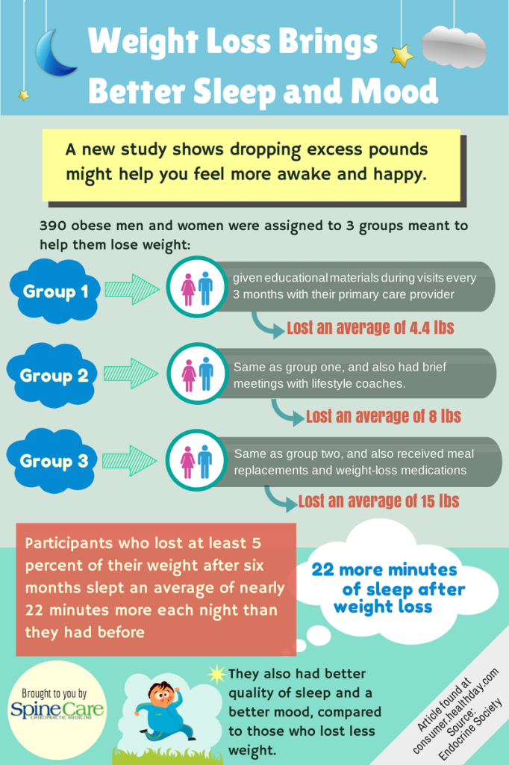
Seeing your doctor can help you lose weight!
One can lose up to 15lb with medical help.

Slide 64
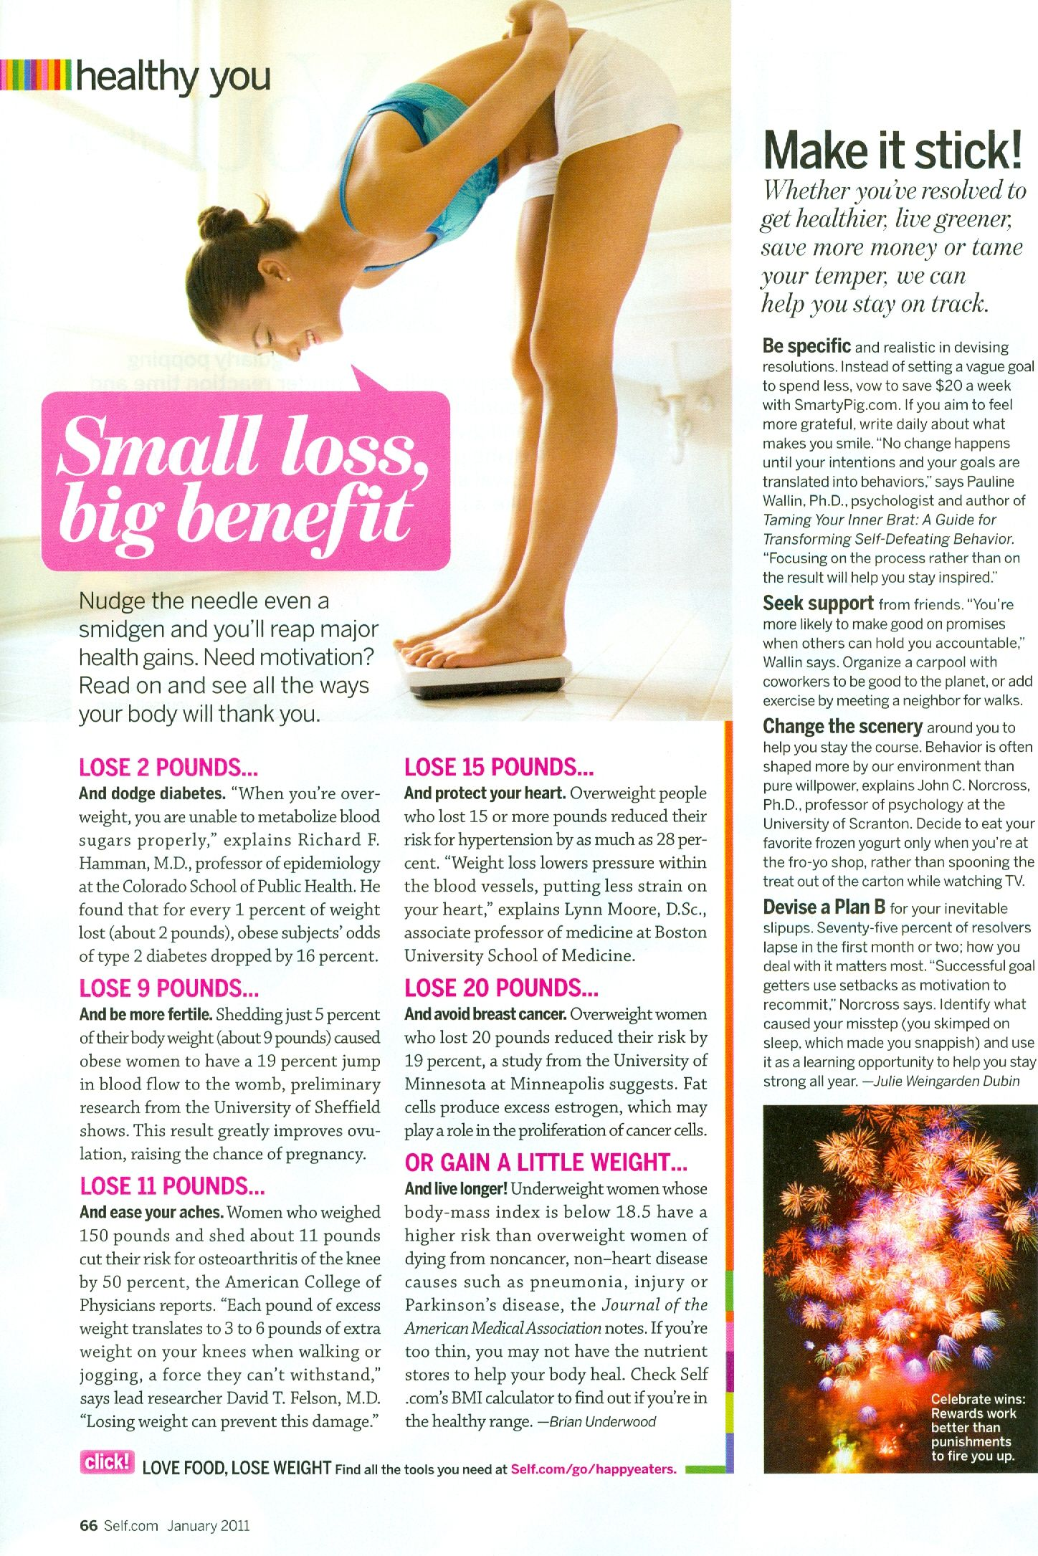
Wgt. loss reduces disease risk:
1% tbw=16% Diabetes Mellites
5% tbw=19% Infertility
10% tbw=50% Osteoarthritis
15lb tbw=28% Hypertension
20lb tbw=19% Breast Cancer tbw=total body weight
https://i.pinimg.com/originals/56/5d/b0/565db078d519a635c33eb99ea3dcf5b6.jpg

Slide 65
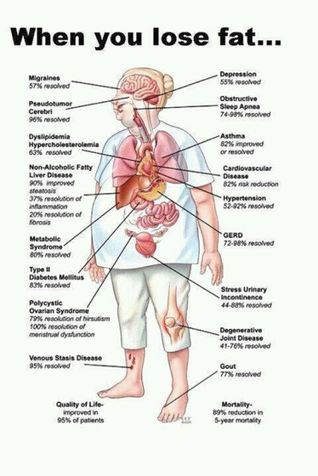

Slide 66

Buy a notebook.
Document everything you eat every day.
Document your physical activity.
Document your sleep habits.
Document your stress levels.

Slide 67
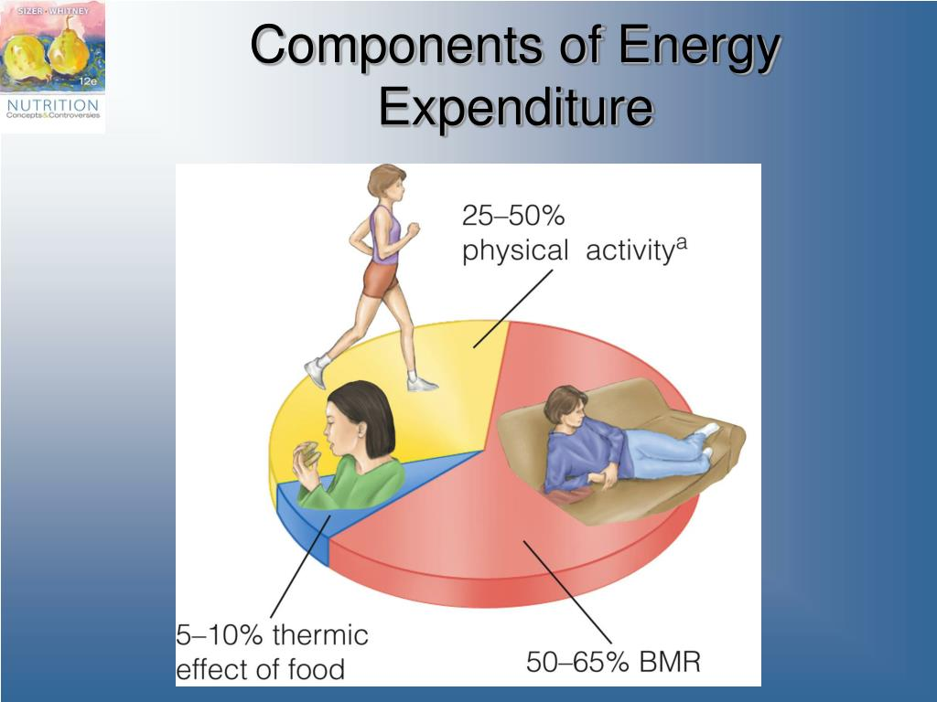

Slide 68
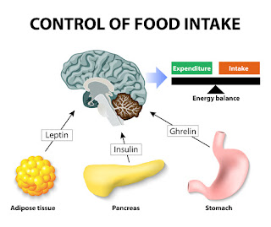

Slide 69
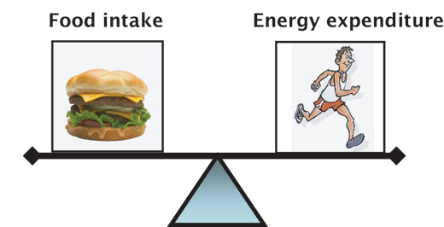

Slide 70


Slide 71
Weight loss options: https://www.myalli.com/about/product-use/?msclkid=db43725670e51e3c5eef11825ec51b6c&gclsrc=3p.ds https://plushcare.com/weight-loss-online/?utm_heading=Semaglutide+%28Ozempic%2C+Rybelsus%2C+etc.%29+for+Weight+Loss+Treatment+Prescribed+Online&utm_adgroup=Semaglutide_%28weight_loss%29_%7C_Broad&msclkid=5f498e904387176acf50ed446d07825e https://www.laymandrugs.com/how-much-weight-can-you-lose-on-ozempic/ https://www.mayoclinic.org/healthy-lifestyle/weight-loss/in-depth/weight-loss-drugs/art-20044832
Diet and Exercise
Medications
Surgery (Restrictive Malabsorption)
Semaglutide* (Wegovy) (GLP-1 receptor agonist) e.g., Ozempic.
Bupropion-naltrexone (Contrave)*
Liraglutide* (Saxenda)
Orlistat* (Xenical, Alli)
Phentermine-topiramate (Qsymia)*
Setmelanotide* (Imcivree)
Green Tea Abstract
Green Coffee Abstract
Rasberry Ketones
* FDA approved
DASH, Weight Watchers
High Protein(Paleo)
Low Carb (Atkins)
Low Fat (Ornish)
Meal Replacement (Nutrisystem, Slim Fast, Jenny Craig.)
Very Low Calorie (Optifast).
Roux-en-Y
Sleeve Gastrectomy

Slide 72

History of Weight Loss Medications
So why is there still so much obesity? https://www.consultant360.com/exclusive/primary-care/overview-anti-obesity-medications

Slide 73

The Famous Ozempic

Slide 74

Ozempic(Semaglutide): GLP-1 Agonist
1. Glucagon-like peptide-1 receptor agonist
2. Mimic GLP-1 Hormone released naturally released in the GI tract in response to eating.
3. Act at the pancreas to release insulin and suppress the release of Glucagon.
4. Act in the brain to reduce hunger.
5. Delay gastric emptying to cause the sensation of fullness.
6. Approved for non-diabetics for weight loss.

Slide 75

Weight loss surgery

Slide 76
Surgery is not a panacea nor perfect!
Operation | Failure Rate at 5 years | Success Rate
Lap-banding | About 30% | Mean weight loss at 10 years is 49% of excess weight
Sleeve Gastrectomy | About 20% | Mean weight loss at 10 yrs is 55-60% of excess weight
Gastric bypass | About 20% | Mean weight loss is 10 yrs is 55-60% excess weight

Slide 77

What is a calorie?
“the amount of heat required to raise the temperature of one kilogram of water one degree Celsius.”

Slide 78

One pound of fat has 3500-4100 calories: https://www.healthline.com/nutrition/calories-in-a-pound-of-fat https://www.medicalnewstoday.com/articles/325176

Slide 79

So, to lose one pound of fat…
You must reduce calorie intake!

Slide 80

Calories and Age:
Caloric requirement peak at age 25 and then decrease by 2% every 10 years.
Dieting for Dummies, Jane Kirby, RD

Slide 81

The Aging body replaces muscle with fat.

Slide 82


Slide 83

How many calories do you need?
Depends
Age?
Weight?
Level of physical activity?
AGE: Calorie peak at 25yo, then reduce by 2% q10 years.
Formula:
Weight lb/2.2= Weight kg
Weight kg x 21.6=y
Y x 1.2/1.4/1.6= calories per day.
(Depending on level of activity)

Slide 84

Calculate calories
Joe is: 35yo BM
231lb
231/2.2=105kg
105kg x 21.6= 2,268.00
2268.00 x 1.2 (sedentary)
2,721cal/day
(2% age reduction)
Reduce calories by 2% Rule=2,667cal/day.

Slide 85

The 20% Rule:
Only reduce your calories by 20% per week:
SO, FOR Joe…
2667/day-534=2133cal
Dieting for Dummies, 2004, Jane Kirby rd

Slide 86

Calorie reduction: >20% per week could result in slowing your RMR.
Foods with <5calories can be list as “0” calories.
Calories on food are rounded to nearest 5-point (<50 calories) or 10-point increment (>50 calories.)

Slide 87

Sugar:
Men 36 grams (150 calories) 9 tsp/day.
Women 25 grams (100 calories) 6 tsp/day.
1 gram sugar = 4 CALORIES https://www.heart.org/en/healthy-living/healthy-eating/eat-smart/sugar/how-much-sugar-is-too-much

Slide 88

42 GRAMS OF SUGAR

Slide 89

McDonald’s more than tripled amount of sugar in burgers. https://www.dietdoctor.com/mcdonalds-triples-amount-sugar-hamburgers https://diabetesmealplans.com/16358/mcdonalds-for-diabetes-what-can-i-eat/ https://www.thesun.co.uk/fabulous/5782783/mcdonalds-food-has-more-calories-sugar-and-salt-than-30-years-ago-despite-chains-pledges-to-be-healthier/ https://news.sky.com/story/shocking-rise-in-sugar-and-salt-in-mcdonalds-burgers-in-last-30-years-11287119

Slide 90


Slide 91
Medications that can raise your blood sugar.
Prescription medicines that can raise your glucose include:
Steroids (also called corticosteroids). They treat diseases caused by inflammation, like rheumatoid arthritis, lupus, and allergies. Common steroids include hydrocortisone and prednisone. But steroid creams (for a rash) or inhalers (for asthma) aren’t a problem.
Drugs that treat anxiety, ADHD, depression, and other mental health problems. These can include clozapine, olanzapine, quetiapine, and risperidone.
Birth control pills
Drugs that treat high blood pressure, such as beta-blockers and thiazide diuretics
Statins to lower cholesterol
Adrenaline for severe allergic reactions
High doses of asthma medicines, or drugs that you inject for asthma treatment
Isotretinoin for acne
Tacrolimus, which you get after an organ transplant
Some medicines that treat HIV and hepatitis C
OTC medicines that can raise your blood sugar include:
Pseudoephedrine, a decongestant in some cold and flu medicines
Cough syrup. Ask your doctor if you should take regular or sugar-free.
Niacin, a B vitamin

Slide 92

Fibrous foods release sugar slowly, and thusly, maintain more steady blood sugar levels…REDUCE DIABETES RISK
Brown rice
Whole grain bread
Beans
Peas
Whole Fruits
Cucumbers, Apples, Oranges and Pears
Turn off the Fat Genes, Neal Barnard, MD, page 123.
Turn off the Fat Genes, Neal Barnard, MD; page

Slide 93

Watch out for hidden sugar pitfalls!

Slide 94

LIMIT:
Potatoes, Corn and White Bread (They are processed quickly and raise blood sugar quickly.)

Slide 95


How to read a food label:

Slide 96



Slide 97



Slide 98

Types of Diets

Slide 99

Keto Diet
The ketogenic diet involves consuming a very low amount of carbohydrates and replacing them with fat to help your body burn fat for energy. Health benefits can include weight loss and lowering your risk for certain diseases.

Slide 100

Keto Diet https://www.mdpi.com/2072-6643/9/5/517

Slide 101

The Adkins
Diet
What is the Atkins Diet?
The Atkins Diet is a popular low-carbohydrate eating plan developed in the 1960s by heart specialist (cardiologist) Robert C. Atkins. The Atkins Diet restricts carbs (carbohydrates) while focusing on protein and fats. https://www.mayoclinic.org/healthy-lifestyle/weight-loss/in-depth/atkins-diet/art-20048485

Slide 102

Apple Cidar Vinegar and Weight Loss: No evidence.
“Apple Cidar Vinegar is likely to cause weight loss.” https://www.mayoclinic.org/healthy-lifestyle/weight-loss/expert-answers/apple-cider-vinegar-for-weight-loss/faq-20058394

Slide 103
Emotional Eating Pitfalls
Behavioral health
Stress, Lonely, Angry, Boredom
Starvation/Portion
Size
Cortisol
Comfort eating
Guilt
Craving favorite foods
Social Eating
Overeat (takes the brain 20minutes to know your full.)
Eating quickly
Timing of eating
Cleaning your plate
Eating out (portion size, salt, sugar, fat, etc.)
Anorexia
Bulimia
Binge Eating Disorder
Body Dysmorphic Disorder
Avoidant/Restrictive Food Disorder
Fat Shamming
Depression

Slide 104

Stress induced food cravings
Potato chips vs. Pumpkin seeds or dry roasted nuts
Milk Chocolate vs. Dark chocolate
Pasta vs. Veggie Spiral Squash Spaghetti
Ice cream vs. Dark chocolate dipped strawberries
Soda pop vs. Sparkling water
Red meat vs. Fish, i.e., Salmon

Slide 105

Exercise
“physical activity has been recommended worldwide for cardiovascular disease prevention and treatment.”
https://pubmed.ncbi.nlm.nih.gov/32807982/

Slide 106


Slide 107

Which exercise burns the most calories?
Exercise/body weight | 125 lbs | 155 lbs | 185 lbs
Running | 652 | 808 | 965
Water polo | 566 | 703 | 839
Bicycling | 480 | 596 | 710
Calisthenics | 480 | 596 | 710
Circuit training | 480 | 596 | 710
Jump rope | 453 | 562 | 671
Stationary bicycling | 420 | 520 | 622
Rowing machine | 420 | 520 | 622
Aerobic dance | 396 | 492 | 587
Swimming (casual) | 396 | 492 | 587
Jogging | 396 | 492 | 587
Hiking | 340 | 421 | 503

Slide 108


Slide 109

BMR increased:
Muscle mass >40% total body mass.
BMR decreased:
<30% total body mass. https://pubmed.ncbi.nlm.nih.gov/31262787/

Slide 110
The Limits of Exercise Alone
ONE SINGLE POUND OF FAT
STORES 4100calories
MUST MAKE Dietary changes!
TURN OFF THE FAT Genes, Barnard
https://www.healthline.com/nutrition/calories-in-a-pound-of-fat#TOC_TITLE_HDR_3

Slide 111

Exercise alone won’t work!

Slide 112

Food as a source of energy
Https://www.forbes.com/health/body/foods-to-eat-to-lose-weight/ https://www.medicalnewstoday.com/articles/323947#animal-products
Increase metabolism
High energy source
Foods to help lose weight
Cold water
Apple cider vinegar
Coffee
Green tea
Seeds
Coconut oil
Lemon and grapefruit
Chili peppers
Broccoli and Kale
Ginger
Avocado
Lean meats (chicken/turkey)
Red/black beans
Bananas
Avocado
Apples
Salmon
Sardines
Tuna
Dark berries
Yogurt
Yams and sweet potato
Quinoa
Brown rice
Nuts and seed
Vegetable
Avocados
Apples
Lean protein
Nuts and seeds
Salmon
Shrimp
Unripe bananas
Sauerkraut
legumes

Slide 113

Timing of eating
BREAKFAST IS KEY!

Slide 114


Slide 115

Intermittent Fasting
1. Alternate-day fasting. Eat a normal diet one day and either completely fast or have one small meal (less than 500 calories) the next day.
2. 5:2 fasting. Eat a normal diet five days a week and fast two days a week.
3. Daily time-restricted fasting. Eat normally but only within an eight-hour window each day. For example, skip breakfast but eat lunch around noon and dinner by 8 p.m. https://www.mayoclinic.org/healthy-lifestyle/nutrition-and-healthy-eating/expert-answers/intermittent-fasting/faq-20441303

Slide 116

Benefits
Human Growth Hormone (HGH): The levels of growth hormone skyrocket, increasing as much as 5-fold. This has benefits for fat loss and muscle gain, to name a few (4Trusted Source, 5Trusted Source, 6Trusted Source, 7Trusted Source).
Insulin: Insulin sensitivity improves and levels of insulin drop dramatically. Lower insulin levels make stored body fat more accessible (8Trusted Source).
Cellular repair: When fasted, your cells initiate cellular repair processes. This includes autophagy, where cells digest and remove old and dysfunctional proteins that build up inside cells (9Trusted Source, 10Trusted Source)
Gene expression: There are changes in the function of genes related to longevity and protection against disease (11Trusted Source, 12Trusted Source).

Slide 117

Sleep hygiene
Evaluation of for OSA
BODY HABITUS:
MEN NECK SIZE: >17 INCHES.
WOMEN NECK SIZE: >16 INCHES.
BERLIN QUESTIONAIRE/STOP-BANG sleep questionnaire.
Sleep study: Polysomnogram.
Snoring.

Slide 118


Slide 119

Obesity
Genetics
Environment
Body Type
Food cravings
Body Physiology
Sugar and fat metabolism
BMR
Muscle Composition and Exercise tolerance
Food selection.
Calorie intake (portion size.)
Level of Physical Activity.
Mood disorders.
Stress level.
Sleep hygiene.

Slide 120


Slide 121

Summary
Weight loss is not simply about the cosmetic results. It is, at its heart, about improving the quality and duration of life and reducing risk for potentially preventable diseases. Take the first step and see you doctor and open a dialogue about what you can do…

Slide 122


Thank You
Melvin Richardson, MD
Family Medicine
Community HealthNet
OSC
5927 Columbia Avenue
Hammond, IN. 46320

Slide 123


Slide 124


Slide 125


Slide 126


